Slide 1
PREDICTING ELEMENTS OF DNA/RNA SECONDARY STRUCTURE
By: Dr. Irfana Iqbal
MSc II, 4th Semester
Fundamentals of Bioinformatics

Slide 2
Notes:
Step 1: In order to retrieve the rna sequence, enter RNA sequence query in search bar for options. Pick ideal or common one i.e: RNA CENTRAL. Enter RNA CENTRAL in query Google bar and open the first link that appears afterwards.

Slide 3
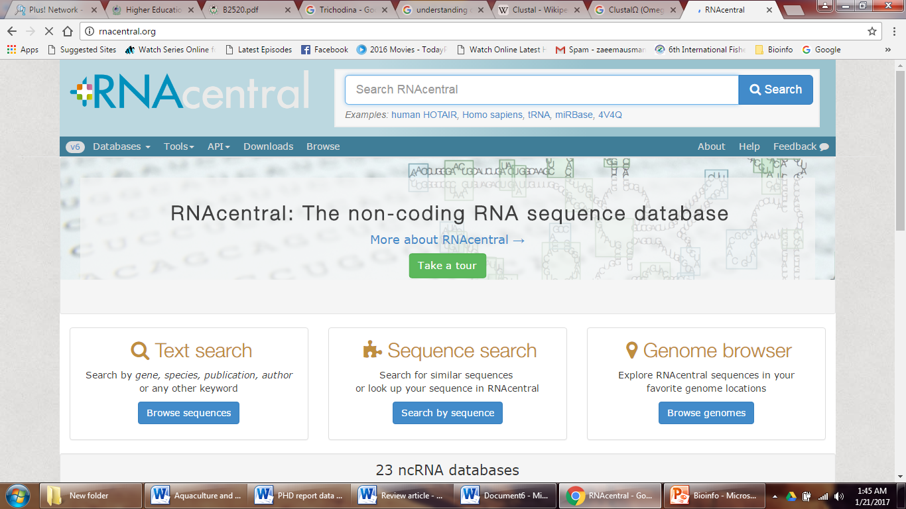
Hit
Notes:
Step:2 RNA CENTRAL home page will appear like wise having query search bar and several options to retrieve sequence as you scroll down.
Hit option of BROWSE” on left side.

Slide 4
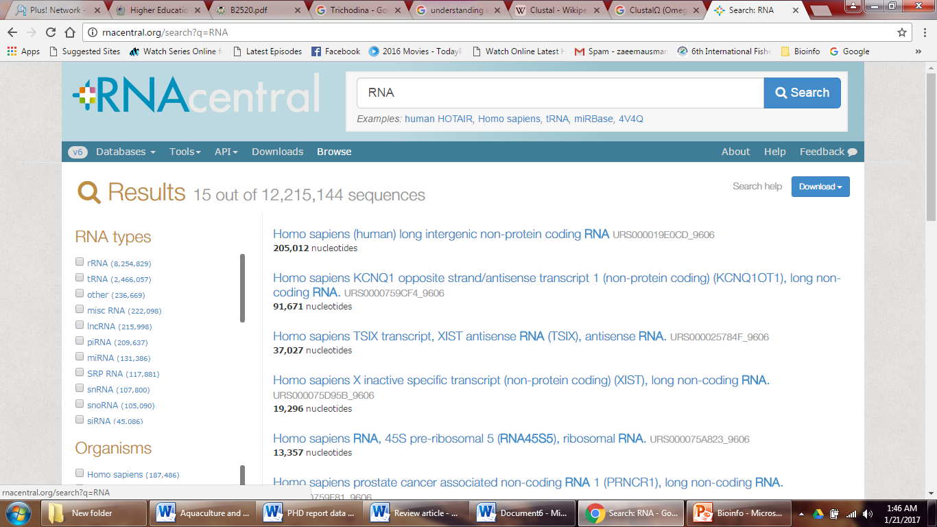
Notes:
Step 3: Browse will open many options at the left from where you can choose specie” (e.g: human, Bacteria) as required. All the sequences available in this tool will appear and then you can use according to specific length, name or accession number as your choice.

Slide 5
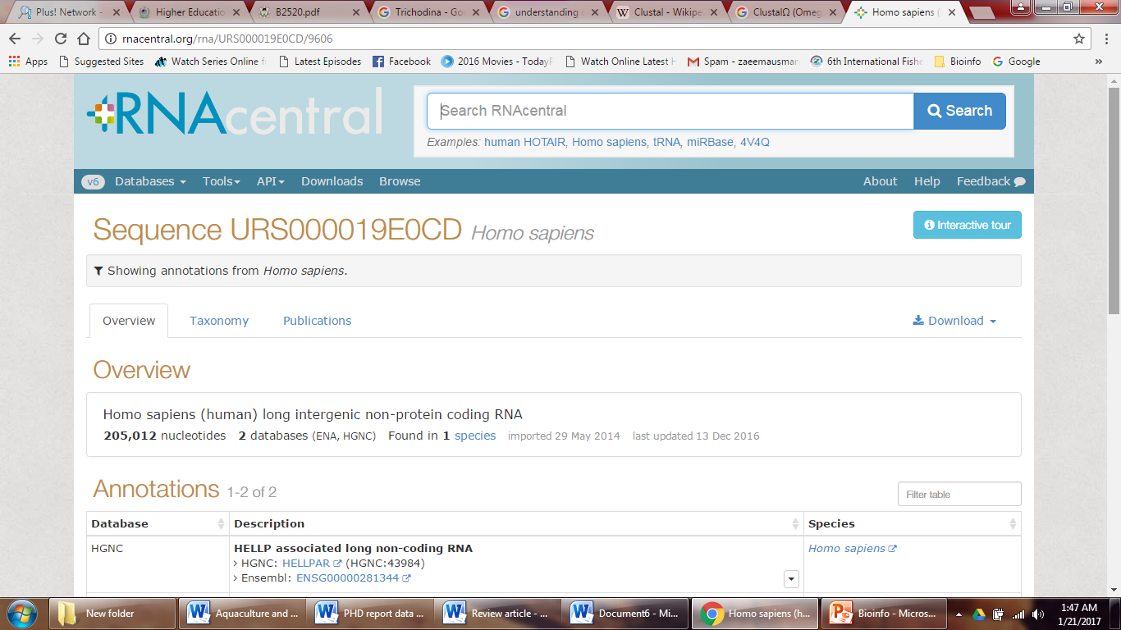
Download
Save
Notes:
Step 4: After choosing particular sequence and clicking the hyperlink. You will get to the page having its features and sequence available in several format. Scroll down for retrieving sequence.

Slide 6
Select and copy sequence
Notes:
Step 5: Hit the option for sequence, RNA” and copy the following sequence in FASTA FORMAT of your chosen nucleotide.

Slide 7
Notes:
Step:6 Enter RNA fold” in your Google query bar and select the first link that appears.

Slide 8
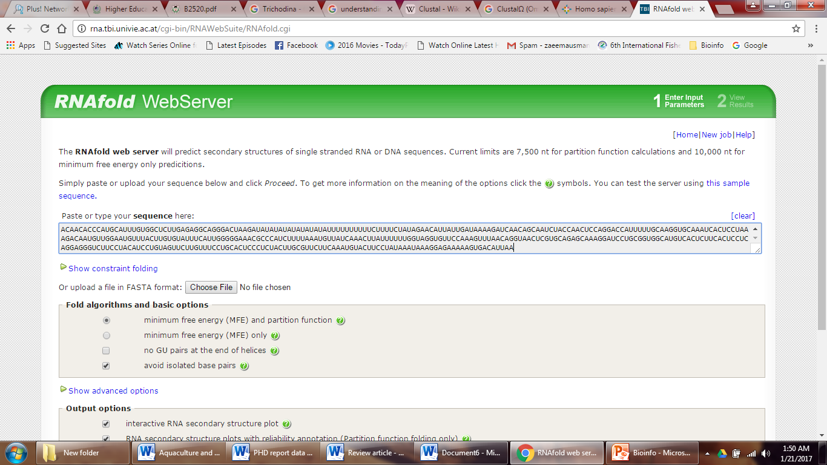
Notes:
Step 7: When RNA fold home page appears copy your sequence you retrieved before from RNA CENTRAL and paste in RNA fold bar or hit choose file if you have downloaded the sequence file in your system.

Slide 9
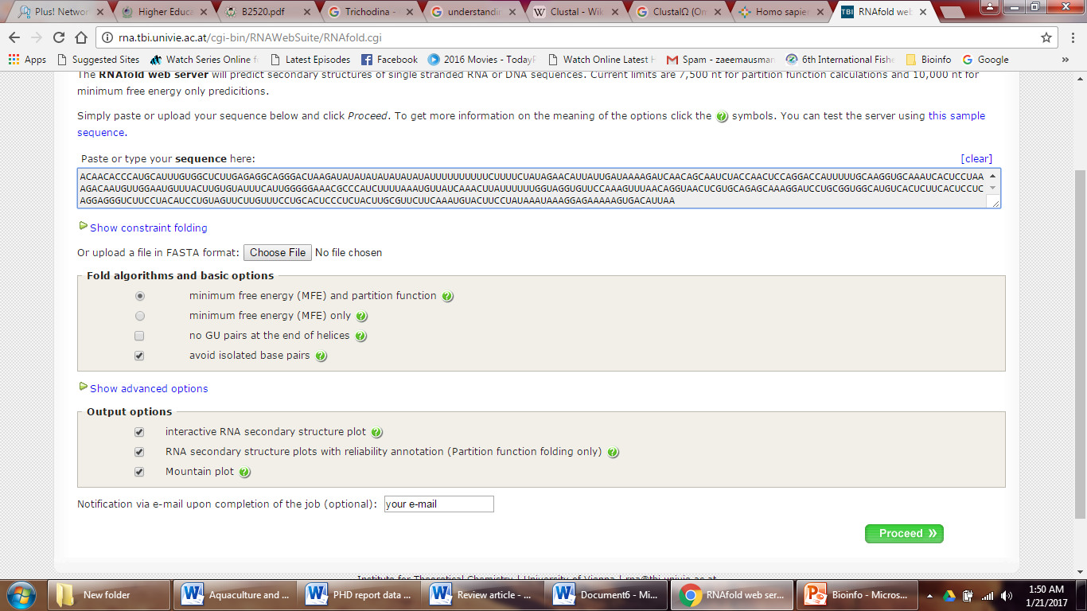
Notes:
Step 8: Hit all output options and enter your in email address in the bar provided in order to get and save your output in system. Enter proceed

Slide 10
Notes:
Step 9: When your results are processing, this screen having URL or hyperlink will appear you can open it in another tab to specifically see your result after its done.

Slide 11
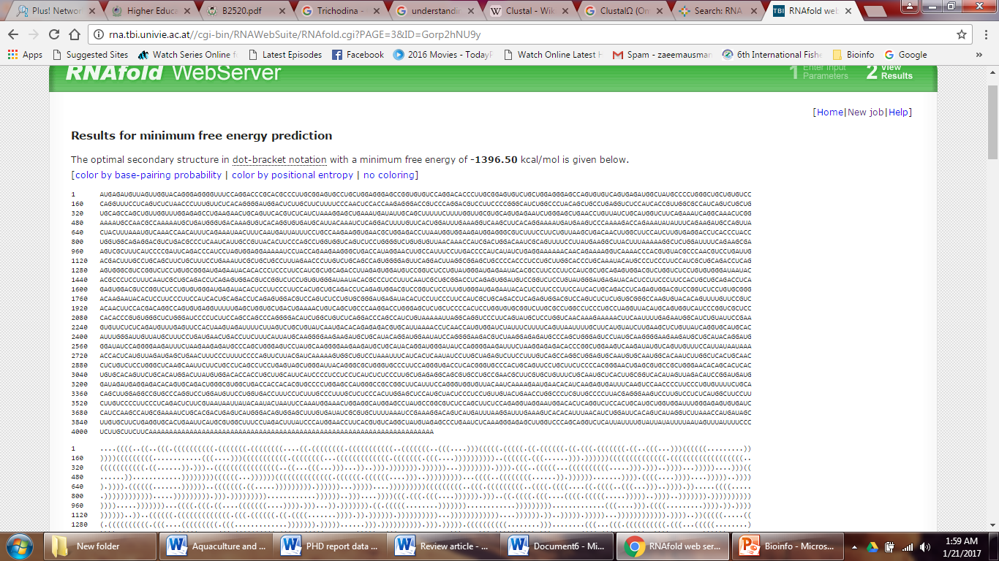
Notes:
Step 10: Results then started to appear like this. Where )))” indicate linear sequences and .” / Dots exhibits No bonding or pairing.
Dots are basically those bases that didn’t get to bond as they are in loop or round circle of RNA shape were they are very quite away from each other. Keep scrolling.

Slide 12
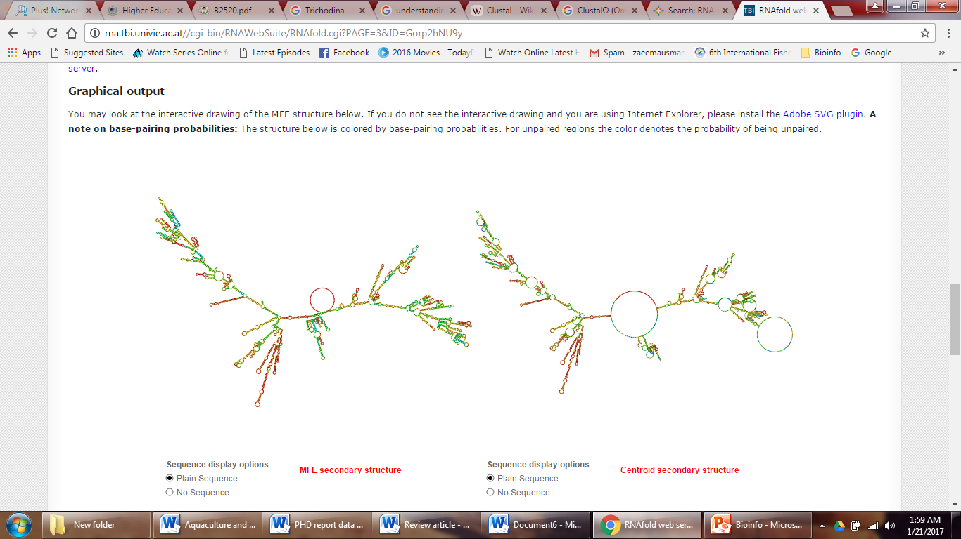
Dot= present here
Notes:
Step 11: Scrolling down for further results will display Graphical output of RNA Shape.

Slide 13
Notes:
Step 12: After Graphical representation, now mountain plot representation of the structure shown indicating, the thermodynamic ensemblensce of RNA structures, and the centroid structure. Additionally we present the positional entropy for each position.

Slide 14
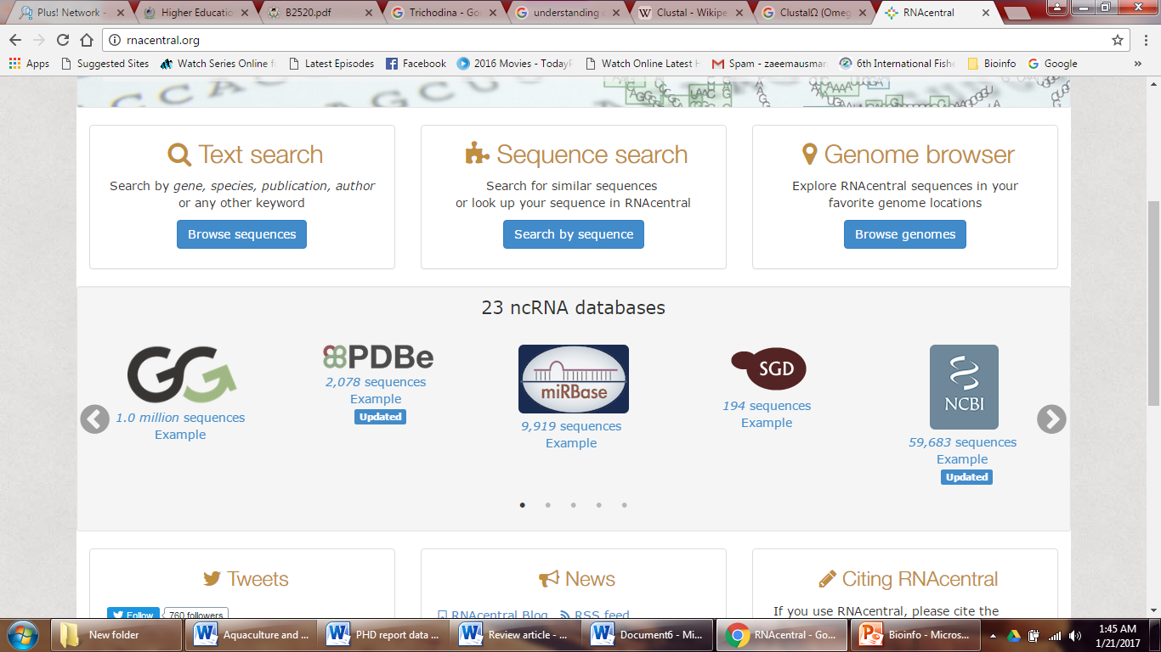
Notes:
Step 2a: When you open RNA CENTRAL home site, apart from choosing that you can also scroll down for other tools like these to retrieve RNA sequence.

