Slide 1
Contional behavior

Slide 2
Conditional behavior:
A way to modify an animal’s behavior in response to a certain stimuli.
Reward or punishment
Types:
Classical conditioning
Operant conditioning

Slide 3
Operant Conditioning:
Operant conditioning (sometimes referred to as instrumental conditioning) is a method of learning that occurs through rewards and punishments for behavior.
Through operant conditioning, an association is made between a behavior and a consequence for that behavior

Slide 4
Example:
For example, when a lab rat presses a blue button, he receives a food pellet as a reward, but when he presses the red button he receives a mild electric shock. As a result, he learns to press the blue button but avoid the red button.

Slide 5
Continue…

Slide 6
Classical Behavior:
Classical conditioning (also known as Pavlovian conditioning) is learning through association and was discovered by Pavlov, a Russian physiologist.
In simple terms, two stimuli are linked together to produce a new learned response in a person or animal.

Slide 7
Example:
For example, imagine that you are conditioning a dog to salivate in response to the sound of a bell. You repeatedly pair the presentation of food with the sound of the bell. You can say the response has been acquired as soon as the dog begins to salivate in response to the bell tone.
Once the response has been established, you can gradually reinforce the salivation response to make sure the behavior is well learned.

Slide 8
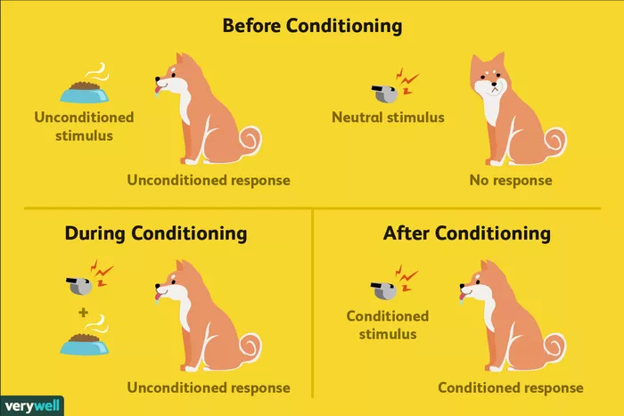
Continue…..

Slide 9
Comparison:
Classical Conditioning :First described by Ivan Pavlov, a Russian physiologist
Focuses on involuntary, automatic behaviors
Involves placing a neutral signal before a reflex
Operant Conditioning :First described by B. F. Skinner, an American psychologist
Involves applying reinforcement or punishment after a behavior
Focuses on strengthening or weakening voluntary behaviors

