Slide 1
Hormones and Behavior
Mechanism of Behavior
Behavior of Animals in response to Hormones

Slide 2
Introduction
Hormones are chemical messengers released from endocrine glands that travel through the blood system to influence the nervous system to regulate behaviors such as aggression, mating, and parenting of individuals.

Slide 3
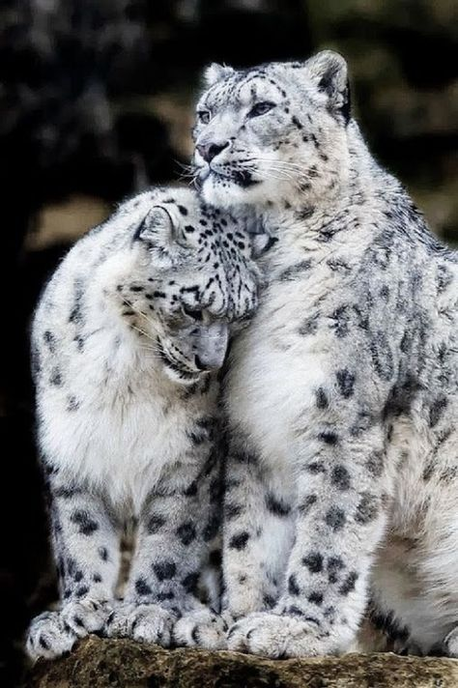
HOW HORMONES EFFECT ANIMAL BEHAVIOR?
Changes in external or internal stimuli causes hormonal changes and release.
Endocrine glands secrete hormones which cause emotional changes.
Effects on nervous system, sensory perception and effector system
Animal show social, sexual, maternal, aggressive behavior in response to hormone release.

Slide 4
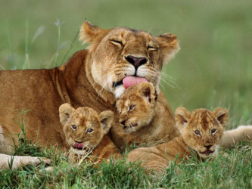
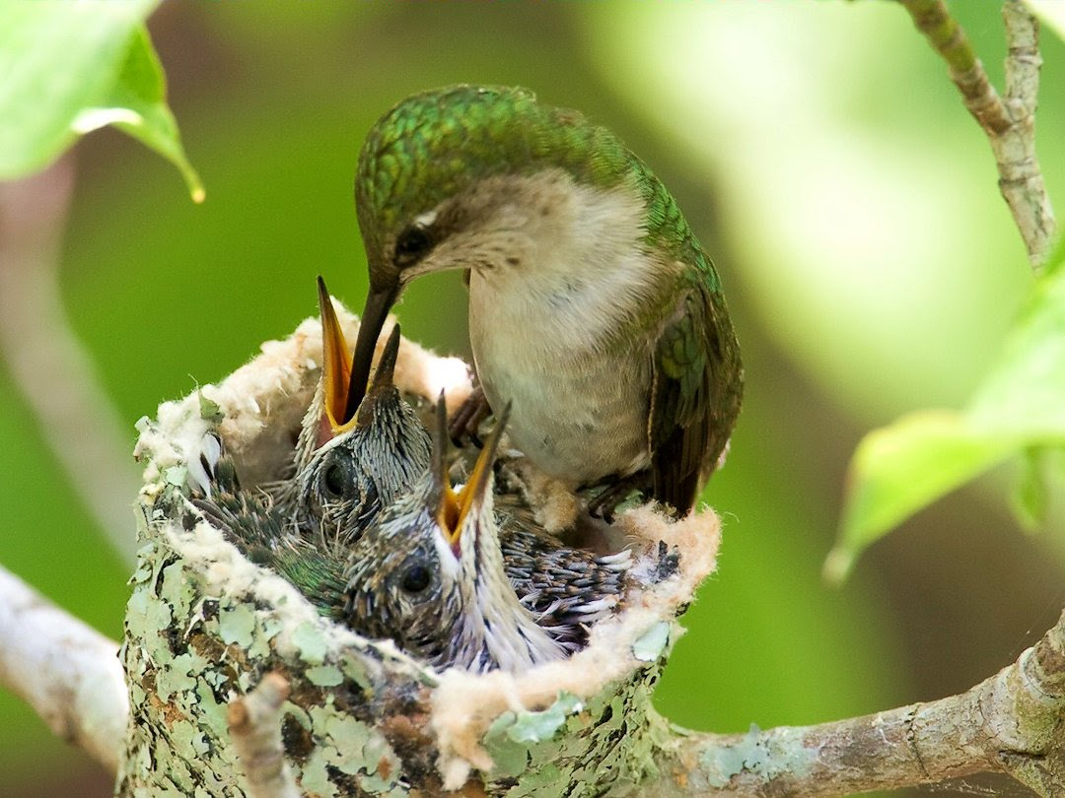
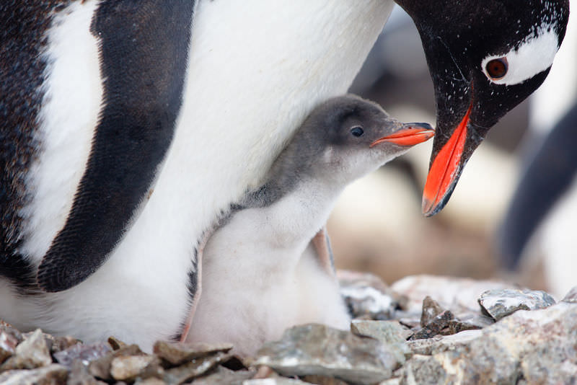
1.HORMONES AND PARENTAL CARE
Hormones ensures great return for parental care efforts.
Male parental care is facilitated by increase in prolactin and reduction in plasma testosterone.
Male mammals express parental behaviors, mediated by seasonally- regulated hormones e.g. Rhabdomys pumilio
Maternal Behavior
In vertebrates hormones regulate maternal behavior
Pituitary hormone, prolactin influence
secretion of milk

Slide 5
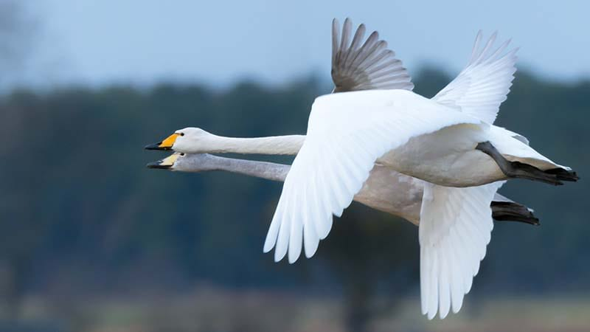
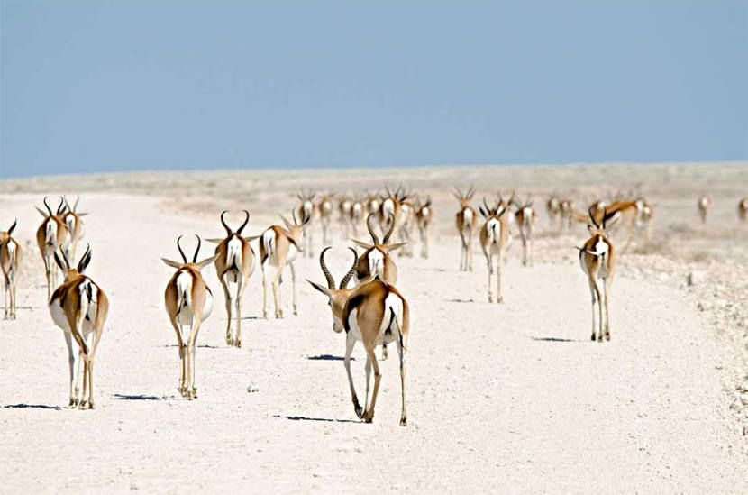
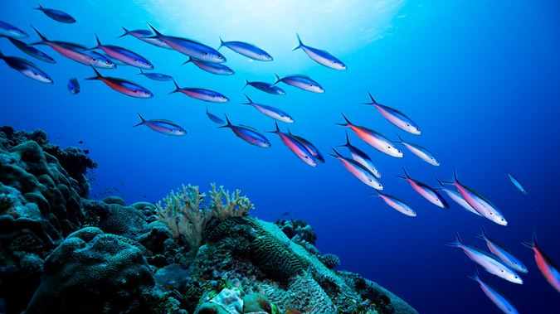
2.Hormones and migration
1. Thyroid hormones mediate migratory behaviors
2. Thyroidectomy inhibit pre-migratory fattening
3. Androgens regulate spring migration to breeding grounds in fish and birds
4. Mammals, amphibians, fishes, reptiles and birds migrate due to seasonal hormonal changes
5. Seasonal and circadian rhythms of melatonin concerns with migratory nocturnal restlessness or “zugunruhe” in birds for night flight

Slide 6
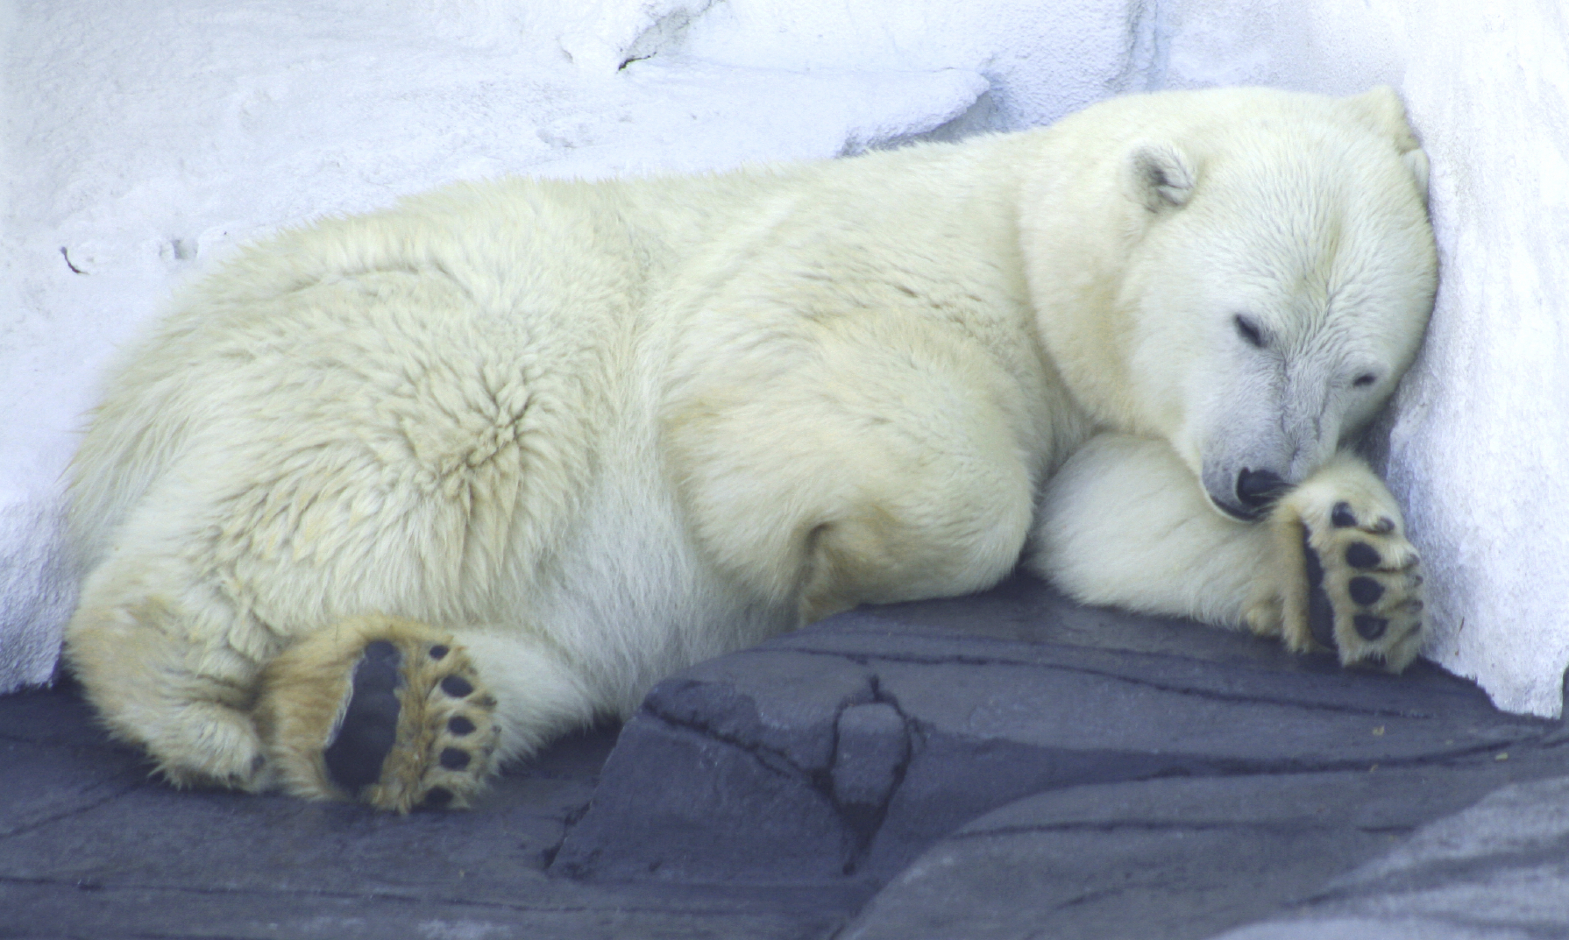
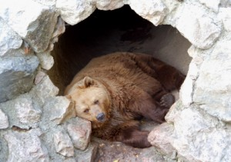
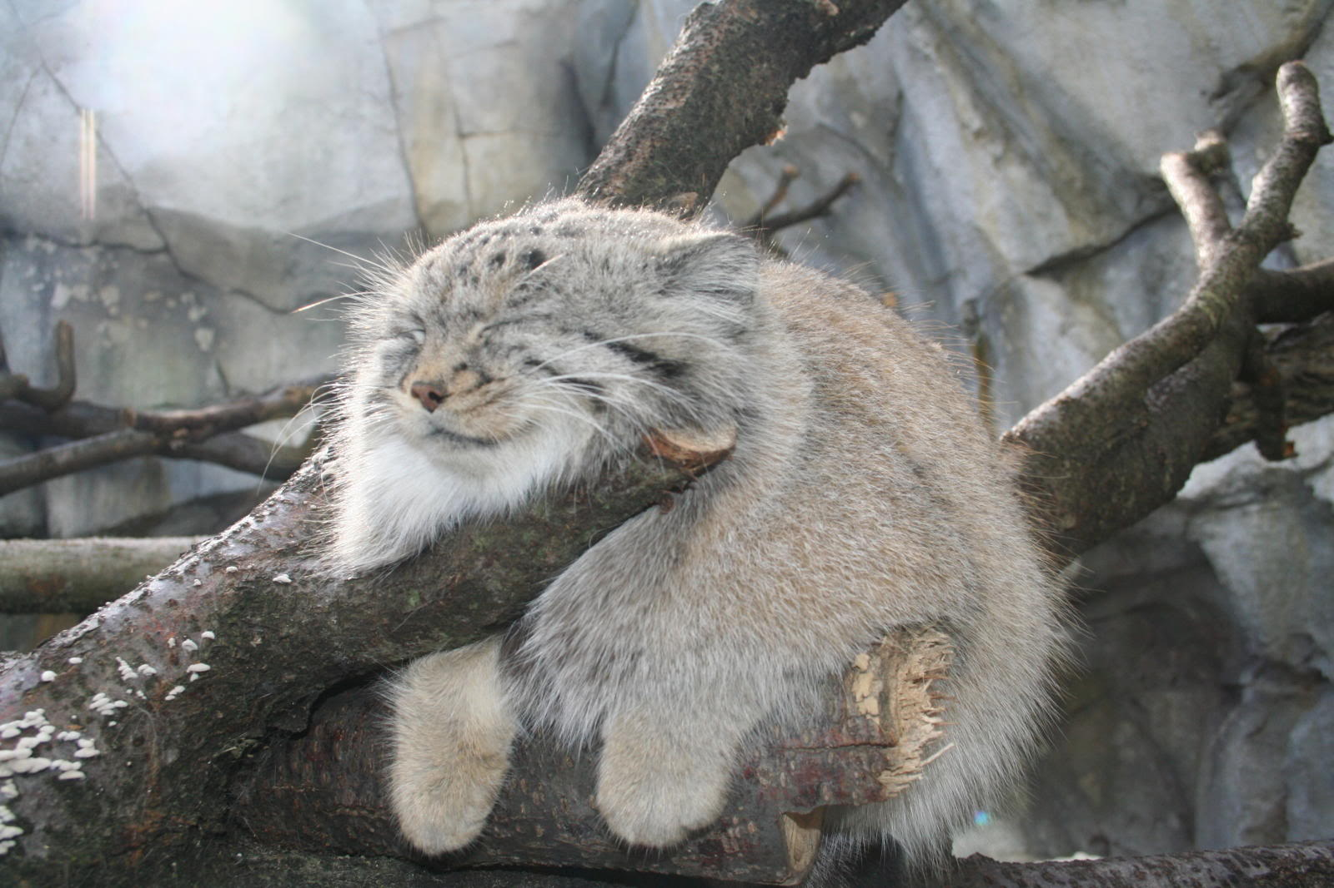
3.Hormones and hibernation & torpor
Hibernation:
1. Duration of melatonin secretion, decreased plasma level of gonadal
2. Steroids during short photoperiods
stimulates hibernation
3. Food intake and brown adipose tissue
growth increase due hormonal changes,
signals to hibernate
4. Elevated testosterone inhibits, terminate hibernation
5. Thyroid hormone terminate hibernation

Slide 7
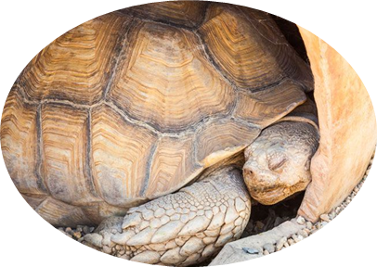
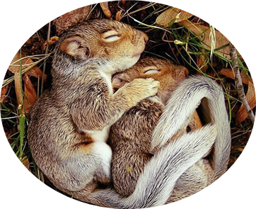
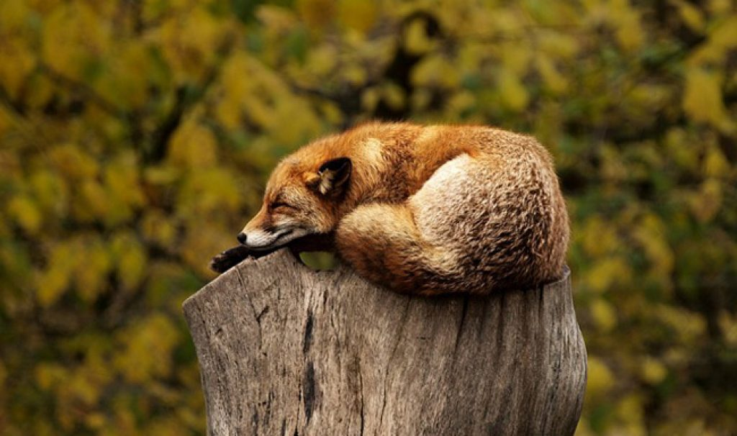
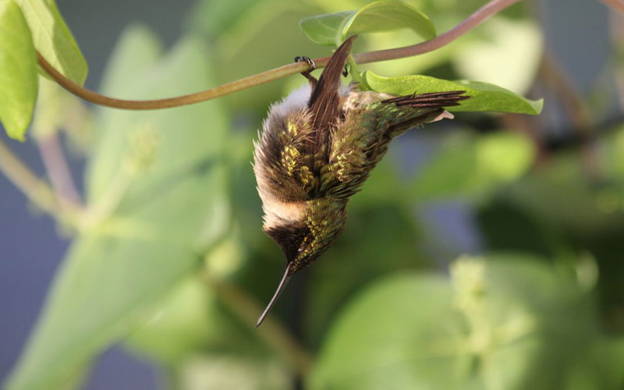
torpor
1. Increase insulation, decrease heat loss.
2. Maintenance of body temperature, metabolism and water balance
3. Thyroid hormones effects on torpor, lowered intracellular T3 concentrations in peripheral tissues promote torpor e.g. Djungarian hamsters (Phodopus sungorus)
4. Leptin play role in, duration and depth of torpor expression

Slide 8
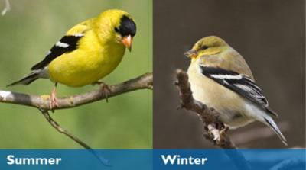
4. Hormones and molting
1. Vertebrates change external appearance in response to environmental changes and seasonal frequency
2. Purposes:
Replacement of damage covering
Camouflage
Signaling of sexual competence
3. Directly constrain expression of specific behavior
4. Example: Birds molt seasonally, contain brown feather in summer due to a-MSH production, molt in winter, replace brown with white feathers, for matching to winter snow

Slide 9
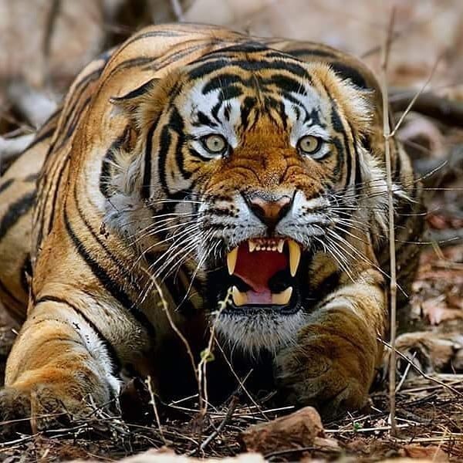
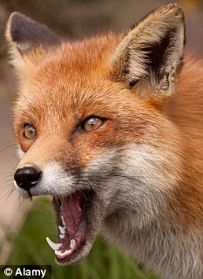
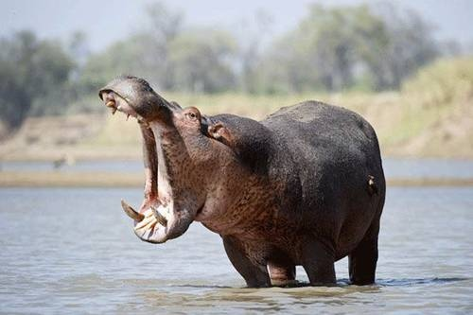
5. Hormones and aggressive behavior
1. Males more aggressive then females
2. Aggressive behavior in young male animals (testosterone)
3. Testosterone, Serotonin
4. Endocrine system produces hundreds of hormones, interact with nervous system to regulate
• Short Term process: (responses to threats)
• Long Term process: (sex differentiation, maturation, reproduction)
5. Hormones secreted in response to external and internal stimuli, results in agression.

Slide 10
thanku

