Slide 1
Movement and muscles

Slide 2
Sliding filament theory
The sliding filament theory describes a process used by muscle to contract.It is developed by Andrew Huxley and Rolf Nieergerke and by Hugh Huxley and jean Hanson in 1954.The contraction is not uniform across the sarcomere; the central position of the thick filaments becomes unstable and can shift during contraction. However the actions of elastic proteins such as titin are hypothesised to maintain uniform tension across the sarcomere and pull the thick filament into a central position

Slide 3
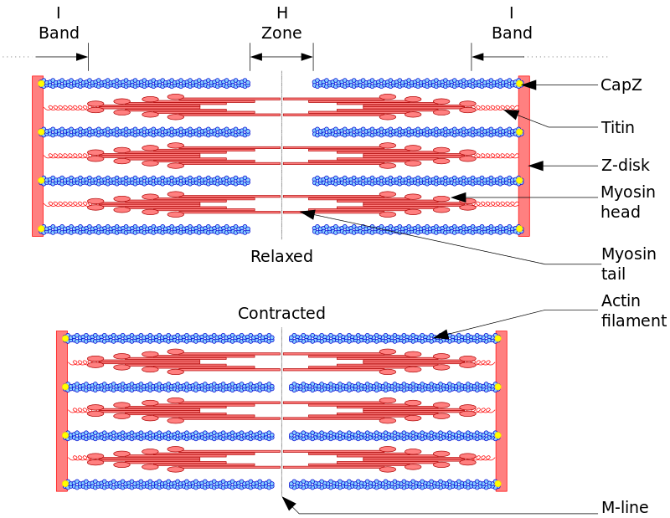
Sliding filament theory

Slide 4
Mechanism of muscle contraction
Cross bridge Cycle :
Cross bridge cycle is a myosin projection.
Consisting of two myosin heads, that extends from the thick filaments. Each myosin head has two binding sites:
ATP
ACTIN

Slide 5
Cross bridge cycle
Step 1:
When a muscle is relaxed, tropomyosin cover the binding site of actin.
A molecule of ADP and phosphate remains attached to myosin from the previous contraction.

Slide 6
Cross bridge cycle
Step 2:
During a contraction, calcium bind to troponin.
Tropomyosin is repositioned, exposing the myosin binding site of actin filaments.

Slide 7
Cross bridge cycle
Step 3:
Myosin heads bind to actin filaments. And the phosphate is released.
Step 4:
Myosin head spring forward “power stroke” pulling the actin filaments. ADP is released from myosin.

Slide 8
Cross bridge cycle
Step 5:
Myosin is released from actin.
A new molecule of ATP binds to myosin, causing it to be released from the actin filaments.
ATP is not yet broken down, but is essential to release the cross bridge.

Slide 9
Cross bridge cycle
Step 6:
ATP is broken down, providing the energy to “cock” the myosin filaments (recovery stroke).
Step 7:
Steps 1-6 are repeated several time

Slide 10
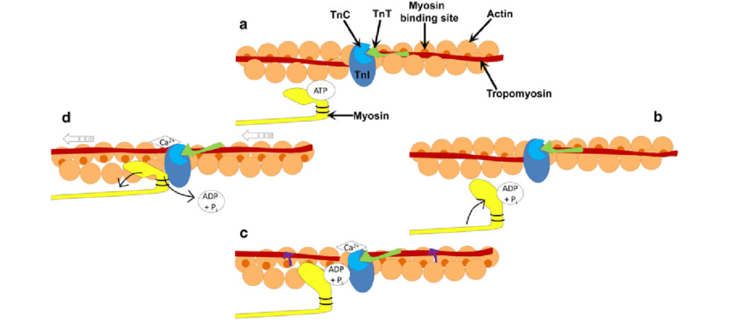
Cross bridge cycle

