Slide 1
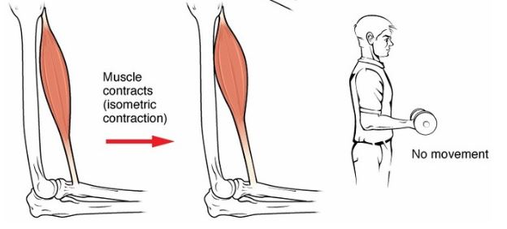
Types Of Muscles Contraction
Isometric contraction:
The muscle is activated, but instead of being allowed to lengthen or shorten, it is held at a constant length.

Slide 2
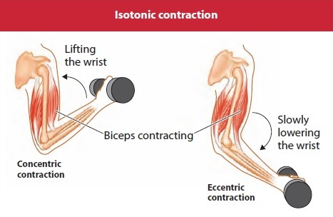
Isotonic contraction:
Tension remains the same, while the muscle's length changes.
Isotonic contractions differ from isokinetic contractions in that in isokinetic contractions the muscle speed remains constant.
An isotonic contraction will keep force constant while velocity changes, but an isokinetic contraction will keep velocity constant while force changes. A near isotonic contraction is known as Auxotonic contraction.
.

Slide 3
Types of isotonic contraction
Concentric contraction:
Muscle tension rises to meet the resistance, then remains the same as the muscle shortens.
Eccentric contraction:
Muscle lengthens due to the resistance being greater than the force the muscle is producing.

Slide 4
