Slide 1
Parametric Methods for Regression Model Fitting and Identiﬁcation of Prognostic Factors Chapter 11

Slide 2
Introduction
Prognosis, the prediction of the future of an individual patient.
Patient characteristics (also called concomitant variables, independent variables, covariates, prognostic factors, or risk factors)
Theoretical model (or distribution), that ﬁts the observed data and identify the most important factors.

Slide 3
PRELIMINARY EXAMINATION OF DATA
The dependent variable (also called the response variable), or the outcome of prediction, may be dichotomous, polychotomous, or continuous.
Dichotomous dependent variables are response or nonresponse, life or death, and presence or absence of a given disease.
Polychotomous dependent variables (different grades of symptoms e.g., no evidence of disease, minor symptom, major symptom) and (scores of psychiatric reactions e.g., feeling well, tolerable, depressed, or very depressed).
Continuous dependent variables (survival time or length of remission).

Slide 4
Prognostic Variable
Numerical or nonnumerical
Discrete (number of previous strokes or number of lymph node metastases)
Continuous (age or blood pressure)
Use of dummy variables for qualitative variables (e.g., a histological classiﬁcation into one of three cell types A, B, or C, Sex)
Interaction of variables
Transformation of variables
Selection of potential prognostic factors
Handling missing data in regression analysis

Slide 5
MODEL SELECTION METHODS
Forward Selection Procedure
Backward Selection Procedure
Stepwise Selection Procedure
Information Criterion (AIC and BIC) Procedures

Slide 6
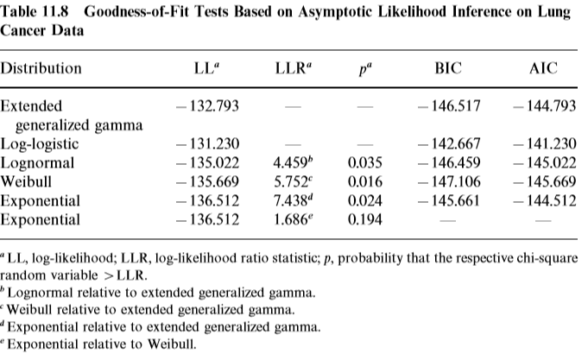
Selection of a Parametric Model with a Fixed Subset of Covariates
log-logistic model

Slide 7
Selection of Model: Cox--Snell Residual Procedure with Covariates
The graph of versus , should be closed to a straight line with unit slope and zero intercept if the ﬁtted model for the survival time T is correct.

Slide 8
Selection of Model: Example 11.8
Use Cox—Snell residuals plots from ﬁtting the exponential, Weibull, lognormal, log-logistic, and extended generalized gamma models, respectively with the three covariates KPS, INDADE, and INDSMA, to the lung cancer data in Example 11.6 for choice of model.

Slide 9
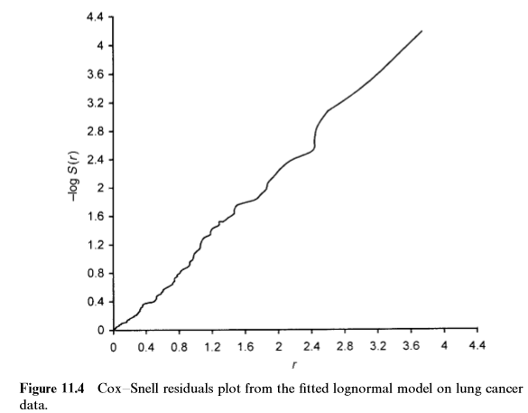
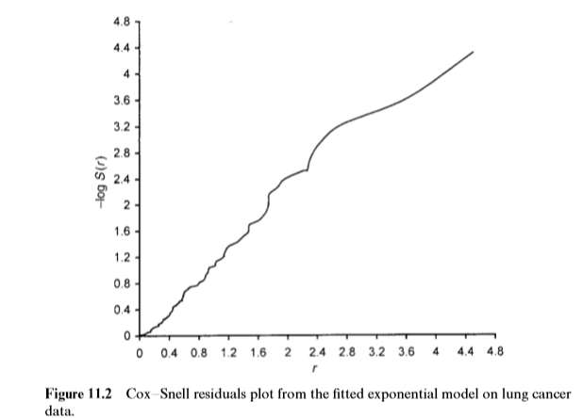
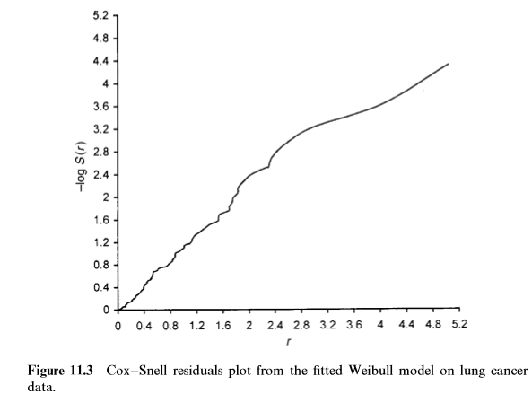
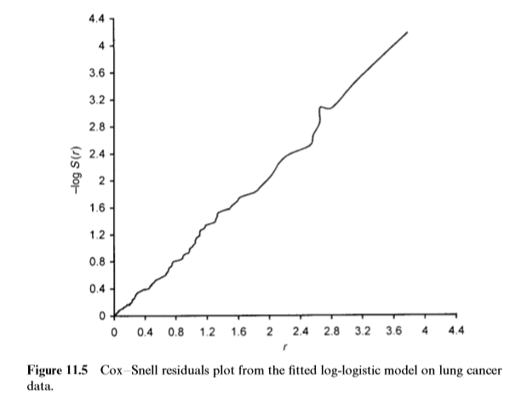
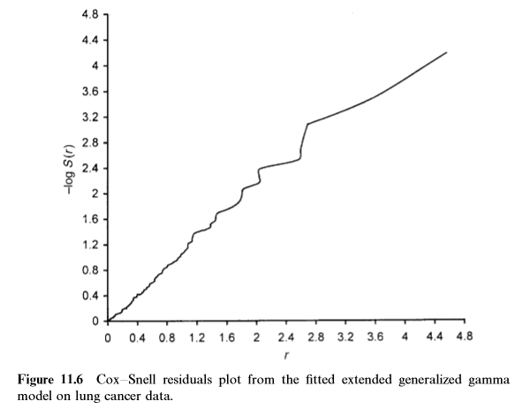
Cox--Snell Residual Plots
Relatively better fit by Loglogistic

