Slide 1
Comments on Tests
Tests are based on rank statistics.
Gehen’s generalized wilcoxen test, cox Mantel test, Log rank test, Peto and peto’s test are applicable to progressive censoring.
Two categorization
Generalization of Wilcoxen test (Gehen’s and Peto and Peto’s)
Non Wilcoxen test (Cox- Mantel test and Logrank test)
In Logrank test, if the statistic S is the sum of w scores in group 2, it is same as U of the Cox-Mantel test.

Slide 2
When sample sizes are small (n1,n2<=50), Cox’s Ftest is more powerful than Gehen’s generalized Wilcoxen test if samples are from exponential or weibul distribution and if there are no censored observation or data are singly censored.
If samples are from exponential distributions, with or without censoring, the Cox-Mantel and Logrank tests are more powerful and more efficient than generalized Wilcoxen tests of Gehan and Peto and Peto’s.
There is little difference between Cox-Mantel and Logrank test s and the two Generalized Wilcoxen tests.
When sample taken from weibul distribution with constant hazard ratio the results are essentially same as in the exponential distribution.
When hazard ratio is non constant the two generalization of the Wilcoxen test have more power than the other tests.

Slide 3
The logrank test is more powerful than the Wilcoxen tests in detecting departures when the two hazard functions are proportional or or when there is random but equal censoring and when there is no censoring.
The Generalized Wilcoxen tests appear to be more powerful than the logrank test for detecting many other types of differences e.g. when the hazrd functions are not parallel and when there is no censoring and the logarithm of the survival times follow the normal distribution with equal varaince but possibly different means.

Slide 4
The generalized Wilcoxen tets give more weight to early failures than later failures, whereas the logrank test gives equal weight to all failures.
Generalized Wilcoxen tests are more likely to detect early differences in the two survival distributions, whereas the logrank test is more sensitive to differences in the right tails.
Gehan’s test use is criticed when censoring rates are high.
If heavy censoring exists, the test statistic is dominated by a small number of early failures and has a very low power.

Slide 5
There are situations when neither logrank mor wilcoxen test is very effective.
When two distribution differ but their hazrd function or survivorship function cross, neither wilcoxen nor logrank test is very powerful.
Other tests are Tarone and Ware, Fleming and Harrington.

Slide 6
MANTEL--HAENSZEL TEST
The Mantel—Haenszel (1959) test is particularly useful in comparing survival experience between two groups when adjustments for other prognostic factors are needed.

Slide 7
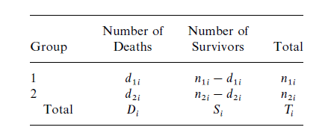
MANTEL--HAENSZEL TEST
s = number of strata
n_{ji} =number of individuals in group j, where j=1, 2, and stratum i, i=1, . . . , s
d_{ji}= be the number of deaths (or failures) in group j and stratum i.

Slide 8
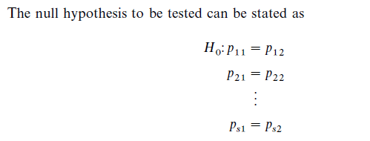
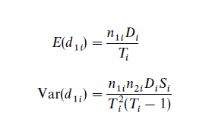

Slide 9
Example 5.7
Five hundred and ninety-five persons participate in a case control study of the association of cholesterol and coronary heart disease(CHD). Among them, 300 persons are known to have CHD and 295 are free of CHD. To find out if elevated cholesterol is significantly associated with CHD, the investigator decides to control the effects of smoking. The study subjects are then divided into two strata: smokers and nonsmokers. The following tables give the data for smokers:

Slide 10
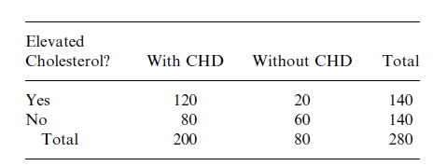
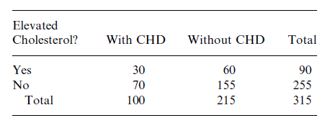
smokers
Nonsmokers

Slide 11
Example 5.8
Table 5.7 gives survival data in life-table format of male cases with localized cancer of the rectum in Connecticut for 1935—1944 and 1945—1954.We use Mantel and Haenszel’s chi-square test to see if the survival distribution of patients diagnosed in 1935—1944 is the same as for patients diagnosed in 1945—1954.The null hypothesis is that the two survival distributions are the same.

Slide 12
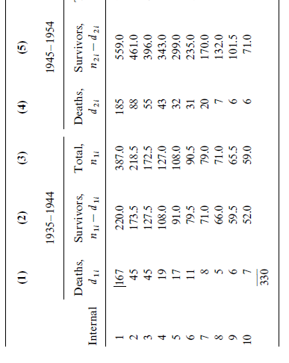
Table 5.7

Slide 13
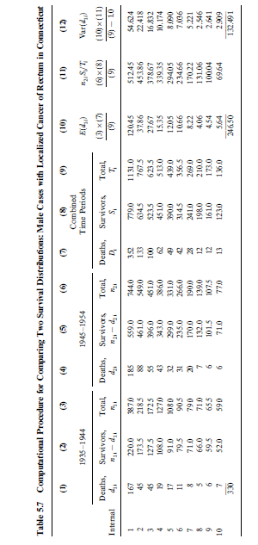

Slide 14
Conclusion
It is significant at the 0.001 level. Thus, the data show a significant difference between the survival distributions of patients diagnosed in 1935—1944 and 1945—1954.

Slide 15
COMPARISON OF K (K>2) SAMPLES
For uncensored data
Kruskal-Wallis Test H test
For Censored data
Generalization of H test (Peto and Peto’s, 1972)

Slide 16
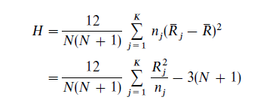
Kruskal-Wallis Test H test
Rank all N observations in ascending order
Separate ranks of k groups in separate columns
Compute sum of ranks for each group
Compute H
In case of ties

Slide 17
Conclusion
H an asymtotic Chi-Square distribution. For large n reject H₀if
When K=3 and no. of observation in three samples is 5 or fewer use exact permutational distribution of H (Table B-4). Reject H₀ if

Slide 18
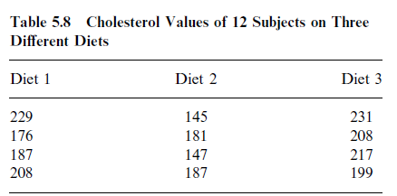
Example 5.9
In a study of the relationship between cholesterol level and diet, three diets are given randomly to 12 men whose initial cholesterol levels are almost the same. Table 5.8 shows the cholesterol levels of the 12 people after having their assigned diet for a given period of time. The purpose of the study is to decide if the three diets are equally effective in controlling cholesterol level.

Slide 19
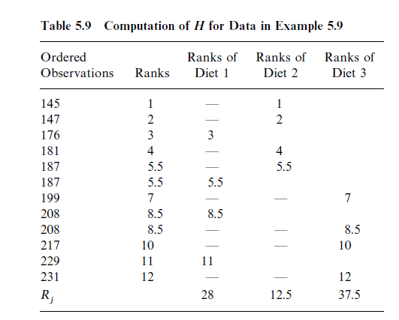
Computations
H₀=states that there is no difference in cholesterol level of men having the three diets
H₁=the cholesterol levels of men having the three different diets are different

Slide 20
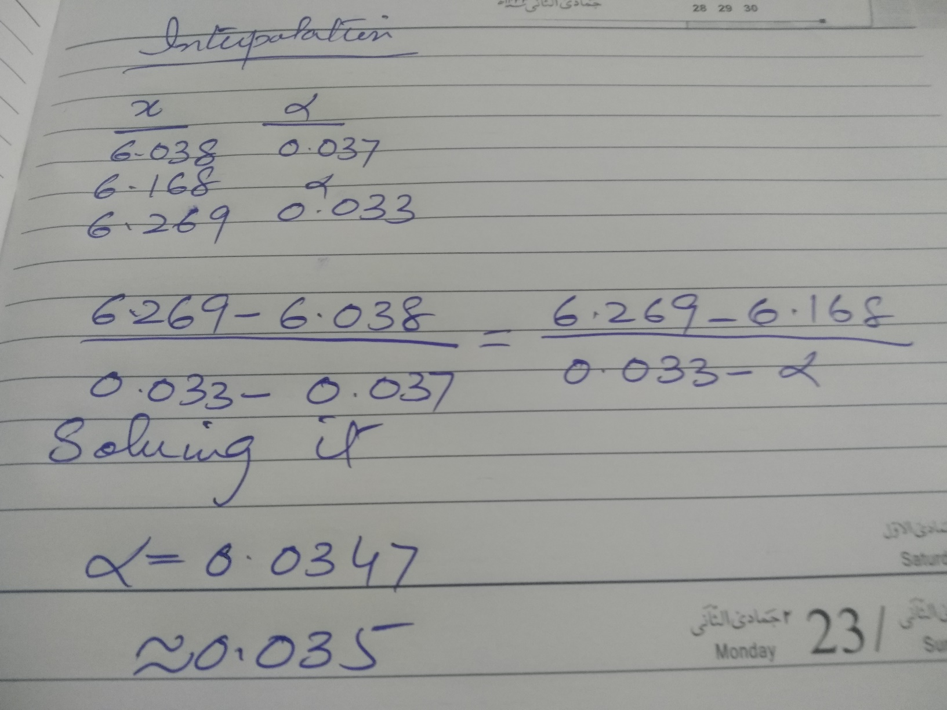
Interpolation

Slide 21
Multiple Comparisons Based on the Kruskal--Wallis Test
When sample sizes are equal n is small, we reject the hypothesis that the ith and jth samples, i<j, are from the same distribution if Table B-5
When sample sizes are equal to n and n is large, we introduce Miller’s(1966) procedure, that is, to reject the hypothesis that the ith and jth samples, i<j, are from the same distribution if Table B-6
For cases of small unequal a conservative procedure is to reject the hypothesis that the ith and jth samples, i<j,are from the same distribution if Table B-4
When n_{1……………} n_{K} are large, Dunn (1964) to reject the hypothesis that the ith and jth samples, i<j, are from the same distribution if Table B-1

Slide 22
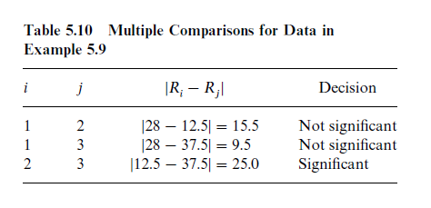
Multiple Comparisons Based on the Kruskal--Wallis Test

Slide 23
COMPARISON OF K (K>2) SAMPLES: Test for Censored Data
Three nonparametric tests were introduced which are based on scores for comparing two samples with censored observations i.e. Gehan’s generalized Wilcoxon test (if Mantel’s procedure is used)
Peto and Peto’s generalized Wilcoxon test Logrank test.
The K-sample test discussed in this section can be considered an extension of these tests and the Kruskal—Wallis test.

Slide 24
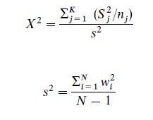
Compute s scores for each group
Reject H₀ if

