Slide 2
What is Survival Analysis?
Survival Analysis is referred to statistical methods for analyzing survival data
Survival data could be derived from laboratory studies of animals or from clinical and epidemiologic studies
Survival data could relate to outcomes for studying acute or chronic diseases

Slide 3
Survival Data
Survival data can include survival time, response to a given treatment, and patient characteristics related to response, survival, and the development of a disease.
The study of survival data has focused on predicting the probability of response, survival, or mean lifetime, comparing the survival distributions of experimental animals or of human patients and the identification of risk and/or prognostic factors related to response, survival, and the development of a disease.

Slide 4
What is Survival Time?
Survival time refers to a variable which measures the time from a particular starting time (e.g., time initiated the treatment) to a particular endpoint of interest (e.g., attaining certain functional abilities)
It is important to note that for some subjects in the study a complete survival time may not be available due to censoring
Survival time can be defined broadly as the time to the occurrence of a given event. This event can be the development of a disease, response to a treatment, relapse, or death. Therefore, survival time can be tumor-free time, the time from the start of treatment to response, length of remission, and time to death.

Slide 5
Important Areas of Application
  Clinical Trials (e.g., Recovery Time after heart surgery)
  Longitudinal or Cohort Studies (e.g., Time to observing the event of interest)
  Social Sciences
  Business Studies
  Life Insurance (e.g., Time to file a claim)
  Quality Control & Reliability in Manufacturing (e.g., The amount of force needed to damage a part such that it is not useable)

Slide 6
Application
Examples of survival data in these fields are the
Lifetime of electronic devices, components, or systems (reliability engineering)
Felons’ time to parole (criminology)
Duration of first marriage (sociology)
Length of newspaper or magazine subscription (marketing)
Worker’s compensation claims (insurance) and their various influencing risk or prognostic factors.

Slide 7
Objectives of survival analysis
  Estimate time-to-event for a group of individuals, such as time until second heart-attack for a group of MI patients.
  To compare time-to-event between two or more groups, such as treated vs. placebo MI patients in a randomized controlled trial.
  To assess the relationship of co-variables to time-to-event, such as: does weight, insulin resistance, or cholesterol influence survival time of MI patients?
  Note: expected time-to-event = 1/incidence rate

Slide 8
CENSORING
Different types
  Right
  Left
  Interval
Each leads to a different likelihood function
Most common is right censored

Slide 9
Right censored data
“Type I censoring”
Event is observed if it occurs before some prespecified time
Mouse study
Clock starts: at first day of treatment
Clock ends: at death
Always be thinking about ‘the clock’

Slide 10
Animal studies usually start with a fixed number of animals, to which the treatment or treatments is given. Because of time and/or cost limitations, the researcher often cannot wait for the death of all the animals. One option is to observe for a fixed period of time, say six months, after which the surviving animals are sacrificed. Survival times recorded for the animals that died during the study period are the times from the start of the experiment to their death. These are called exact or uncensored observations.
The survival times of the sacrificed animals are not known exactly but are recorded as at least the length of the study period. These are called censored observations. Some animals could be lost or die accidentally. Their survival times, from the start of experiment to loss or death, are also censored observations. In type I censoring, if there are no accidental losses, all censored observations equal the length of the study period.

Slide 11
Right Censoring
Observation begins at the defined time origin and ceases before the event of interest is realized.
  The survival time is only known to exceed a certain value.
  Incomplete nature of the observation occurs in the right tail of the time axis.

Slide 12
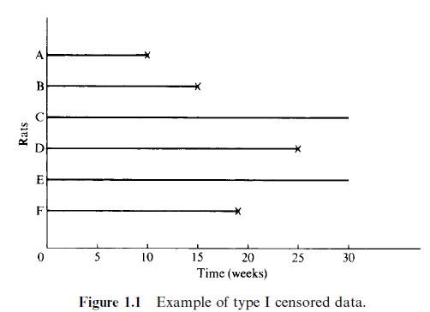
Rats Example

Slide 13
Simple example: Type I censoring
Time 0

Slide 14
Introduce “administrative” censoring
Time 0
STUDY END

Slide 15
Introduce “administrative” censoring
Time 0
STUDY END

Slide 16
More realistic: clinical trial
“Generalized Type I censoring”
Time 0
STUDY END

Slide 17
More realistic: clinical trial
“Generalized Type I censoring”
Time 0
STUDY END

Slide 18
Additional issues
Patient drop-out
Loss to follow-up

Slide 19
Drop-out or LTFU
Time 0
STUDY END

Slide 20
Example: Diet-tumor Study
A laboratory investigator is interested in the relationship between diet and the development of tumors.
3 diet groups: low-fat, saturated-fat, unsaturated-fat diets
30 rates per group
An identical amount of tumor cells were injected into a foot pad of each rat, and the tumor-free times of the rats were recorded.
The study was terminated after 200 days.

Slide 21
Example: Diet-tumor Study
Tumor-free times (days) for the low-fat group are as follows:
140, 177, 50, 65, 86, 153, 181, 191, 77, 84, 87, 56, 66, 73, 119, 140
and 200+ for the other 14 rats.
“+” denotes a censored observation.
Q: What are Cis?

Slide 22
Example: HIV+ Study
Subjects were enrolled from 1/1/1989 to 12/31/1991.
The study ended on 12/31/1995.
The event of interest is death due to AIDS or AIDS-related complications.

Slide 23
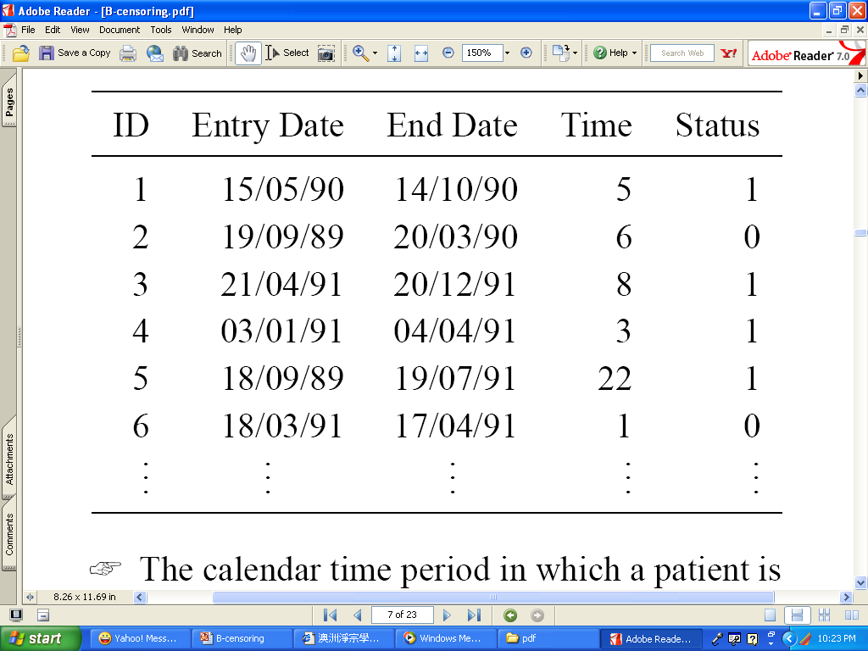
Example: HIV+ Study

Slide 24
How do we ‘treat” the data?
Shift everything
so each
patient time
represents time
on study
Time of
enrollment

Slide 25
Right Censoring: Type II
Arises when n subjects start on study at the same time, with the study terminating once r failures have been observed, where r is some pre-determined integer (r<n).
Experiments involving type II censoring are often used in testing of equipment life.

Slide 26
Another option in animal studies is to wait until a fixed portion of the animals have died, say 80 of 100, after which the surviving animals are sacrificed. In this case, type II censoring, if there are no accidental losses, the censored observations equal the largest uncensored observation. For example, in an experiment of six rats (Figure 1.2), the investigator may decide to terminate the study after four of the six rats have developed tumors. The survival or tumor-free times are then 10, 15, 35, 25, 35, and 19 weeks.

Slide 27
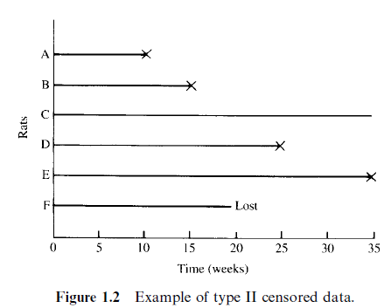

Slide 28
Example
A life test of aircraft components cannot wait until all components have failed.
Others?

Slide 29
Another type of censoring:
Competing Risks
Patient can have either event of interest or another event prior to it
Event types ‘compete’ with one another
Example of competers:
  Death from lung cancer
  Death from heart disease
Common issue not commonly addressed, but gaining more recognition

Slide 30
Type III Censoring
In most clinical and epidemiologic studies the period of study is fixed and patients enter the study at different times during that period. Some may die before the end of the study; their exact survival times are known. Others may withdraw before the end of the study and are lost to follow-up. Still others may be alive at the end of the study. For ‘‘lost’’ patients, survival times are at least from their entrance to the last contact. For patients still alive, survival times are at least from entry to the end of the study. The latter two kinds of observations are censored observations. Since the entry times are not simultaneous, the censored times are also different.

Slide 31
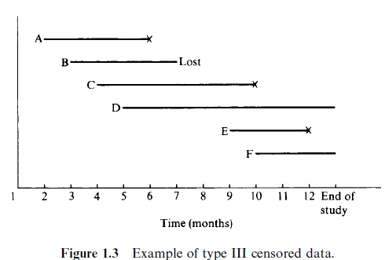

Slide 32
Type I and type II censored observations are also called singly censored data
Type III, progressively censored data.
Another commonly used name for type III censoring is random censoring.
All of these types of censoring are right censoring or censoring to the right.

Slide 33
Left Censoring
The event has occurred prior to the start of the study
OR the true survival time is less than the person’s observed survival time
We know the event occurred, but unsure when prior to observation
In this kind of study, exact time would be known if it occurred after the study started
Example:
  Survey question: when did you first smoke?
  Alzheimers disease: onset generally hard to determine
  HPV: infection time
  For example, an epidemiologist wishes to know the age at diagnosis in a follow-up study of diabetic retinopathy.

Slide 34
Left Censoring
Arises when the event of interest has already occurred for the individual before observation time.
  The survival time is only known to be less than a certain value.
  Incomplete nature of the observation occurs in the left tail of the time axis.

Slide 35
Interval censoring
Interval censoring occurs when the event of interest is known to have occurred between times a and b. For example, if medical records indicate that at age 45, the patient in the example above did not have retinopathy, his age at diagnosis is between 45 and 50 years.
Due to discrete observation times, actual times not observed
Example: progression-free survival
  Progression of cancer defined by change in tumor size
  Measure in 3-6 month intervals
  If increase occurs, it is known to be within interval, but not exactly when.
Times are biased to longer values
Challenging issue when intervals are long

Slide 36
Interval Censoring
A more general type of censoring occurs when failure is known to occur only within an interval.
A generalization of left and right censoring.

Slide 37
Example: Cancer Recurrence
Survival (failure) time is the time to recurrence of colorectal cancer, following surgical removal of primary tumor.
After surgery, patients are examined every 3 months to determine if cancer has recurred.

Slide 38
Key components
Event: must have clear definition of what constitutes the ‘event’
  Death
  Disease
  Recurrence
  Response
Need to know when the clock starts
  Age at event?
  Time from study initiation?
  Time from randomization?
  time since response?
Can event occur more than once?

Slide 39
Truncation
Truncation is a condition which screens out certain subjects so that the investigator will not be aware of their existence.
For truncated data, only subjects who satisfy the condition are observed by the investigator.
The condition is usually associated with a truncation time

Slide 40
Truncation Time
Truncation time for individual i, denoted ti, is the time of the occurrence of the event truncating individual i.

Slide 41
Left Truncation
Arises when the condition is that the truncation time must occur prior to the event of interest.
Only individuals with Yi > ti are observed.
Left truncated data are rarely seen in medical research; it is often due to the threshold of an apparatus.

Slide 42
Example: astronomical data
With a given telescope, we can only detect a very distant stellar object which is brighter than some limiting flux — the object is left-truncate if it lies beyond detection by our telescope – we cannot tell if the object is even there if we cannot see it.

Slide 43
Example: Channing House
Channing House is a retirement center in Palo Alto, CA
All the residence were covered by a health care program provided by the center
Ages at death of 462 individuals who were in residence during Jan 1964 to July 1975 are recorded
Ages at which individuals entered the retirement center are also recorded

Slide 44
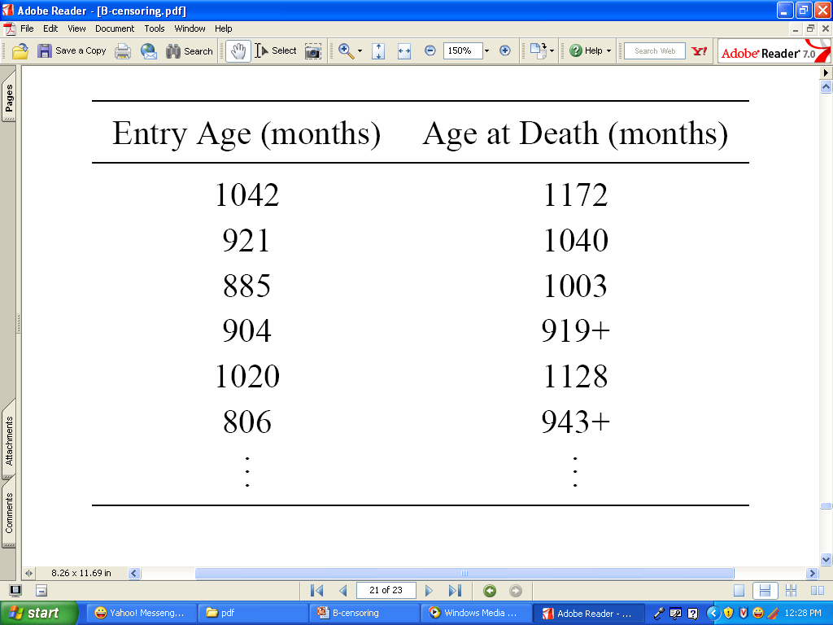
Example: Channing House
What is the time and condition of truncation?
The problem can be solved by revising our target population.

Slide 45
Right Truncation
Arises when only individuals who have experienced the event of interest are included in the sample.
That is, ti = the end date of study and only individuals with Yi < ti are observed.

Slide 46
Example: AIDS
Only those who developed AIDS were asked for their infection dates
Data: infection and induction times for 258 adults who were infected with AIDS virus and developed AIDS by 6/30/1986
  Time in years infected by AIDS virus (from 4/1/1978)
  Waiting time to the development of AIDS (from the date of infection)
Q: What is the time and condition of truncation?

Slide 47
Relapse
A deterioration in someone's state of health after a temporary improvement. The return of signs and symptoms of a disease after a remission.

Slide 48
Remission
A temporary reduction of the severity of disease or pain. A period in the course of a disease when symptoms become less severe.
Generally used in Lukemia

