Slide 1
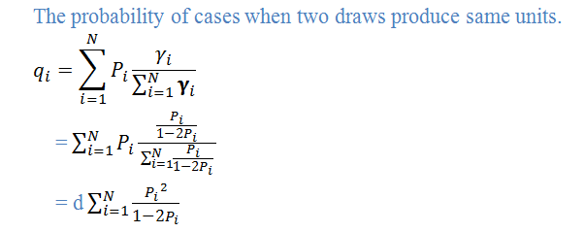
Sampford selection procedure
The selection procedure proposed by sampford (1967)
Select 1st unit with PPS & W.R
Select 2nd unit with pp to
Repeat 1st two steps if same unit are selected

Slide 3
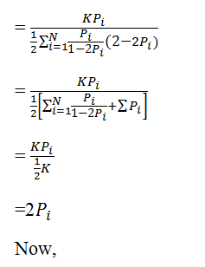
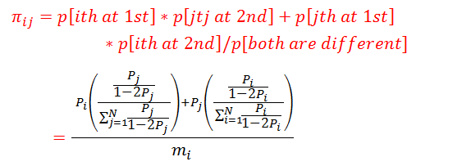

Slide 4
