Slide 1

Theil’s Method:
For testing $H_{0}$: =$β=β_{0}$ has been proposed by Theil (T5). The procedure is based on the Kendall tau statistic.

Slide 2
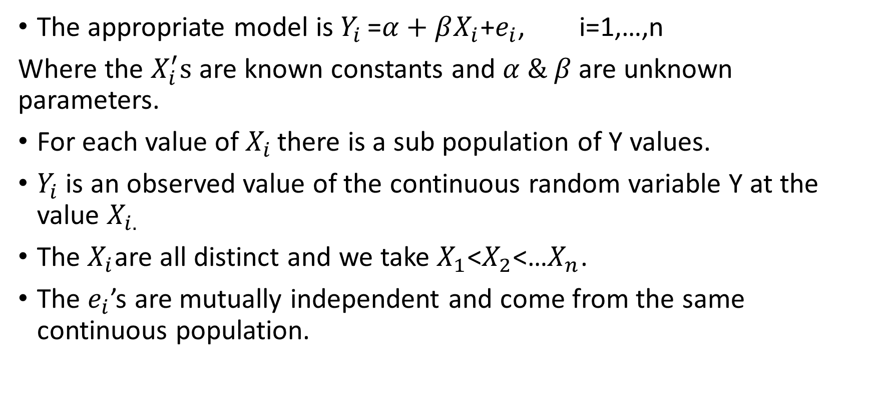
Assumptions
The appropriate model is $Y_{i }$=$α+βX_{i}$+$e_{i}$, i=1,…,n
Where the $X_{i}^{′}s$ are known constants and $α \& β$ are unknown parameters.
For each value of $X_{i }$there is a sub population of Y values.
$Y_{i}$ is an observed value of the continuous random variable Y at the value $X_{i.}$
The $X_{i}$are all distinct and we take $X_{1}$<$X_{2}$<…$X_{n}$.
The $e_{i}$’s are mutually independent and come from the same continuous population.

Slide 3
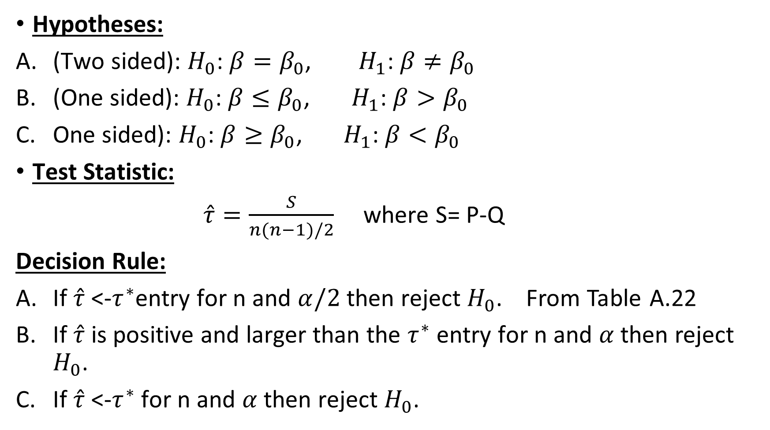
Hypotheses:
(Two sided): $H_{0}$: $β=β_{0}$, $H_{1}$: $β≠β_{0}$
(One sided): $H_{0}$: $β≤β_{0}$, $H_{1}$: $β>β_{0}$
One sided): $H_{0}$: $β≥β_{0}$, $H_{1}$: $β<β_{0}$
Test Statistic:
$\hat{τ}=\frac{S}{n(n−1)/2}$ where S= P-Q
Decision Rule:
If $\hat{τ}$ <-$τ^{∗}$entry for n and $α/2$ then reject $H_{0}$. From Table A.22
If $\hat{τ}$ is positive and larger than the $τ^{∗}$ entry for n and $α$then reject $H_{0}$.
If $\hat{τ}$ <-$τ^{∗}$ for n and $α$then reject $H_{0}$.

Slide 4
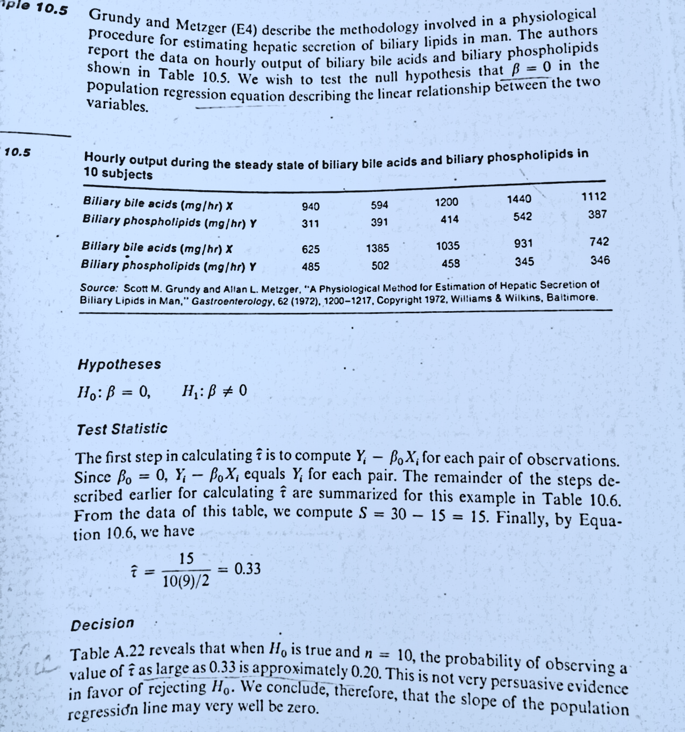
Example:

Slide 5
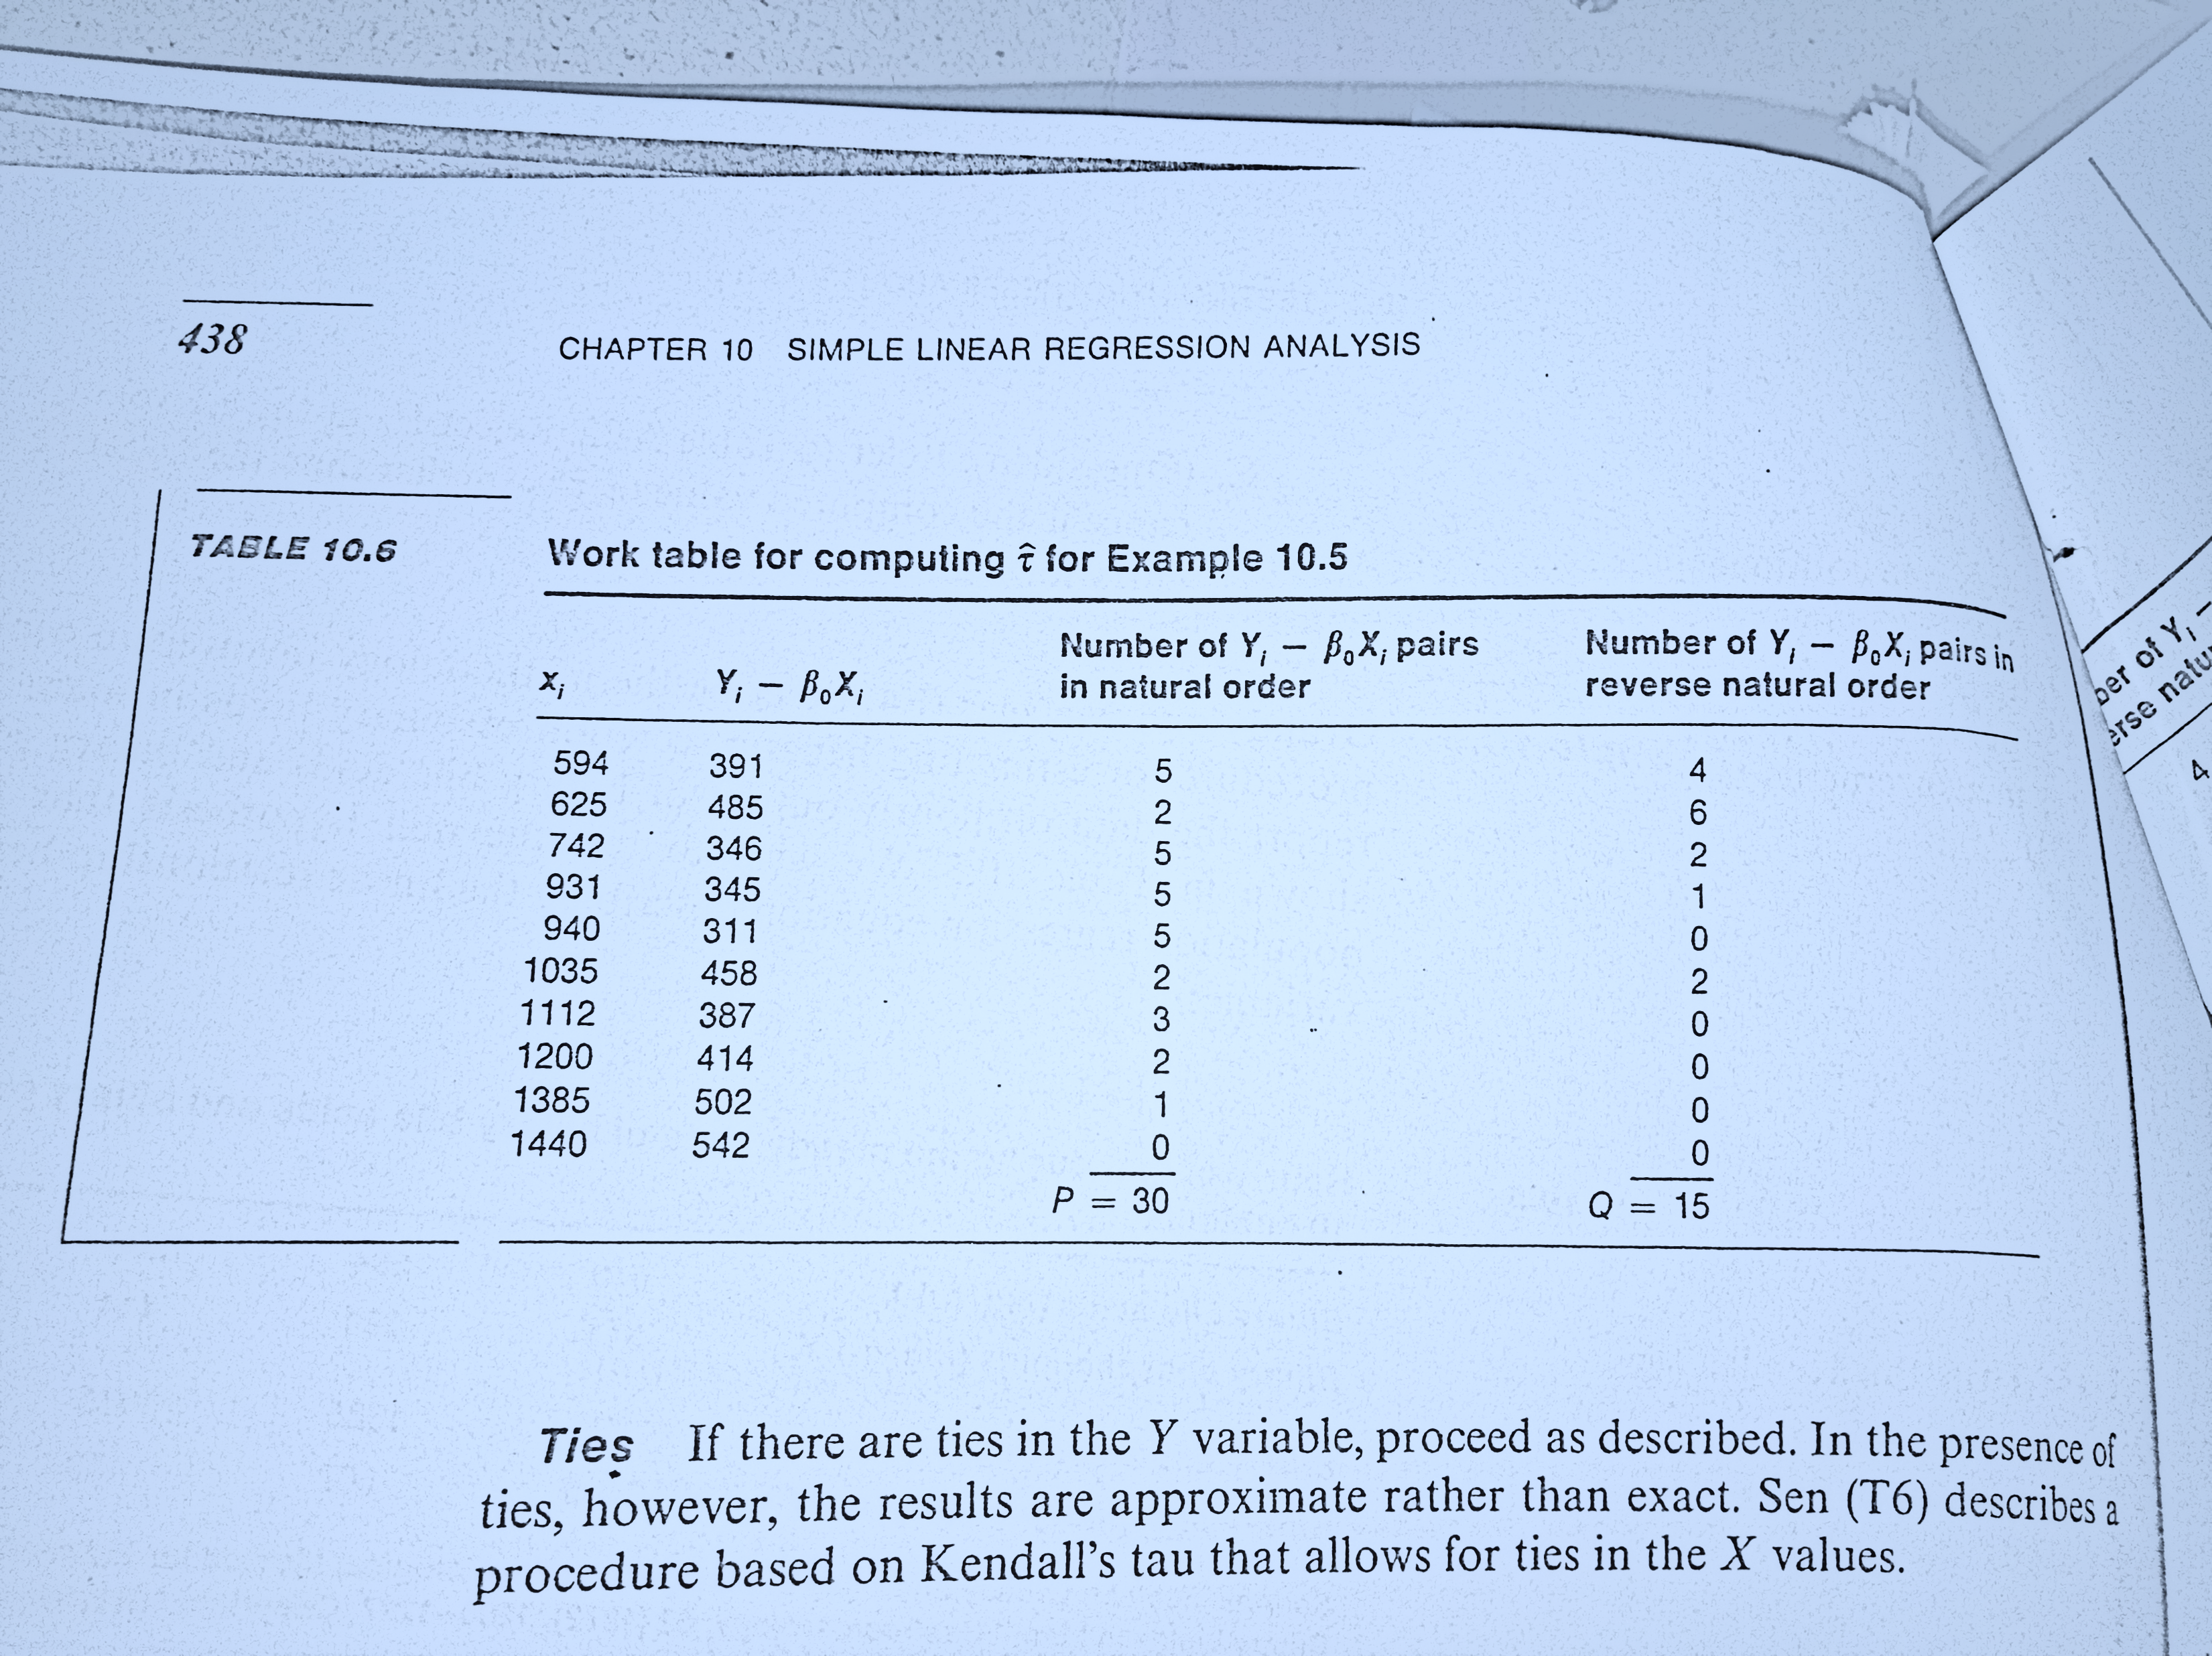
Work Table:

