Slide 1
Confidence Interval for median difference based on Wilcoxon Test
We may construct a confidence interval for the median difference based on the Wilcoxon matched-pairs signed-ranks test if the assumptions underlying that test are met.
We may construct the interval graphically or arithmetically.

Slide 2
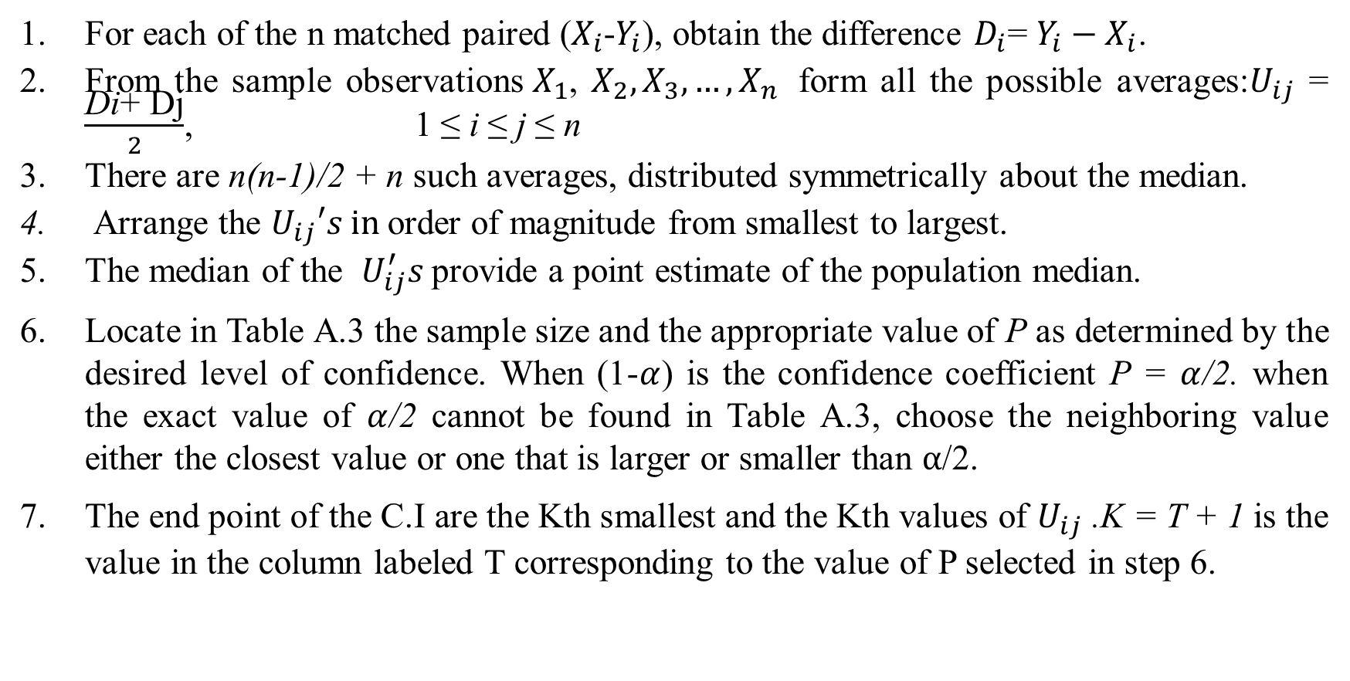
Arithmetic Procedure:
For each of the n matched paired ($X_{i}$-$Y_{i}$), obtain the difference $D_{i}$= $Y_{i}−X_{i}$.
From the sample observations${ X}_{1}$, $X_{2},X_{3},…, X_{n }$ form all the possible averages:$U_{ij}$ = $\frac{\text{Di}\text{+ }\text{D}\text{j}}{2}$, 1 ≤ i ≤ j ≤ n
There are n(n-1)/2 + n such averages, distributed symmetrically about the median.
Arrange the $U_{ij}′s in$order of magnitude from smallest to largest.
The median of the $U_{ij}^{′}s$provide a point estimate of the population median.
Locate in Table A.3 the sample size and the appropriate value of P as determined by the desired level of confidence. When (1-$α$) is the confidence coefficient P = $α$/2. when the exact value of $α$/2 cannot be found in Table A.3, choose the neighboring value either the closest value or one that is larger or smaller than $α$/2.
The end point of the C.I are the Kth smallest and the Kth values of $U_{ij}$ .K = T + 1 is the value in the column labeled T corresponding to the value of P selected in step 6.

Slide 3
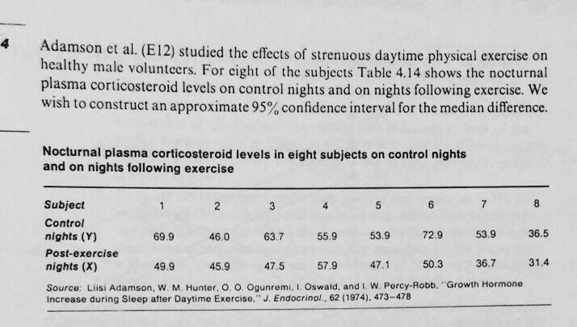
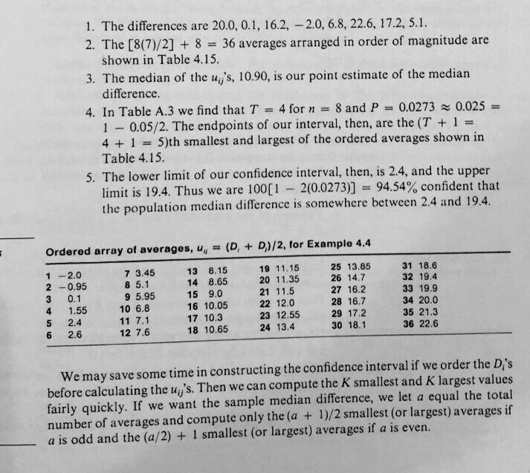
Example: Solution:

Slide 4
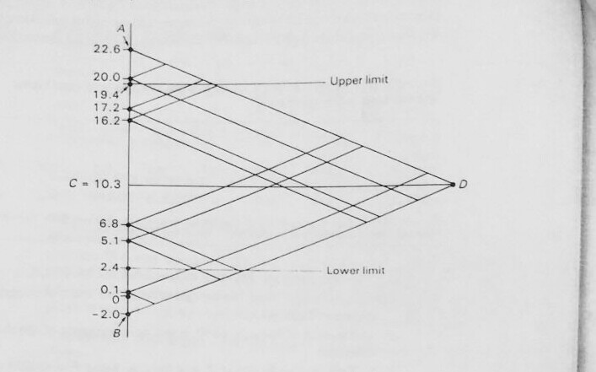
Graphical Procedure: Example 4.4 from Daniel’s Book

Slide 5
For each of the n matched paired ($X_{i}$-$Y_{i}$), obtain the difference $D_{i}$= $Y_{i}−X_{i}$.
Plot the difference on the vertical axis of the graph.
Label the largest difference A and the smallest difference B. In example 4.4, A=22.6 and B= -2.0
Find the point halfway between A & B and label it C. In the example, C appears on the graph at 10.3.
Draw a line of convenient length through C, perpendicular to the vertical axis. Label the end point of this line D.
Connect AD and DB with straight lines to from the triangle ADB.
Draw a line parallel to BD from each data point on the vertical axis to line AD.
Draw a line parallel to AD from each data point on the vertical axis to line BD.
To locate the upper confidence limit consult Table A.3 to determine K. Draw a horizontal line from the kth intersection with the vertical axis. The point of this line and the vertical axis is the upper limit of the confidence interval which is 19.4 from the example.
To locate the lower limit, begin with point B and count up to the kth intersection. Draw a horizontal line. The point at which the line intersects the vertical axis is the lower limit is about 2.4.

