Slide 1
APPLICATION OF PHARMACOKINETICS IN HEPATIC DISEASES
4th Prof.
Pharm. D

Slide 2
Introduction
Acute liver impairment interferes with drug metabolism and elimination.
Chronic liver impairment affects all parameters of pharmacokinetic.
Because most drugs are metabolized by the liver, it is susceptible to drug toxicity.
Impaired liver function greatly increases the risks of adverse drug effects.

Slide 3
Introduction Cont’d
Many drugs change liver function tests without clinical signs of liver dysfunction.
Hepatotoxicity is potentially life threatening.
Liver is able to function with as little as 10% of undamaged hepatic cells.
With severe hepatic impairment, extrahepatic metabolism becomes more important.

Slide 4
Introduction Cont’d
People at risk for impaired liver function include:
Primary liver disease (e.g., hepatitis, cirrhosis).
Diseases that impair blood flow to the liver (heart failure, shock, major surgery, or trauma).
Hepatotoxic drugs.
Malnourished people or those on low-protein diets.

Slide 5
General guidelines
General guidelines when using drugs include:
Clinical signs for hepatotoxicity should be sought (nausea, vomiting, jaundice, hepatomegaly).
Hepatotoxic drugs should be avoided if possible: (acetaminophen, INH, statins, methotrexate, phenytoin, aspirin and alcohol).

Slide 6
General guidelines Cont’d
Monitoring liver tests:
Serum bilirubin levels above 4 to 5 mg/dl
Prothrombin time greater than 1.5 times control
Serum albumin below 2.0 g/dl
Elevated alanine and aspartate aminotransferases (ALT & AST).

Slide 7
EFFECT OF HEPATIC DISEASES ON PHARMACOKINETIC PARAMETERS

Slide 8
DRUG DELIVERY RATE
An important variable of drug elimination is the rate of drug delivery to the organ of elimination.
Portal hypertension may divert blood away from the liver.
Within the liver, disease may decrease overall liver blood flow as well as directing the blood flow to different parts (shunting).
The most highly perfused areas may not be those with most functional enzymes.

Slide 9
Absorption
Some oral drugs are extensively metabolized in the liver.
This process is called the first-pass effect or presystemic metabolism.
Systemic bioavailability is the product of absorption and first-pass effect.
Liver disease decreases first-pass metabolism and so increase bioavailability.
With cirrhosis, oral drugs are distributed directly into the systemic circulation.
This means that oral drugs metabolized in the liver must be given in reduced doses.

Slide 10
Absorption Cont’d
The oral bioavailability of a number of drugs with intermediate to high hepatic extraction ratios has indeed been shown to be significantly increased in patients with liver cirrhosis.
e.g. the bioavailability of the sedative agent clomethiazole is increased more than 10-fold in patients with cirrhosis. Propranolol and verapamil also show increased bioavailbility owing to a decrease first-pass metabolism.

Slide 11
EXTRACTION RATIO (E)
CL = Qb X E
Where
Qb=blood flow to the organ
CL= total clearance
The extraction ration varies between 0 and 1 and describes the amount of the drug that is eliminated from the blood compared to the total quantity in the blood.

Slide 12
EXTRACTION RATIO (E) Cont’d
i) High Extraction:
‘E’ close to 1
Liver clearance is dependant only on blood flow through the liver.
Drugs with high extraction by the liver are very sensitive to altered liver blood flow.
E.g. Clomethiazole, Verapamil, Morphine, Propranolol, Lidocaine.

Slide 13
EXTRACTION RATIO (E) cont’d
ii) Low Extraction:
Extraction ratio close to 0
Blood flow becomes less important unless the blood flow is severely restricted, leading to hepatic damage.
The hepatic clearance of poorly extracted drugs is mainly influenced by changes in plasma protein binding and intrinsic hepatic clearance of the unbound drug.
Clearance of low extraction drugs is said to be enzyme capacity-limited.
e.g. theophylline, phenytoin, tolbutamide, diazepam, warfarin

Slide 14
CLEARANCE
Pharmacokinetic alterations in patients with hepatic diseases result in complex changes in total and bound drug in plasma and thus, clearance of the drug from the body.
Normal clearance is:
ClH = LBF. (Fb.Cl’int)
LBF+ (Fb.Cl’int)
Where:
LBF= liver blood flow
Fb= unbound fraction of drug
Cl’int= Intrinsic clearance

Slide 15
CLEARNCE CONT’D
For drugs with low hepatic extraction ratio (<30%) value of LBF is much greater than unbound fraction of the drug in blood and intrinsic clearance of the compound (LBF>>Fb.Cl’int) and sum of denominator is equal to LBF. Thus eq.becomes
ClH = LBF. (Fb.Cl’int) = (Fb.Cl’int) LBF
Opposite situation exist for drugs having high hepatic extraction ratio (>70%), thus equation becomes
ClH = LBF. (Fb.Cl’int) = LBF
(Fb.Cl’int)

Slide 16
CLEARNCE CONT’D
Half-life:
t1/2= (0.693 . V)
Cl
Where:
V= volume of distribution
So, any change in clearance is directly going to affect the half-life of the drug.
Volume of Distribution:
V=VB+ (FB.VT/FT)
Where:
V=apparent volume of distribution
VB= blood volume
FB and FT= free fraction of drug in blood and extravascular tissues

Slide 17
Metabolism
For the drugs eliminated by the liver, clearance of unbound drug is dependant upon metabolic enzyme activity or, less frequently, upon hepatobiliary transport activity.
A reduction in absolute liver cell mass and/or a decrease in enzyme level or activity due to alteration in the function of surviving cells may lead to impaired metabolism of a number of drugs.

Slide 18
Metabolism Cont’d
Most drugs are metabolized in the liver by cytochrome P450 [CYP] or the microsomal enzymes.
CYP system consists of 12 groups:
Nine of them metabolize endogenous substances.
Three of them metabolize drugs.
The three groups that metabolize drugs are: CYP1 to CYP3.

Slide 19
Metabolism Cont’d
The CYP3 metabolizes 50% of drugs, the CYP2 45%, and the CYP1 group 5%.
Excretion decreases when the liver cannot metabolize lipid-soluble drugs into water-soluble ones to be excreted by the kidneys.
An impaired liver cannot synthesize adequate amounts of metabolizing enzymes.

Slide 20
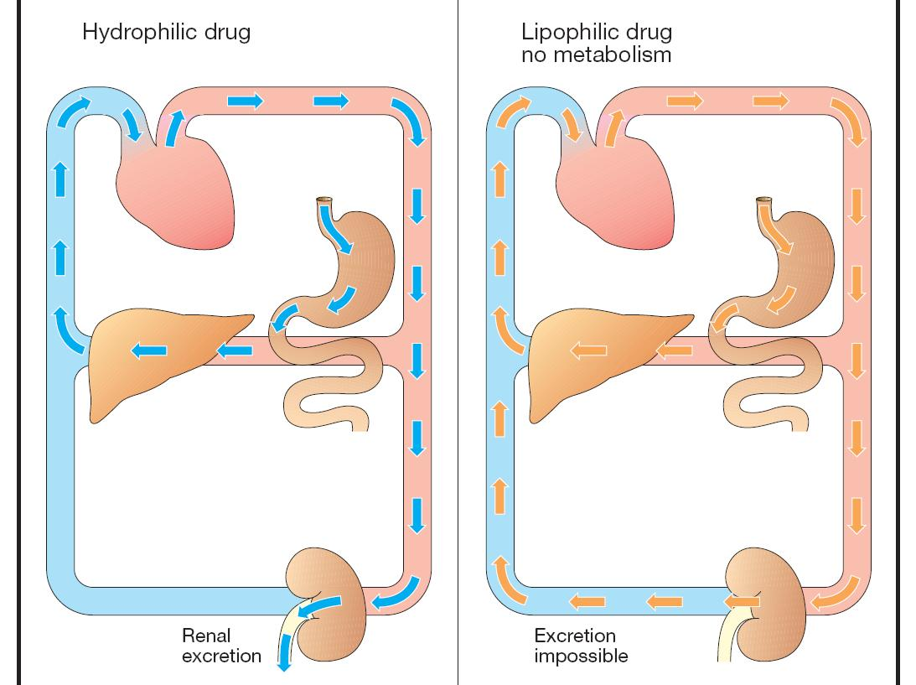
Elimination of drugs

Slide 21
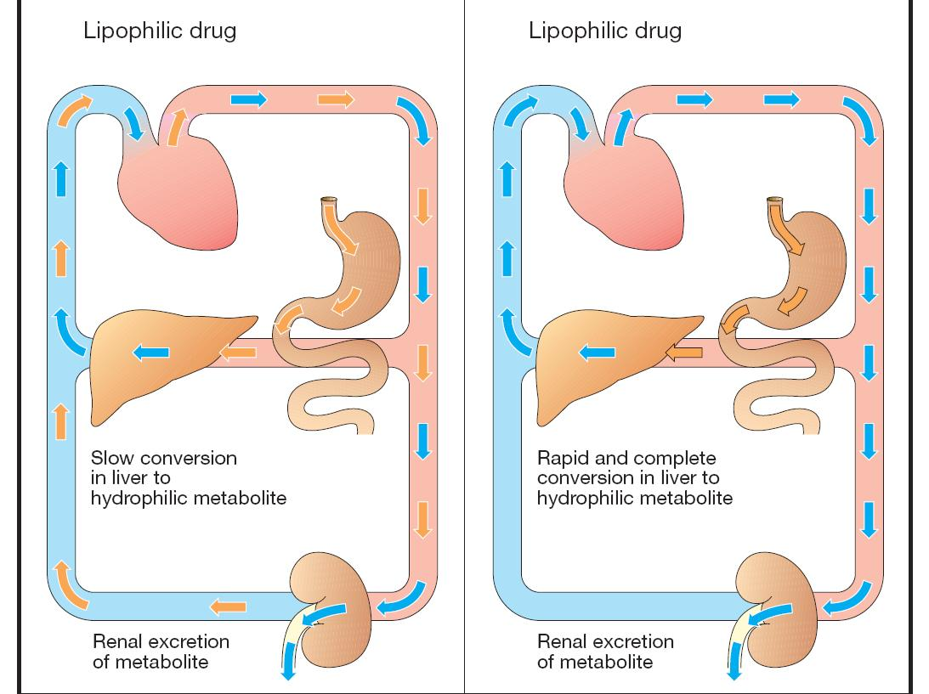

Slide 22
Metabolism Cont’d
Dosage should be reduced for drugs that are extensively metabolized in the liver including:
Cimetidine and Ranitidine
Diazepam and Lorazepam
Morphine and Meperidine (Pethidine)
Phenytoin
Propranolol
Verapamil.

Slide 23
Drug Effect on Liver
With chronic administration, some drugs increase metabolizing enzymes in the liver: enzyme induction.
Enzyme induction accelerates drug metabolism and larger doses is required.
Rapid metabolism also increases the production of toxic metabolites.
Enzyme induction does not occur for 1-3 weeks because new enzymes must be synthesized.

Slide 24
Drug Effect on Liver Cont’d
Enzyme inducers consist of: phenytoin, rifampin, phenobarbital, ethanol, and cigarette smoking.
Tolerance and cross-tolerance are attributed to activation of liver metabolizing enzymes.
They also are attributed to decreased sensitivity or numbers of receptor sites.

Slide 25
Drug Effect on Liver Cont’d
Metabolism can be decreased in a process called enzyme inhibition.
It occurs with co-administration of drugs that compete for the same metabolizing enzymes.
In this case, smaller doses of the slowly metabolized drug is needed to avoid toxicity.
Enzyme inhibition occurs within hours or days of starting an inhibiting agent.
Enzyme inhibitors consist of: Cimetidine, fluoxetine, and ketoconazole.

Slide 26
Drug Effect on Liver Cont’d
Some drugs indirectly affect liver function:
Epinephrine decreases blood flow by constricting hepatic artery and portal vein.
β blockers decrease blood flow by decreasing cardiac output.

Slide 27
Liver Blood Flow
Hepatic metabolism also depends on hepatic blood flow.
Hepatic blood flow ↓ => delivery of drug to hepatocytes ↓ => drug metabolism ↓ => drug toxicity ↑

Slide 28
Protein Binding
Protein binding affects distribution.
The impaired liver is unable to synthesize plasma proteins (albumin) adequately.
Liver impairment causes accumulation of substances (bilirubin) that displace drugs from protein-binding sites.

Slide 29
Protein Binding Cont’d
Chronic liver disease (e.g. cirrhosis) is usually accompanied by reduced synthesis of albumin, leading to hypoalbuminaemia and reduced drug binding to plasma proteins, leading to increased free fraction of some highly bound drugs by as much as 50-100%.
Decreased protein binding for high-extraction drugs will increase the apparent volume of distribution and the half-life.
Whether the clearance of these drugs is affected will mainly depend on the effects of disease on liver perfusion. If liver perfusion decreases (and CLint and Vd are stable) then free drug levels will rise, with the potential for increased toxicity.

Slide 30
Protein Binding Cont’d
For low-extraction drugs the effects of liver diseases are more difficult to predict.
Effects of clinical importance occur due to decreased protein binding and reduced metabolism. The net effect is higher free drug concentrations.
Water-soluble drugs will have a significant increase in their volumes of distribution in patients with ascites, possibly necessitating larger loading doses.

Slide 31
Protein Binding Cont’d
When protein binding ↓ => free drug ↑ => drug distribution to sites of action & elimination ↑
=> onset of drug action ↑
=> duration of action ↓
When protein binding ↓ => peak blood levels and adverse effects ↑

Slide 32
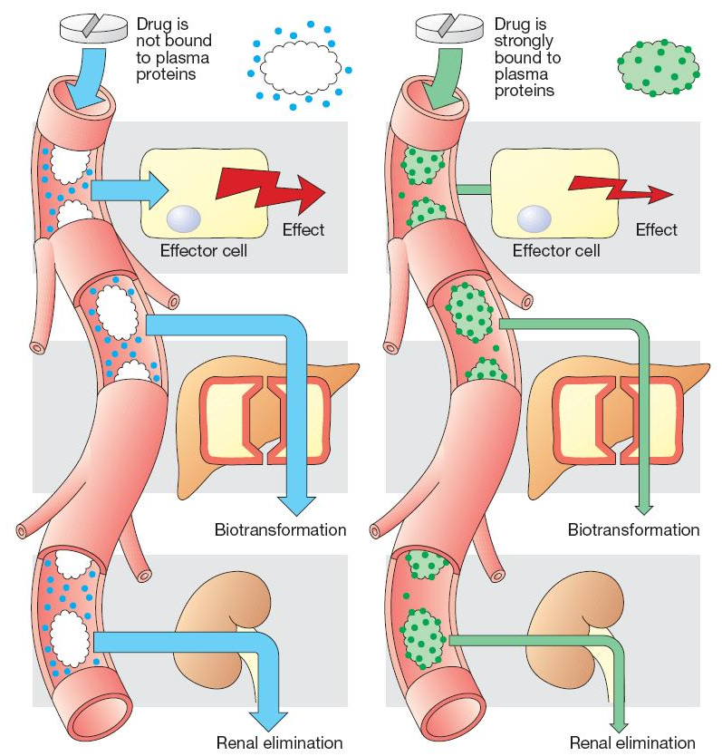

Slide 33
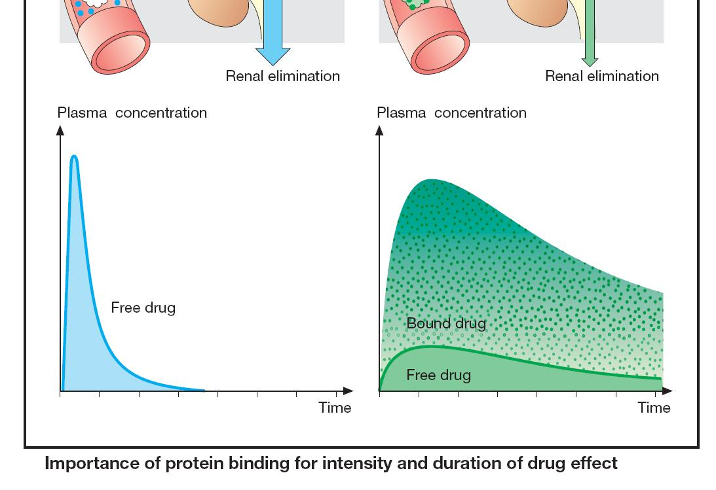

Slide 34
Age Effect
Pharmacokinetics differs in neonates, especially prematures, because their organs are not fully developed.
Until 1 year, liver function is still immature.
Children of 1 to 12 years have increased activity of metabolizing enzymes.
After 12 years of age, children handle drugs similarly to adults.

Slide 35
Age Effect Cont’d
In elderly, physiologic changes alters all pharmacokinetic processes in the liver.
Many drugs are metabolized more slowly and accumulate with chronic administration.

Slide 36
Specific Drugs
Potentially hepatotoxic drugs include:
Acetaminophen
Halothane
Isoniazid
Sodium Valproate
Phenytoin
Amiodarone
Erythromycin
Oral Contraceptives
Trimethoprim-Sulfamethoxazole

Slide 37
Some Features of Toxic and Drug-Induced Hepatic Injury

