Slide 1
APPLICATIONS OF PHARMACOKINETICS IN RENAL DISEASES
4th Prof.
Pharm.D

Slide 2
Kidney
The kidney is an important organ in regulating body fluids, electrolyte balance, removal of metabolic waste and drug excretion from the body.
Creatinine Clearance:
It is the rate of urinary excretion of creatinine/serum creatinine. It can be calculated directly by determining the patient’s serum creatinine concentration and rate of urinary excretion and the rate of urinary excretion of creatinine. Creatinine clearance is used most extensively as a measurement of GFR.
Clearance:
Clearance may be defined as the volume of fluid cleared of drug from the body per unit of time. Its units are ml/min or L/hr.

Slide 3
EFFECT OF RENAL DISEASES ON PHARMACOKINETICS

Slide 4
Absorption
Absorption of oral drugs may be decreased indirectly in renal failure by:
Delayed gastric emptying
Changes in gastric pH
GI symptoms such as vomiting and diarrhea
Edema of the GI tract (in the presence of generalized edema).
In CRF, gastric pH is altered by:
Oral alkalinizing agents (sodium bicarbonate, citrate).
Use of antacids for phosphate-binding effects.
This causes:
Decrease in absorption of oral drugs that require an acidic environment for absorption.
Increases absorption of drugs that are absorbed from a more alkaline environment.

Slide 5
Effects of Renal Disease on Drug Absorption
E.g. The absorption of D -xylose, a marker compound used to evaluate small intestinal absorptive function, was slowed (0.555 hr vs. 1.03 hr) and less complete (48.6% vs. 69.4%) in patients with chronic renal failure than in normal subjects.
Also, the patients with impaired renal function have reduced bioavailability of furosemide and pindolol.
However, it also is possible that impaired renal function will result in increased bioavailability of drugs exhibiting first - pass metabolism when the function of drug metabolizing enzymes is compromised e.g. propranolol.

Slide 6
Distribution
Distribution of drugs is altered by changes in ECF, plasma protein binding, and tissue binding.
Water-soluble drugs are distributed in ECF, including edema fluid, which is increased in renal impairment.
Metabolic acidosis & respiratory alkalosis that occur in renal impairment alter tissue distribution of some drugs.
For example, digoxin can be displaced from tissue by metabolic products that cannot be excreted by impaired kidneys.
Impaired renal function is associated with important changes in the binding of some drugs to plasma proteins. In some cases the tissue binding of drugs is also affected.

Slide 7
Protein Binding
Albumin is the main drug-binding plasma protein for acidic drugs.
Drug binding with albumin is decreased with renal impairment.
This is due to decreased albumin or reduced binding capacity.
Reasons for decreased albumin include:
Nephrotic states in which albumin is lost in the urine.
Hypermetabolic states (stress, trauma, sepsis) in which protein breakdown exceeds protein synthesis.
Liver disease that decreases hepatic synthesis of albumin.
Reasons for reduced binding capacity include:
Uremic toxins that compete with drugs for binding sites.
Structural changes in the albumin molecule.

Slide 8
Protein Binding Cont,d
When less drug is bound to albumin:
More unbound drug distributes into sites of metabolism and excretion.
The higher levels of unbound drug can result in toxicity.
Faster elimination can decrease drug half-life and therapeutic effects.
For basic drugs (clindamycin, propafenone), alpha1-acid glycoprotein (AAG) is the main binding protein.
The amount of AAG increases in those with renal transplants and those receiving hemodialysis.
In these patients larger amounts of a basic drug is bound and a smaller amount is free to exert an effect.

Slide 9
Protein Binding Cont,d
Plasma protein binding of acidic drugs:
Phenytoin is an acidic drug. In patients with normal renal function, 92% of the phenytoin in plasma is protein bound. However, the percentage that is unbound or “free” rises from 8% in these individuals to 16%, or more, in hemodialysis-dependent patients. In a study comparing phenytoin pharmacokinetics in normal subjects and uremic patients, after a single low dose of this drug, the results were as follow:
NORMALS UREMICPATIENTS
% UNBOUND (f_{u}) 12% 26%
V_{d(AREA)} 0.64 L/kg 1.40 L/kg
HEPATIC CLEARANCE (CLH) 2.46 L/hr 7.63 L/hr
INTRINSIC CLEARANCE (CLint) 20.3 L/hr 29.9 L/hr
The three-fold increase in hepatic clearance that was observed in uremic patients was primarily the result of decreased phenytoin binding to plasma proteins.

Slide 10
FREE AND TOTAL PHENYTOIN LEVELS (DOSE = 300 MG/DAY)
■ BOUND [PHENYTOIN]
■ FREE [PHENYTOIN]
[PHENYTOIN] μg/mL

Slide 11
Protein Binding Cont,d
Plasma protein binding of basic and neutral drugs:
The protein binding of basic drugs tends to be normal or only slightly reduced. In some cases, this may reflect the facts that these drugs bind to α1–acid glycoprotein and that concentrations of this glycoprotein are higher in hemodialysis-dependent patients than in patients with normal renal function.
Tissue binding of drugs:
The distribution volume of some drugs also can be altered when renal function is impaired.
E.g. impaired renal function is associated with a decrease in digoxin Vd (L/kg). This presumably reflects a reduction in tissue levels of Na/K-ATPase, an enzyme that represents a major tissue-binding site for digoxin.

Slide 12
Metabolism
Metabolism can increase, decrease, or does not change by renal impairment.
One factor is alteration of drug metabolism in the liver:
In uremia, reduction and hydrolysis is slower, but oxidation by CYP enzymes and conjugation reactions proceed at normal rates.
Another factor is the inability of impaired kidneys to eliminate drugs and active metabolites:
Metabolites may have pharmacologic activity similar to or different from that of the parent drug.
A third factor is impaired renal metabolism of drugs.
The kidney contains many of the same metabolizing enzymes found in the liver.
For example it has renal CYP enzymes, which metabolize some chemicals and drugs.

Slide 13
Metabolism CONT’D
Most drugs are not excreted by the kidneys unchanged but are first biotransformed to metabolites which are then excreted.
Renal failure not only may retard the excretion of these metabolites, which in some cases have important pharmacologic activity, but, in some cases, alters the metabolic clearance of drugs.
The impact of impaired renal function on drug metabolism is dependent on the metabolic pathway.
In most cases, it is unclear how much impairment in renal function needs to be present before drug metabolism is affected.

Slide 14
EFFECT OF RENAL DISEASE ON PHASE I DRUG METABOLISM
OXIDATIONS Normal or Increased
Example: Phenytoin
REDUCTIONS Slowed
Example: Hydrocortisone
HYDROLYSIS
Plasma esterase Slowed
Example: Procaine
Plasma peptidase Normal
Example: Angiotensin
Tissue peptidase Slowed
Example: Insulin

Slide 15
EFFECT OF RENAL DISEASE ON PHASE II DRUG METABOLISM
GLUCURONIDATION Normal
Example: Hydrocortisone
ACETYLATION Slowed
Example: Procainamide
GLYCINE CONJUGATION Slowed
Example: p-Aminosalicylic acid
O-METHYLATION Normal
Example: Methyldopa
SULFATE CONJUGATION Normal
Example: Acetaminophen

Slide 16
Excretion
Excretion of many drugs is reduced in renal failure.
The kidneys normally excrete both the parent drug and metabolites produced by the liver.
Renal excretion includes:
glomerular filtration,
tubular secretion, and
tubular reabsorption all of which is affected by renal impairment.

Slide 17
Excretion Cont,d
An adequate fluid intake is required to excrete drugs by the kidneys.
Any factor that depletes ECF increases the risk of worsening renal impairment which include:
Inadequate fluid intake
Diuretic drugs
Loss of body fluids (bleeding, vomiting, diarrhea)

Slide 18
Excretion Cont,d
The effects of decreased renal function on drug elimination have been examined most extensively. This is appropriate since only elimination clearance (CLE) and drug dose, expressed as amount/time, (I) determine the average steady state concentration of drug in the body (Css):
Css = I / CLE
For many drugs, CLE actually consists of additive renal (CLR) and non renal (CL NR) components, as indicated by the following equation:
CLE = CLR + CLNR
Non-renal clearance is usually equated with drug metabolism, but also could include hemodialysis and other methods of drug removal.
In fact, even the metabolic clearance of a drug frequently consists of additive contributions from several parallel metabolic pathways.
The characterization of drug metabolism by a clearance term usually is appropriate, since the metabolism of most drugs usually can be described by first –order kinetics within the range of therapeutic drug concentrations.

Slide 19
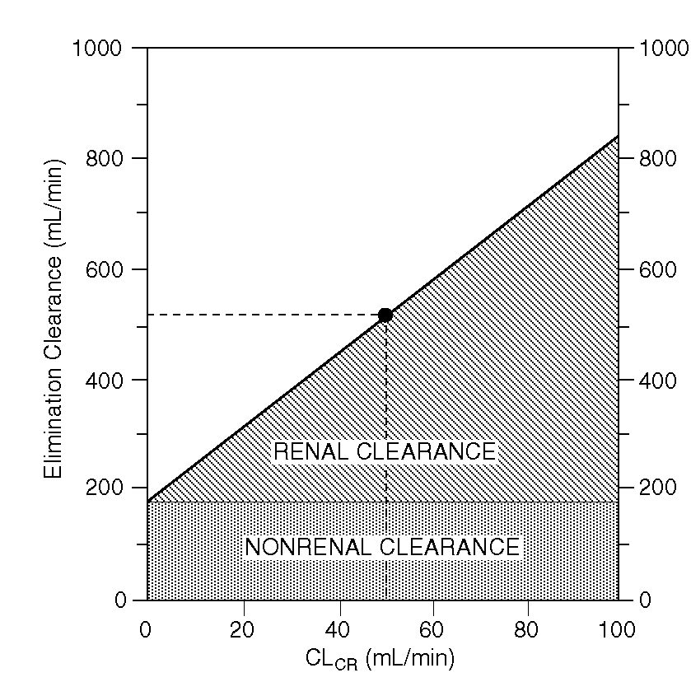
NOMOGRAM FOR CIMETIDINE DOSING*
CL_{E} ≈ 25% OF NORMAL IF FUNCTIONALLY ANEPRHIC

Slide 20
Excretion Cont,d
In the case of cimetidine, Schentag et al. obtained slightly lower estimates of cimetidine % urinary excretion in normal subjects and of CLE in patients with duodenal ulcer and in older normal subjects.
Since only one-fourth of the dose is eliminated non-renally, the data indicate that functionally anephric patients who receive half the usual cimetidine dose will have potentially toxic blood levels that are twice those recommended for patients with normal renal function.

Slide 21
Excretion Cont,d
When dose adjustments are needed for patients with impaired renal function, they can be made by reducing the drug dose or by lengthening the dosing interval.
It is often convenient to administer doses of drugs that have a short elimination half-life at some multiple of their elimination half life.
The multiple that is used is determined by the therapeutic index of the drug. The expected half life can be calculated from the following equation:
_{T1/2 =} _{0.693 . Vd(area)}
_{CLE}
and the usual dose can be administered at an interval equal to the same multiple of the increased half life.
Dose-interval adjustment is usually necessary when safety and efficacy concerns specify a target range for both peak and trough plasma levels.

Slide 22
Excretion Cont,d
Mechanisms of Renal Excretion of Drugs:
GLOMERULAR FILTRATION:
Affects all drugs and metabolites of appropriate molecular size.
Influenced by protein binding
Drug Filtration Rate = GFR x f_{u} x [Drug]
(f_{u} = free fraction)
RENAL TUBULAR SECRETION:
Not influenced by protein binding
May be affected by other drugs, etc.
EXAMPLES:
Active Drugs: ACIDS – Penicillin
BASES – Procainamide
Metabolites: Glucuronides, Hippurates, etc.

Slide 23
Excretion Cont,d
REABSORPTION BY NON-IONIC DIFFUSION
Affects weak acids and weak bases.
Only important if excretion of free drug is major elimination pathway.
EXAMPLES:
Weak Acids: PHENOBARBITAL
Weak Bases: QUINIDINE
ACTIVE REABSORPTION
Affects ions, not proved for other drugs.
EXAMPLES:
Halides: FLUORIDE, BROMIDE
Alkaline Metals: LITHIUM

Slide 24
Age Effect
In the kidneys of elderly, blood flow, GFR, and tubular secretion of drugs is decreased.
All of these changes slow excretion and promote accumulation of drugs in the body.
Impaired kidney function greatly increases the risks of adverse drug effects.

Slide 25
Creatinine
Drug therapy must be individualized according to the extent of renal impairment.
This is determined by measuring creatinine, which is used to calculate creatinine clearance as a measure of the GFR.
Creatinine is determined by muscle mass and the GFR, so its measurement cannot be used as the sole indicator of renal function.
The exception is a young, relatively healthy, well-nourished person with a sudden acute illness.

Slide 27
Creatinine Cont,d
Estimations of creatinine clearance are more accurate for:
Clients with stable renal function (stable serum creatinine).
Average muscle mass (for their age, weight, and height).
Estimations are less accurate for:
Emaciated and obese clients.
For those with changing renal function (as in acute illness).

Slide 28
Creatinine Cont,d
Serum creatinine is a relatively unreliable indicator of renal function in elderly clients.
Because they have diminished muscle mass, they may have a normal creatinine even if their GFR is markedly reduced.
Some drugs (cimetidine and trimethoprim) increase creatinine and create a false impression of renal failure.
They interfere with secretion of creatinine into kidney tubules.

Slide 29
Drug selection
Drug selection is guided by renal function and the effects of drugs on renal function.
Many commonly used drugs may adversely affect renal function (NSAIDs or OTC drugs).
Some drugs are excreted exclusively by the kidneys (aminoglycosides, lithium).
Some drugs are contraindicated in renal impairment (tetracyclines except doxycycline).
Drugs can be used if safety guidelines are followed (reducing dosage, using TDM and renal function tests, avoiding dehydration).
Drugs known to be nephrotoxic should be avoided when possible.
In some instances, however, there are no effective substitutes and nephrotoxic drugs must be given.
Some commonly used nephrotoxic drugs include aminoglycoside antibiotics, amphotericin B, and cisplatin.

Slide 30
Dosage
Dosage of many drugs needs to be decreased in renal failure including:
Aminoglycoside antibiotics
Most cephalosporin antibiotics
Fluoroquinolones
Digoxin
For some drugs, a smaller dose or a longer interval is recommended in:
Moderate renal insufficiency (creatinine clearance 10 to 50 mL/min.).
Severe renal insufficiency (creatinine clearance < 10 mL/min.).

