Slide 1
VIRUS
2ND PROF.
PHARM.D

Slide 2
Definition
Viruses are non cellular particles made up of genetic material and protein that can invade living cells.

Slide 3
Discovery of viruses
Edward Jenner (1798), introduced the term virus in microbiology.
Edward Jenner noticed that milk maids who were infected with cowpox, develop immunity against small pox.
He inoculated a boy with the vesicle fluid taken from the hand of infected maid.
The boy developed immunity against small pox.
Edward Jenner assumed that the vesicle fluid that has been taken from the hand of the milk maid contained the poison (virus), that was responsible for immunity.

Slide 4
Discovery of viruses
In 1884 C. Chamber land, in Pasteur's lab, discovered that if you passed a liquid containing bacteria through an unglazed PORCELAIN tube, the bacteria were COMPLETELY RETAINED and the solution that passed through (the FILTRATE) was sterile.
  In1892 D. IWANOWSKI applied this test to a filtrate of plants suffering from TOBACCO MOSAIC DISEASE with shocking results; the filtrate the fully capable of producing the original disease in the new host.

Slide 5
Discovery of viruses
  Nothing could be seen in the filtrates using the most powerful microscopes, nor could anything be cultivated from the filtrates.
  Iwanowski concluded that the bacteria was so small / or they made a filterable toxin.

Slide 6
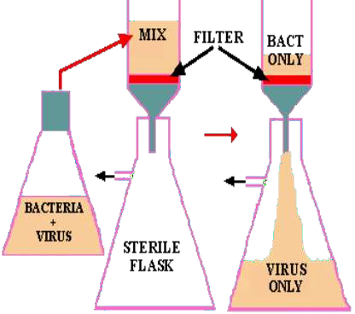
Discovery of Viruses
Filtration of a mixture of bacteria and viruses. If a mixture of viruses and bacteria are filtered through a bacterial-proof filter (red), the viruses will pass through into the filtrate in the flask. Filtered beer is produced by a similar process.

Slide 7
Discovery of Viruses
Martinus Willem Beijerinck (1897) coined the Latin name “virus” meaning poison
He ruled out the filterable toxin conclusion because the filtered sap are capable of causing undiluted infection.
The agent cannot be cultivated on nutrient media (need a host).
Wendell Stanley (1935) discovered this agent after crystallization and found viruses were made of nucleic acid and protein

Slide 8
Are Viruses living or non-living?
Biologists consider viruses to be non-living because:
-Are not cells
-Do not grow or respond to their surroundings
-Cannot make food, take in food, or produce wastes
-Viruses do not respond to stimuli.
They can only multiply if in another living cell

Slide 9
General characteristics of viruses
Viruses are smaller than bacteria, they range in size between 20-300 nanometer (nm).
Viruses contain only one type of nucleic acid, either DNA or RNA, but never both.
Viruses consist of nucleic acid surrounded by a protein coat.
Some viruses have additional lipoprotein envelope.
Viruses lack cellular organelles, such as mitochondria and ribosomes.

Slide 10
General characteristics of viruses
Viruses are obligate cellular parasites. They replicate only inside living cells.
Viruses replicate through replication of their nucleic acid and synthesis of the viral protein.
  Viruses do not multiply in chemically defined media.
Viruses do not undergo binary fission.

Slide 11
Virus and Living organisms
Viruses must infect a living cell in order to grow and reproduce.
They also take advantage of the host’s respiration, nutrition and all the other functions that occur in living things.
Therefore, viruses are considered to be parasites.

Slide 12
Virion
Complete virus particle : nucleic acid + protein coat, which may be surrounded by an envelope
It is the form in which the virus moves between cells or hosts
Viral Genome
EITHER RNA or DNA genome surrounded by a protective virus-coded protein coat (Capsid)

Slide 13
Viroids & Prions
•
Viroids
ss RNA genome and the smallest known pathogens.
Affects plants
Prions
Infectious particles that are entirely protein.
No nucleic acid
Highly heat resistant
Animal disease that affects nervous tissue
Affects nervous tissue and results in
  Bovine spongiform encephalitis (BSE) “mad cow disease”,
  Scrapie in sheep
  kuru & Creutzfeldt-Jakob Disease (CJD) in humans
•

Slide 14
Naming Viruses
International Committee on Taxonomy of Viruses names them based on three characteristics:
  Type of nucleic acid (DNA or RNA)
  Is the nucleic acid double or single stranded
  Presence or absence of nuclear envelope

Slide 15
Prokaryotes Vs. Eukaryotes Vs. Viruses
No membrane bound nucleus
Has a cell wall
Only a few organelles or none at all.
Has a capsule surrounding it
Three main types.
Nucleus with membrane
Only plants have cell wall
Contains many organelles
Has a lipid bi- layer membrane surrounding it.
Specialized by thousands of different sizes and shapes.
No nucleus
No membranes
No organelles
Cannot reproduce on its own
Generally not considered alive by most standards

Slide 16
Origin of virus
According to a hypothesis, viruses are bits of nucleic acid that ‘escaped’ from cellular organism.
Some traces are from animal cells, plant cells and bacterial cells.
Their multiple origins explain why viruses are species-specific.
However, some other have broader range of host cells

Slide 17
REACTION TO PHYSICAL AND CHEMICAL
AGENTS

Slide 18
Heat and Cold
Viral infectivity is generally destroyed by heating at 50–60°C for 30 minutes
Viruses can be preserved by storage at subfreezing temperatures and can thus be preserved in the dry state at 4°C.
pH
Viruses are usually stable between pH values of 5.0 and 9.0.
Some viruses (eg, enteroviruses) are resistant to acidic conditions.
All viruses are destroyed by alkaline conditions.

Slide 19


Radiation
Ultraviolet, x-ray, and high-energy particles inactivate viruses.
Formaldehyde
Formaldehyde destroys viral infectivity by reacting with nucleic acid.
Viruses with single-stranded genomes are inactivated much more readily than those with double-stranded genomes.
Ether Susceptibility
Ether susceptibility can be used to distinguish viruses that
possess an envelope from those that do not

Slide 20
Configuration of Virus
The DNA or RNA genome may be :
  ss – single stranded or
  ds – double stranded
Genomes may be either:
  (+) sense: Positive-sense viral RNA is identical to viral mRNA and thus can be immediately translated into protein by the host cell.
OR
  (-) sense: Negative-sense viral RNA is complementary to mRNA and thus must be converted to positive-sense RNA by an RNA polymerase before translation.

Slide 21
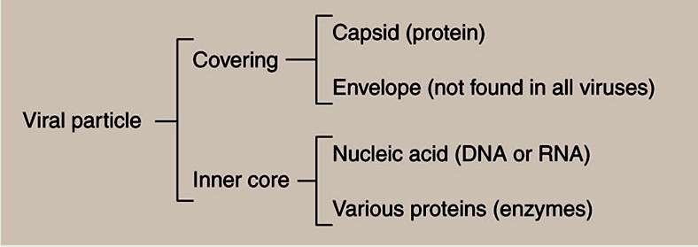

Slide 22

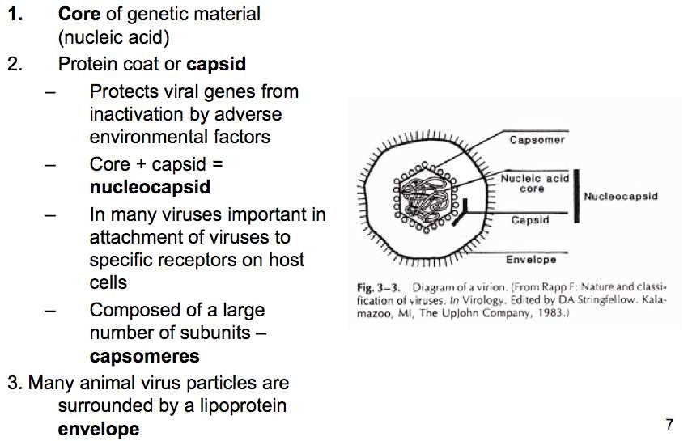
The nucleic acid genome plus the protective protein coat is called the nucleocapsid which may have icosahedral, helical or complex symmetry.

Slide 23

The Envelope
Enveloped viruses obtain their envelope by budding through a host cell membrane
In some cases, the virus buds through the plasma membrane but in other cases the envelope may be derived from internal cell membranes such as those of the Golgi body or the nucleus

Slide 24
The Envelope
Enveloped viruses do not necessarily have to kill their host cell in order to be released, since they can bud out of the cell - a process that is not necessarily lethal to the cell - hence some budding viruses can set up persistent infections

Slide 25
The Envelope
Enveloped viruses are readily infectious only if the envelope is intact (since the viral attachment proteins which recognize the host cell receptors are in the viral envelope)
This means that agents that damage the envelope, such as alcohols and detergents, reduce infectivity

Slide 26
General Morphology
Capsid Structure determines shape:
Helical Viruses = nucleic acid is inside a hollow cylindrical
capsid with a helical structure
Rabies, Ebola viruses, Tobacco Mosaic Virus
Polyhedral viruses = many sided; icosahedron is common with 20 equilateral triangles as sides and 12 vertices
Poliovirus, Adenovirus, herpes,
Complex structures
Pox virus & bacteriophage

Slide 27
ICOSAHEDRAL CAPSID
Icosahedral morphology is characteristic of the nucleocapsids of many “spherical” viruses
The icosahedral capsid structure of adenovirus is made up of three proteins, hexon, penton base, and ﬁber
Some proteins are associated with viral DNA, whereas others are associated with hexon and are involved in the formation of the capsid

Slide 28
HELICAL CAPSID
The icosahedral capsid structure of adenovirus is made up of three proteins, hexon, penton base, and ﬁber
Helical morphology is seen in nucleocapsids of many ﬁlamentous and pleomorphic viruses
Helical nucleocapsids are characterized by length, width, pitch of the helix, and number of protomers per helical turn

Slide 29
Bacteriophage
Viruses that infect bacterial cells are called bacteriophages (phages for short), which means ‘bacteria eaters’
These are large, complex viruses, with a characteristic head and tail structure
The double-stranded, linear DNA genome contains over 100 genes, and is contained within the icosahedral head

Slide 30
Bacteriophage
Much of the knowledge comes from studying bacteriophage, because they can be cultured easily within living bacteria.
Their tail fibers are the base used to attach themselves to bacterial host cell
The tail is the channel for their genetic material to be injected to the host cell.

Slide 31
Nomenclature of Viruses
Various approaches, (do not obey the binomial nomenclature) derived from:
Named after the diseases
eg. Measles virus, smallpox virus
Name after the places where the disease first reported
eg. Newcastle disease virus, Ebola virus, Norwalk virus, Bunyaviridae
Host and signs of disease
eg. Tobacco mosaic virus, cauliflower mosaic virus brome mosaic virus

Slide 32
Latin and Greek words
eg. Coronaviridae – “crown” Parvoviridae – “small”
Virus discovers
eg. Epstein-Barr virus
How they were originally thought to be contracted eg. dengue virus (“evil spirit”), influenza virus
(the “influence” of bad air)
Combinations of the above eg. Rous Sarcoma virus

Slide 33


Slide 34
Reasons beyond classification
Classification of virus been determined bythe structural and chemical composition of virus
Are apply to all plant viruses, animal viruses and bacterial viruses
Virus is acellular cell – cannot be categorised using taxonomic classification
It used International Committee on Taxonomy of Viruses (ICTV) to classify the viruses

Slide 35
Before discovery
Dermotropic – infected skin cell
Neurotrophic – infected nerve cell
Viscerotropic – infect organ of digestive tract
Pneumotropic – infected respiratory system

Slide 36
After discovery
Type and structure of their nucleic acids
Methods of replication
Host range
Chemical and physical characteristics

Slide 37
Classification
Viruses are not classified as members of the kingdoms
Do not obey the biological taxonomy
Generally based on:
1. Classical system
- eg. animal, plant, bacterial virus
- eg. naked or enveloped virus
Genomic - Baltimore classification
Serology - classification based on Diagnostic virology
- eg. Infectious bronchitis virus (IBV) of chickens
(a coronavirus) – 3 different types present, these types have significant antigenic differences, but perhaps very little genetic or biological difference between these viruses.

Slide 38
Classification of Viruses
The following criteria are used to classify viruses:
Morphology – structure of capsid
– presence or absence of envelope
Size of the virion
Type of host/host structures the virus infected
  Bacteriophages: infect bacterial cells
  Plant viruses infect plant cells
  Animal viruses are subgrouped by the tissues they attack:
a) Dermotrophic: if they infect the skin
b) Neurotrophic: if they infect nerve tissue
4. Genome composition – DNA / RNA
– ds/ss DNA and ds/ss RNA

Slide 39
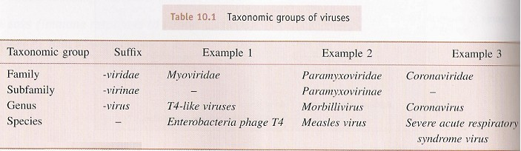
Classification of Viruses
Taxonomic groups – family, subfamily, genus and species
The names of virus families (family) are italicized
- End in Latin suffix –viridae
The genera (genus) end in the suffix – virus
The species – English common name

Slide 40
Viruses are divided into three groups, based on the morphology of the nucleocapsid and the arrangement of capsomeres.
Symmetry of viruses
Arrangement of capsomers in the virus.
Two primary shapes of virus is rod and spherical.
Rod shaped virus-helical symmetry
Spherical virus-icosahedron

Slide 41


Slide 42
Baltimore Classification of viruses
The division of the viruses into classes based on genome type and mode of replication and transcription
Suggested by David Baltimore – Seven Baltimore classes.
Major groups of viruses are distinguished first by their nucleic acid content as either DNA or RNA
RNA and DNA viruses can be single-stranded (ssRNA, ssDNA) or double-stranded (dsRNA, ssDNA)

Slide 43
7 class of Baltimore classification
Class
Description of genome and replication strategy
Example of bacterial virus
Example of animal virus
I Double stranded DNA genome | Lamda,T4 | Herpesvirus, poxvirus
II Single stranded DNA genome | ØX174 | Chicken anemia virus
III Double stranded RNA genome | Ø6 | Reovirus
IV Single stranded RNA genome plus sense | MS2 | Poliovirus
V Single stranded RNA genome minus sense |  | Influenza virus,Rabies virus
VI Single stranded RNA genome that replicated with DNA intermediate |  | Retrovirus
VII Double stranded DNA genome that replicates with RNA intermediate |  | Hepatitis B virus

Slide 44
Class I
Double-stranded (ds) DNA viruses are in class 1
The production of mRNA and genome replication in such viruses occurs as it would from the host genome.
Class II
Single-stranded(ss) DNA viruses.
These viruses form a double stranded DNA intermediate during replication and this intermediate used for transcription.
RNA polymerase requires double-stranded DNA as template.

Slide 45
Positive and Negative strand RNA viruses
The production of mRNA and genome replication is much different with RNA viruses (Class III-VI).
mRNA is the complementary base sequence to the template strand of DNA.
In virology, mRNA is said to be plus(+) configuration.
While its complement is said to be the minus (-) configuration.
How does these viruses replicate?
Cellular RNA polymerases do not catalyze formation of RNA from an RNA template but from DNA template.
RNA viruses whether plus, negative or double stranded require a specific RNA-dependant RNA polymerase.

Slide 46
Class IV
Positive-strand of RNA viruses
Viral genome is of the plus configuration and hence serve directly as mRNA.
The viruses required other protein, therefore mRNA encodes a virus specific and RNA dependent RNA polymerase.
Once synthesized, this polymerase makes complementary minus strands of RNA and then use as template to make more plus strand.

Slide 47
Class III and Class V
Class III (double-stranded RNA viruses)
Class V(negative strand RNA virus)
mRNA must be first synthesized, however cells does not have RNA polymerase.
To circumvent ,these viruses contain enzyme in the virion,enters cell along with the genomic RNA.
Therefore, in this case complementary plus strand is synthesized by RNA dependant RNA polymerase and used as mRNA.
Plus strand used as template to make more negative- strand genome.

Slide 48
Class VI
Single-stranded RNA genome that replicates with DNA intermediate.
This RNA virus require reverse transcriptase to copy the information found in RNA to DNA.
Class VII
Double-stranded DNA genome that replicates with RNA intermediate.
Required reverse transcriptase
Mechanism producing mRNA is similar in virus Class I

Slide 49
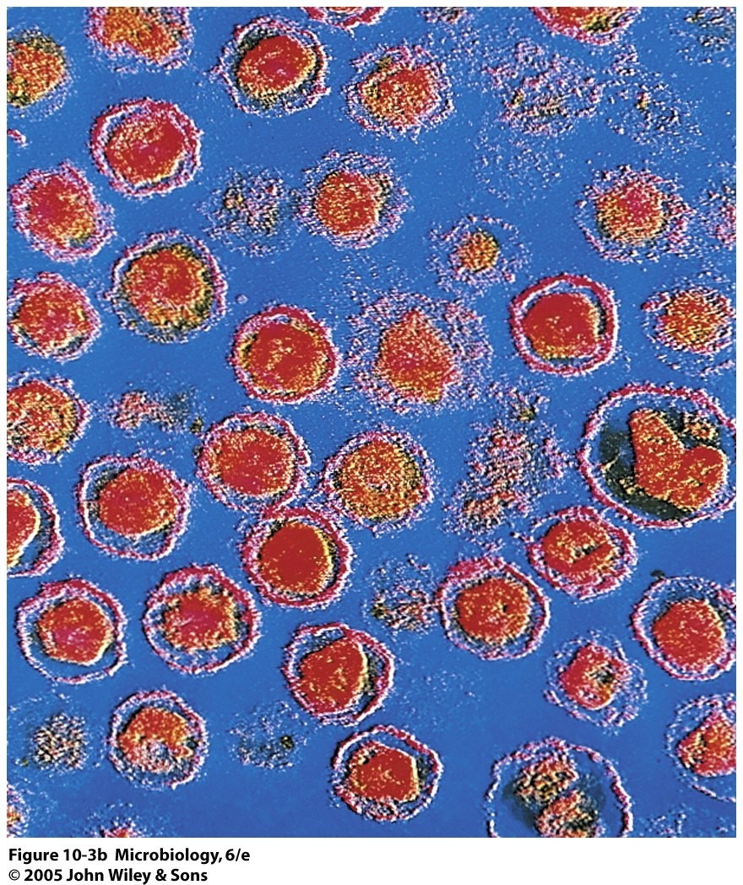
Retroviruses: are enveloped viruses that have two complete copies of (+) sense RNA. They also contain the enzyme reverse transcriptase, which uses the viral RNA to form a complementary strand of DNA, which is then replicated to form a dsDNA
retro, latin for “backward”
(Class IV) in Baltimore Classification

Slide 50
Ambisense genome
•
A virus genome composed of ssDNA or ssRNA
that is partly (+) sense and partly (-) sense.
Example:
- Bunyaviridae ((-) sense RNA) and Arenavirus ((-) sense RNA)

Slide 51
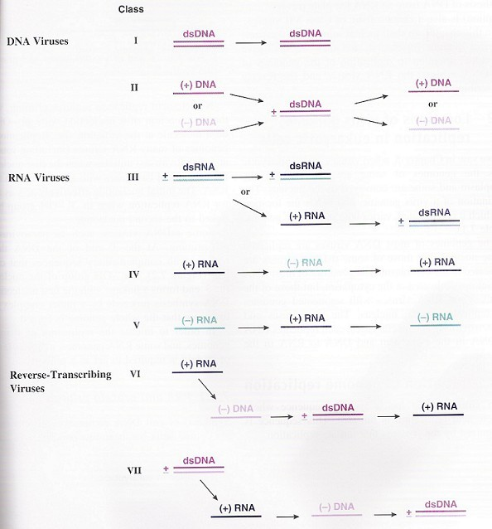
Baltimore Classification - Advantages
Can classify between the (+) strand RNA viruses that do (Class VI) and do not (Class
IV) undergo reverse transcription
Can classify between the dsDNA viruses that do (Class VII) and do not (Class I) carry out reverse transcription

Slide 52
General Properties of RNA Viruses
·
Many ssRNA viruses contain positive (+) sense RNA, and during an infection acts like mRNA and can be translated by host’s ribosomes.
·
Other ssRNA viruses have negative (-) sense RNA and the RNA acts as a template during transcription to make a complementary (+) sense mRNA.
·
Negative (-) sense RNA must carry a RNA polymerase
RNA dependent RNA polymerase –
within the virion.
Class III, IV and V
·
RNA viruses must either carry enzymes or have genes for those enzymes in order to copy RNA genomes after infecting a host cell

Slide 53
RNA viruses (+ve sense)
Picornaviridae
Togaviridae
Flaviviridae
Retroviridae

Slide 54
RNA viruses (-ve sense)
Paramyxoviridae
Rhabdoviridae
Orthomyxoviridae
Filoviridae
Bunyaviridae
Reoviridae (double-stranded)

Slide 55
DNA viruses
Double – stranded
      Adenoviridae
      Herpesviridae
      Poxviridae
      Papovaviridae
      Hepadnaviridae
Single – stranded
      Parvoridae

Slide 56
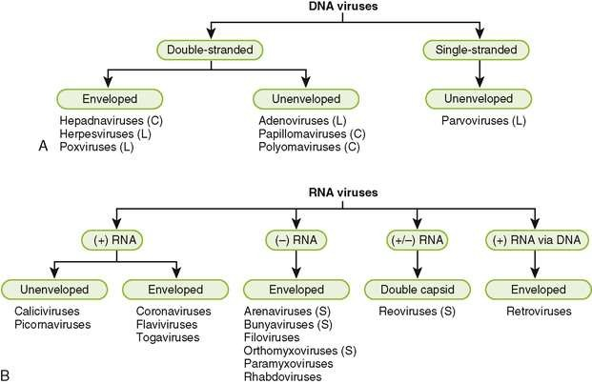
Classification of major viral families based on genome structure and virion morphology. A, DNA viruses. L, linear genome; C, circular genome. B, RNA viruses. S, segmented genome.

Slide 57
 | Important viruses of humans
 | VIRUS | DISEASE | Genome Type
 | Adenovirus | Respiratory infections | dsDNA
 | Epstein barr virus | Infectious mononucleosis Nasopharyngeal carcinoma Burkitt's lymphoma | dsDNA
 | Herpes simplex Type 1 | Cold sores | dsDNA
 | Herpes simplex Type 2 | Genital warts | dsDNA
 | HIV | AIDS | (+)ssRNA
 | HPV | Warts | dsDNA
 | Influenza virus | Influenza | (-)ssRNA

Slide 58
VIRUS | DISEASE | Genome Type
Ebola virus | Haemorrhagic fever | (-)ssRNA
Paramyxo virus | Mumps | (-)ssRNA
Polio virus | Poliomyelitis | (+)ssRNA
Rabies Virus | Rabies | (-)ssRNA
Rubella virus | German measles | (+)ssRNA
Small pox | Small pox | dsDNA
Vericella Zoster | Chicken pox, shingles | dsDNA

Slide 59
In visualizing the structure of a virus
X-RAY CRYSTALLOGRAPHY
Electron microscopy
It is used to generate information about the overall shape of the virus; it is also used with diagnostic purposes through detection of virus
It is a means of determining the physical structure, dimensions of the individual proteins and components of the virus.

Slide 60
Viruses In Dental Diseases
HSV Virus
Varicella Zoster Virus
  Small Pox Virus
  Paramyxovirus
    HPV Virus
  Measles Virus
Coxsackie Virus
  HIV Virus
HHV-8 Virus

Slide 61
Viral Reproduction
Steps of Lytic Cycle
      Attachment
      Entry
      Replication
      Assembly
Lysis/Release (lyses the cell)

Slide 62
How do viruses replicate?
2 methods of replication:
Lytic Cycle – the virus enters the cell, replicates itself hundreds of times, and then bursts out of the cell, destroying it.
Lysogenic Cycle – the virus DNA integrates with the host DNA and the host’s cell helps create more virus DNA. An environmental change may cause the virus to enter the Lytic Cycle.

Slide 63
In the lytic cycle, the virus reproduces itself using the host cell's chemical machinery. The red spiral lines in the drawing indicate the virus's genetic material. The orange portion is the outer shell that protects it.

Slide 64
In the lysogenic cycle, the virus reproduces by first injecting its genetic material, indicated by the red line, into the host cell's genetic instructions.

Slide 65
1. ATTACHMENT
The first step in viral infection is attachment, interaction of a virion with a specific receptor site on the surface of a cell.
Receptor molecules differ for different viruses but are generally glycoproteins.
human immunodeficiency virus binds to the CD4 receptor on cells of the immune system,
Rhinoviruses bind intercellular adhesion molecule 1 (ICAM-1),
Epstein-Barr virus recognizes the CD21 receptor on B cells.
The presence or absence of receptors plays an important determining role in viral pathogenesis.
The attachment step may initiate irreversible structural changes in the virion.

Slide 66
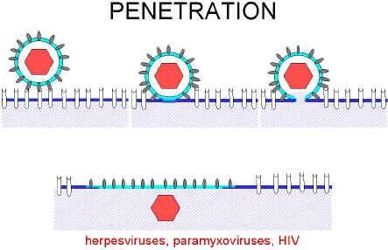
2. Penetration
After binding, the virus particle is taken up inside the cell. This step is referred to as penetration

Slide 67
3. UNCOATING
Uncoating occurs shortly after penetration.
Uncoating is the physical separation of the viral nucleic acid from the outer structural components of the virion so that it can function.
The genome may be released as free nucleic acid (picornaviruses) or as a nucleocapsid (reoviruses).
The nucleocapsids usually contain polymerases.
Uncoating may require acidic pH in the endosome.
4. TRANSCRIPTION
Virus mRNA is produced using either cellular enzymes or
virus-coded enzymes.

Slide 68
5. GENOME REPLICATION
This stage can take place in either the cytoplasm or nucleus
of the infected cell.
Depending on the size of the virus genome the enzymes involved in genome replication may be encoded by either the virus itself or the host cell
6.TRANSLATION
This stage uses the host cell machinery – ribosomes and enzymes etc.
Various proteins are synthesised
- structural - only in virion
-and non-structural- detected only in the virus- infected cell.

Slide 69
7. VIRION ASSEMBLY
The newly formed virus proteins and genomic nucleic acid assemble to produce the new virus particles.
8. VIRION RELEASE
Various strategies are available for the release of the progeny virus from the infected cell depending on the particular virus group.
The virus may bud through the cell membrane OR
The virus may simply cause lysis of the cell resulting in cell death and the release of progeny virus particles.

Slide 70
Surface of virions consists of possibly 240 subunits comprising of 3 different polypeptides termed Large, middle, small surface(HBs) proteins
The lipid in the outer protein shell or the HBs particles is derived from an intracellular compartment & not the plasma membrane
.

Slide 71
Viruses and cancer
10% of cancer is caused by viruses
  An oncovirus is a virus that can cause cancer
  An oncogene is a cancer causing gene
Oncogenic viruses
  DNA viruses
    Human papillomavirus – cervical cancer
    Hepatitis B causes liver cancer

Slide 72
Major Human Oncogenic Virus
DNA VIRUSES
Small DNA tumor viruses
Human Papilloma virus (HPV)
-Adenovirus
Herpesviruses (large)
Epstein Barr virus (EBV)
Kaposi’s Sarcoma Herpesvirus (KSHV)
Other
Hepatitis virus B
RNA viruses
Human T-cell Leukemia Virus 1 (HTLV1) Hepatitis virus C

Slide 73
Viruses Associated With The Development Of Human Neoplasia
VIRUSES NEOPLASMS
DNA VIRUSES
Human papilloma virus
Cervical Ca, warts, ano genital carcinoma Cervical carcinoma NPCa, African Burkitt’s Kaposi’s sarcoma Hepatocellular Ca Certain B cell lymphomas
Herpes simplex virus II Epstein-Barr virus Human Herpes virus 8 Hepatitis B virus Herpes simplex virus 6
(HBLV)
58

Slide 74








Viruses Associated With The Development Of Human Neoplasia
VIRUSES
NEOPLASMS
RNA VIRUSES
Human T-cell leukemia virus I
Some T-cell leukemia, Lymphoma
Some cases of hairy cell leukemia
Lymphoma; Kaposi’s
sarcoma
Human T-cell leukemia virus II
Human immunodeficiency virus
59

Slide 75
Transmission of Viruses
Respiratory transmission
  Influenza A virus
Faecal-oral transmission
  Enterovirus
Blood-borne transmission
  Hepatitis B virus
Sexual Transmission
  HIV
Animal or insect vectors
  Rabies virus

Slide 76
Common Methods of Inactivating Viruses for Various Purposes
Sterilize laboratory supplies and equipment,
Disinfect surfaces or skin,
Sterilization may be accomplished by
steam under pressure,
dry heat,
ethylene oxide,
γ-irradiation.
Surface disinfectants include
sodium hypochlorite,
glutaraldehyde,
formaldehyde.
Skin disinfectants include
chlorhexidine, 70% ethanol, and iodophores.

