Slide 1
Subject:
Analytical Studies of Classical Persian
1st Semester of PHD Persian
Dr. Faiza Kiran

Slide 2
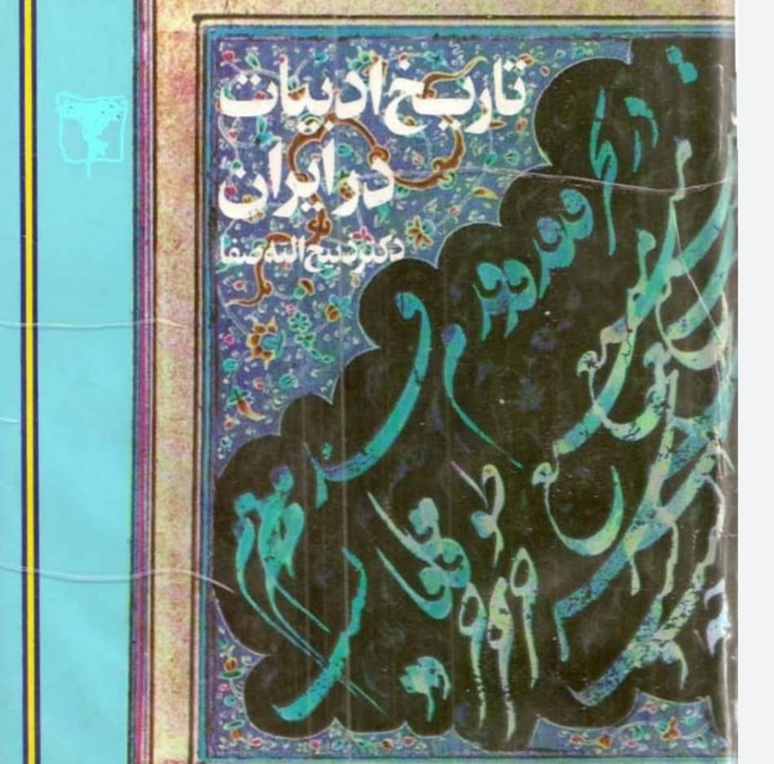

Slide 3
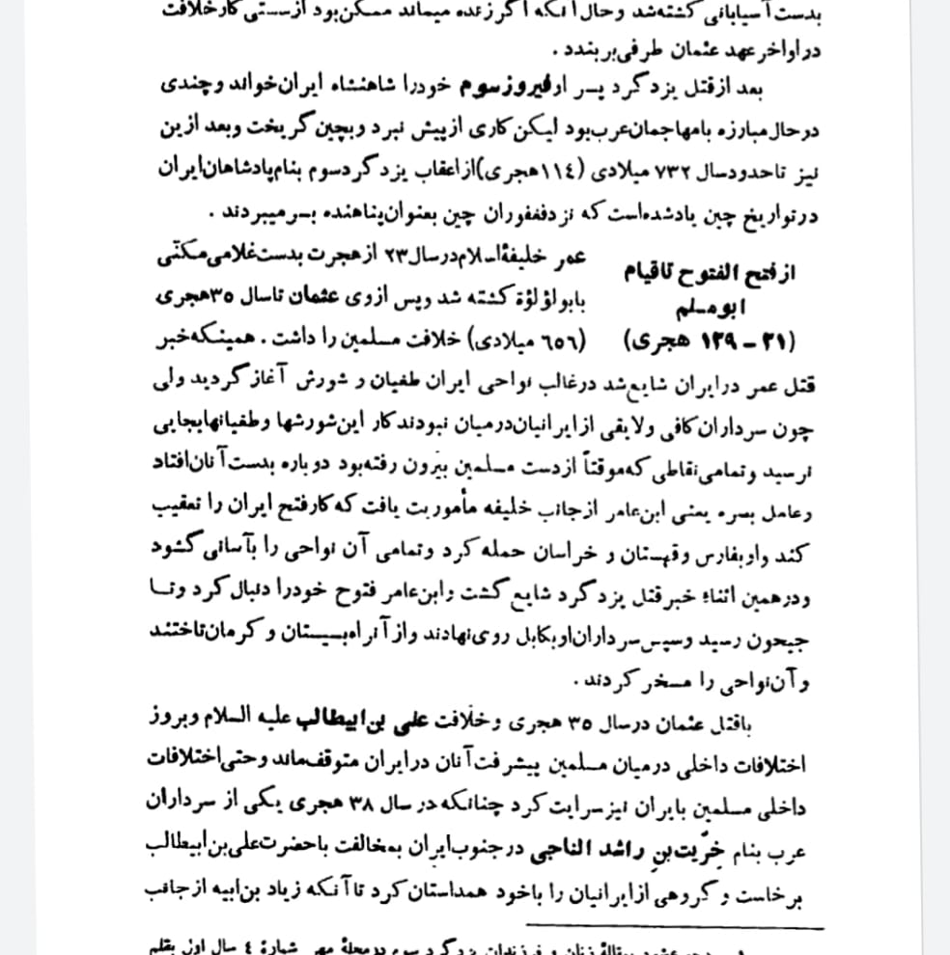

Slide 4
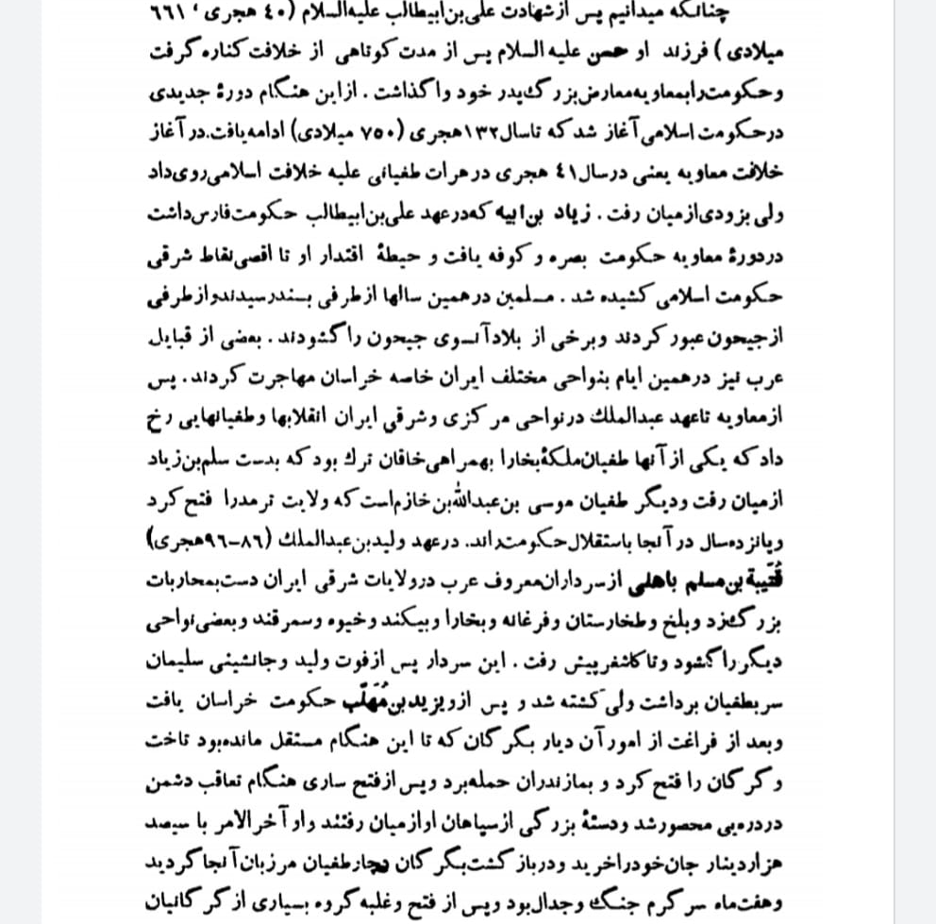

Slide 5
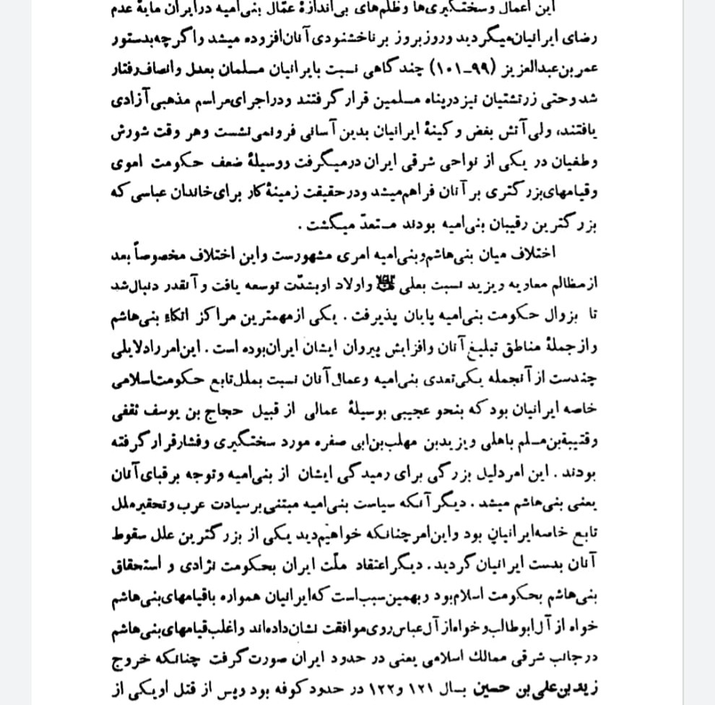

Slide 6
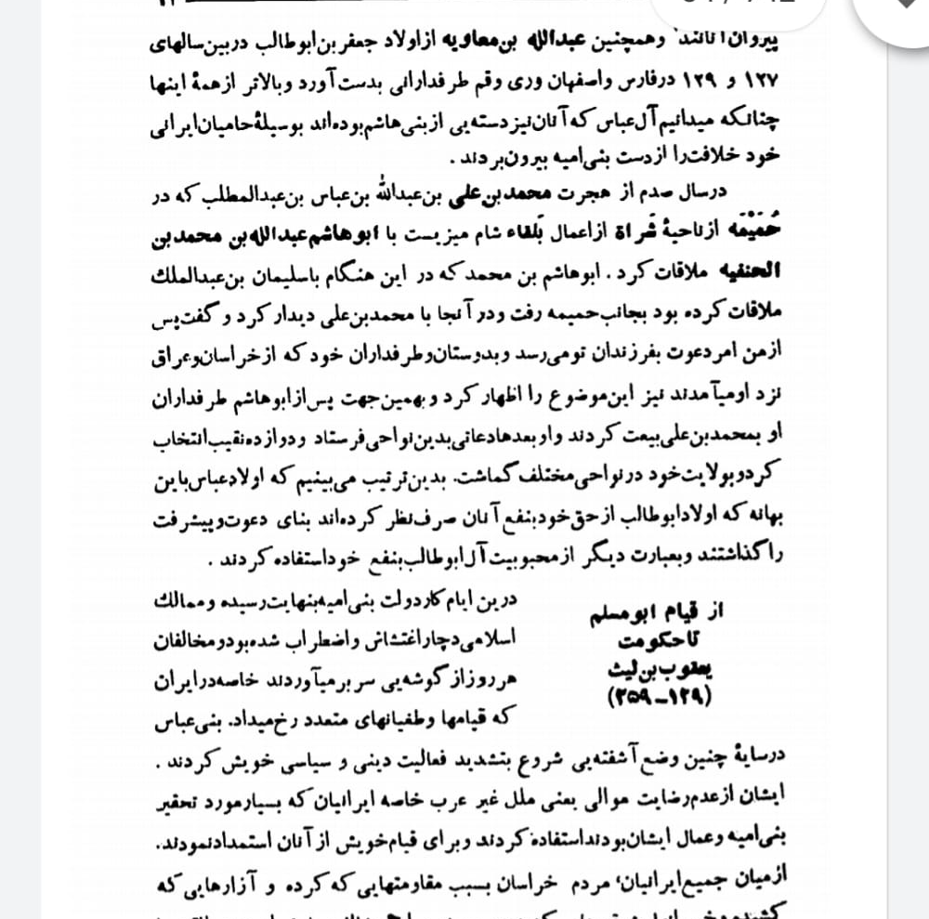

Slide 7
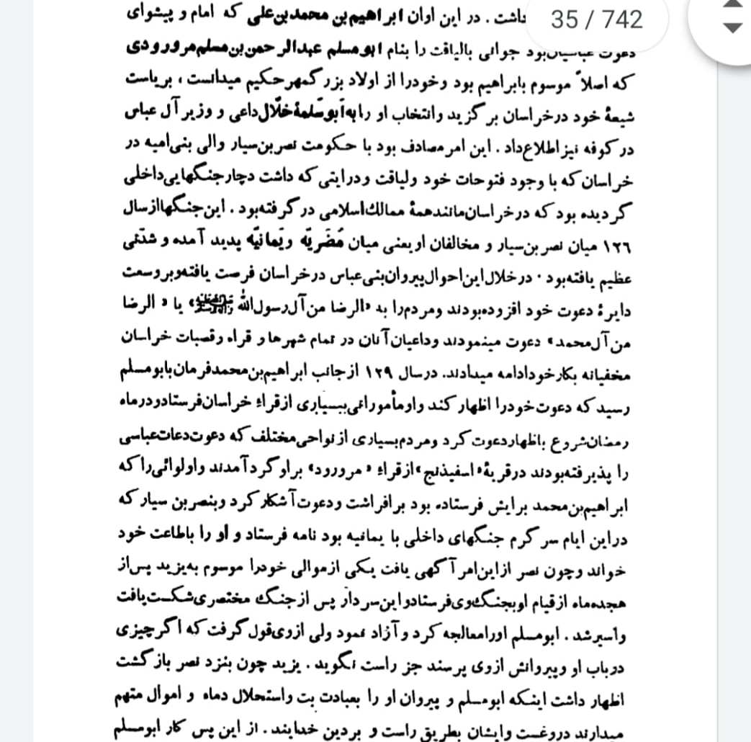

Slide 8
