Slide 1
MS Semester I Persian Grammar and Rhhetoric Advance عنوان: تلمیح Instructor Dr.Anjum Tahira

Slide 2
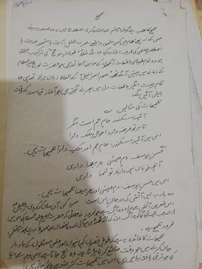
تلمیح

