Slide 1
Iqbal ka Nazariya Riyasat-II Session 2019-2023 Semester: 2nd Minor Course Code: 104
Instructor: Dr. Sara Bukhari

Slide 2
جاوید نامہ

Slide 3
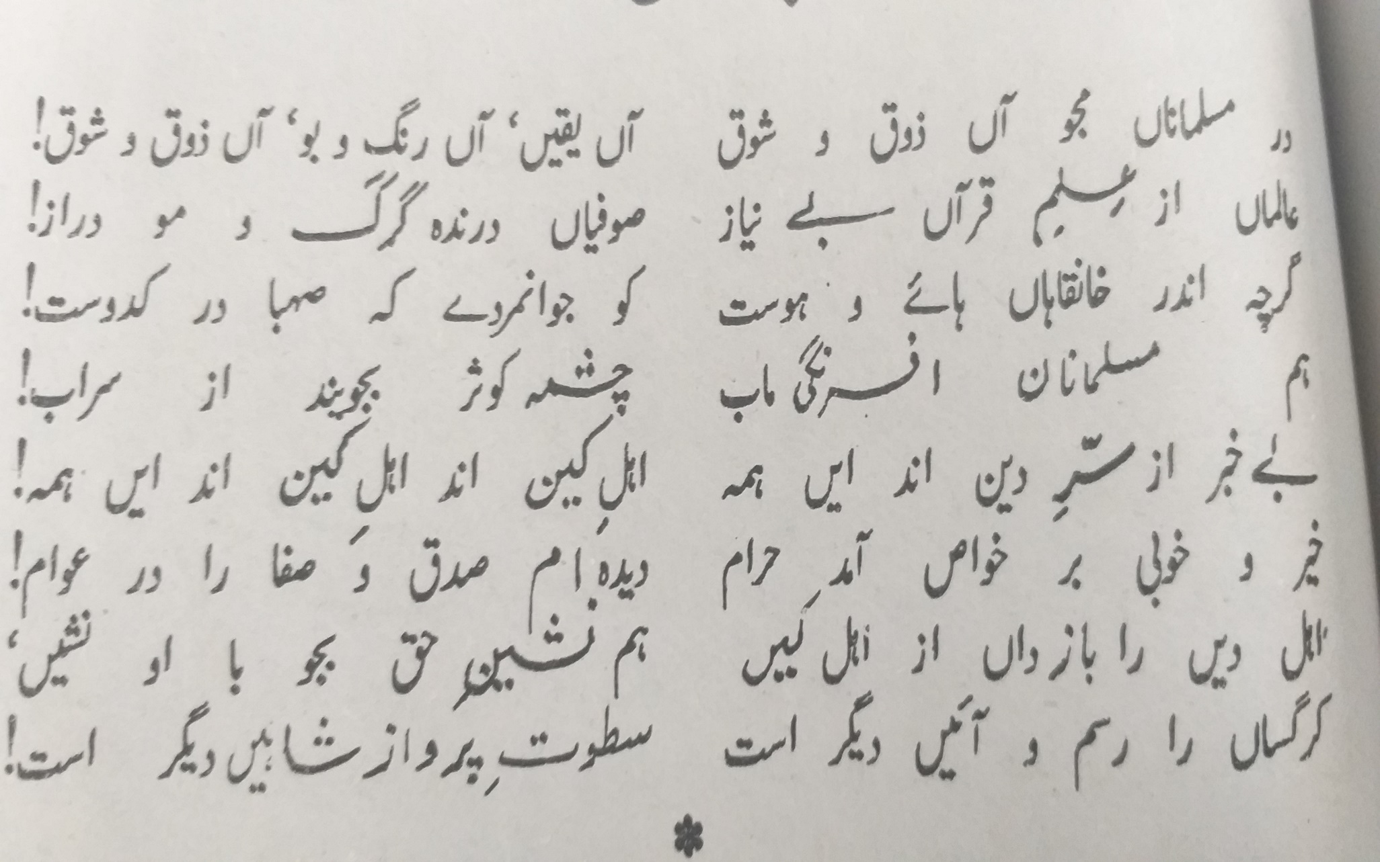

Slide 4
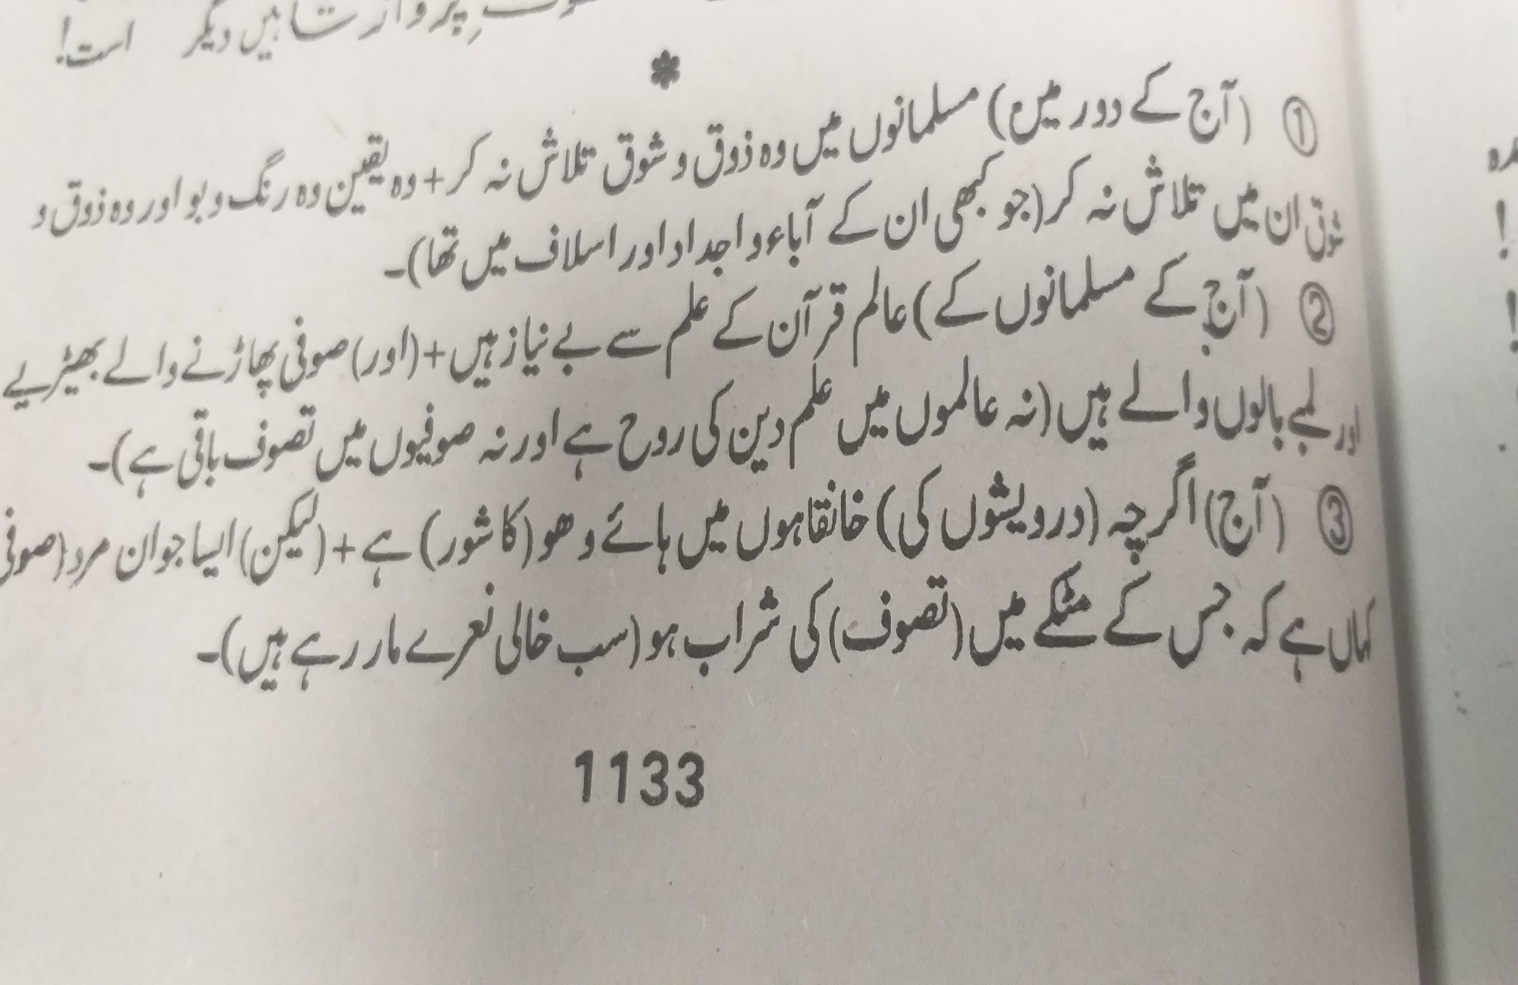

Slide 5
