Slide 1
Mystical Persian Literature in Sub-continent
Semester: 7
Session: 2017-2021
Credit Hours: 03
Course Code: Per-4102
Course Instructor: Dr Naheed Kausar

Slide 2
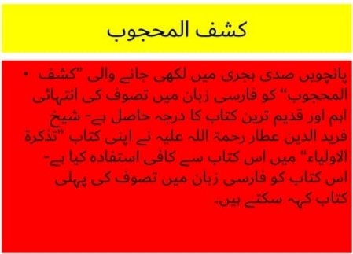

Slide 3
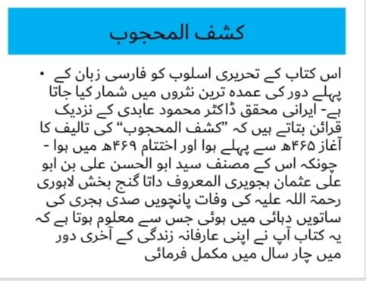

Slide 4
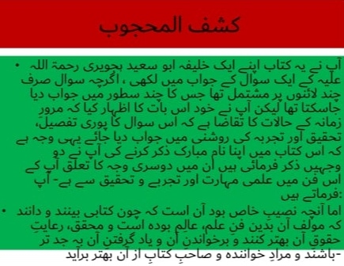

Slide 5
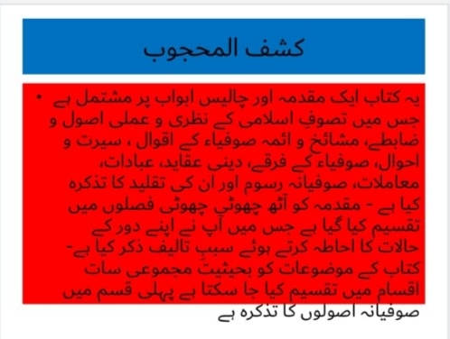

Slide 6
