Slide 1
Persian Advance Grammer Session 2018-22 By Dr.Faiza Kiran

Slide 2
Lecture 6

Slide 3
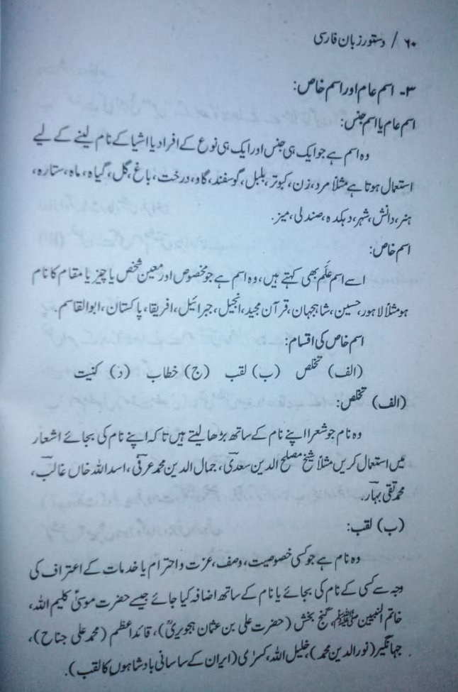

Slide 4
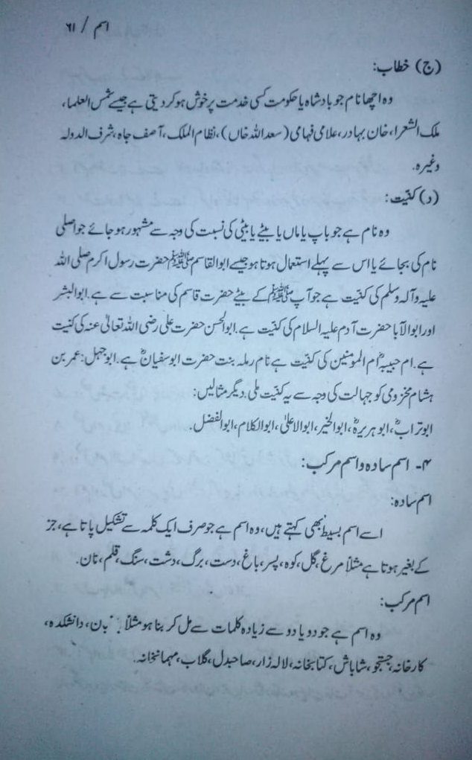

Slide 5
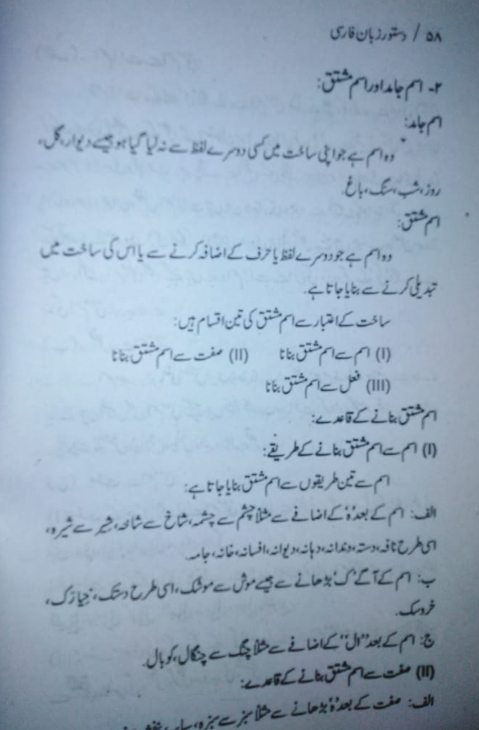

Slide 6
