Slide 1
Persian Advance Grammer
Session 2018-22
By
Dr. Faiza Kiran

Slide 2
Lecture:12

Slide 3
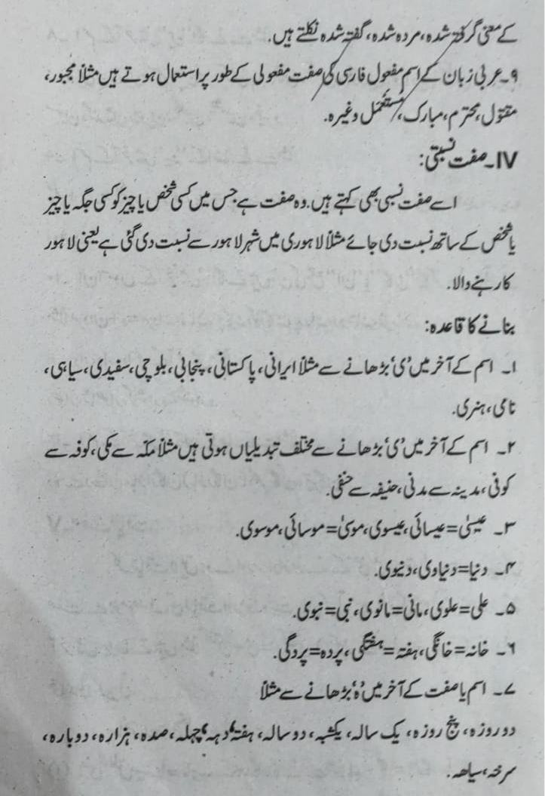

Slide 4
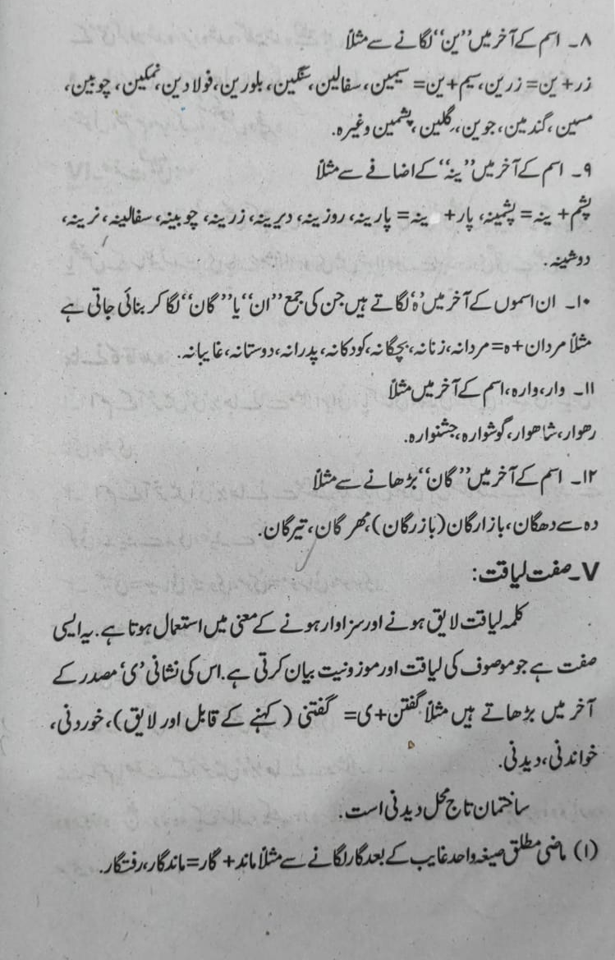

Slide 5
