Slide 1
Modern Persian Prose in Iran Semester: 5th Major Course Code: 303 Lecture No. 4-5-6
Instructor: Dr. Sara Bukhari

Slide 2
داستان کوتاہ سہ تار

Slide 3
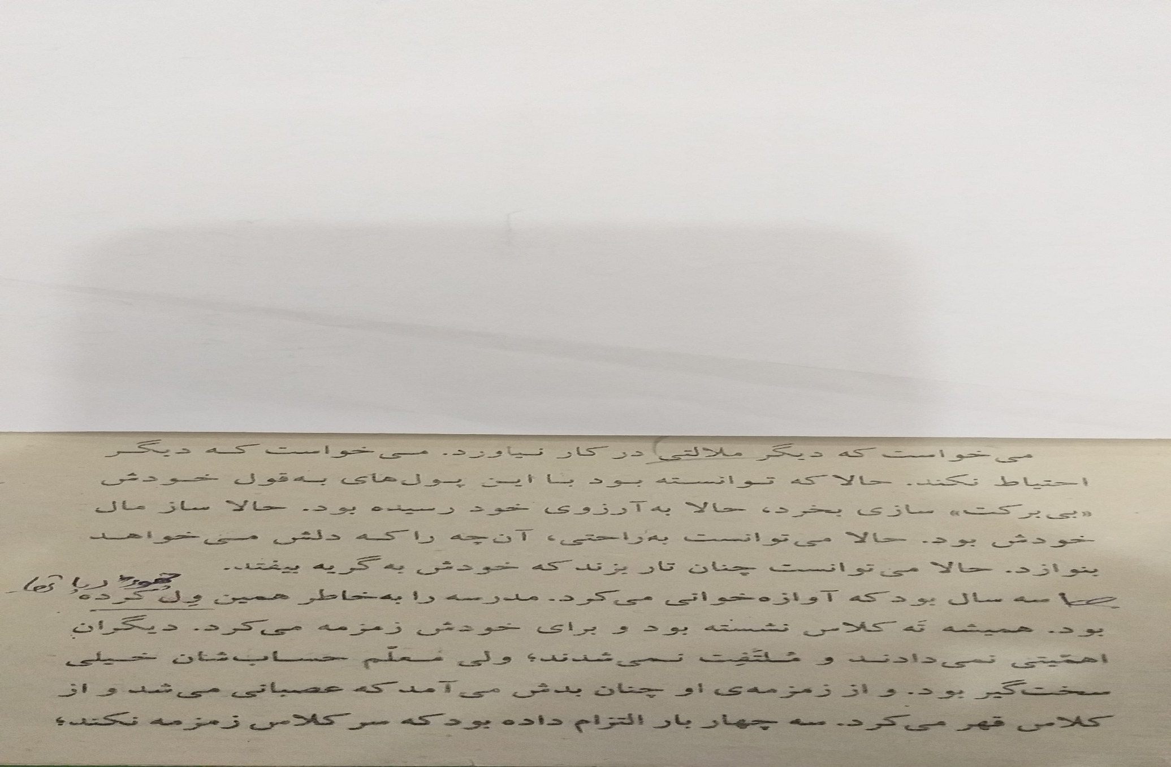

Slide 4
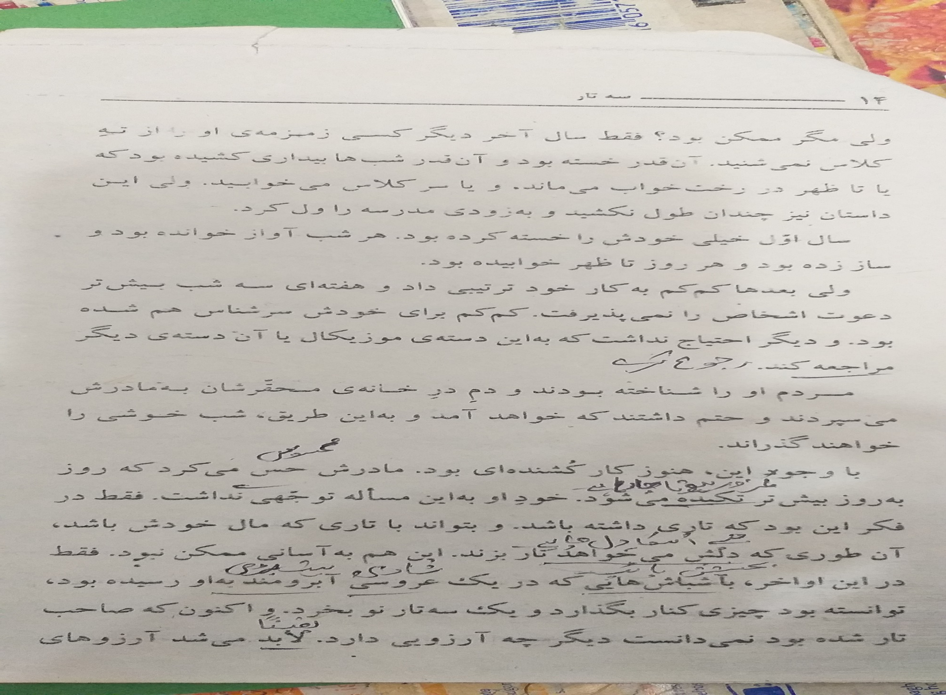

Slide 5
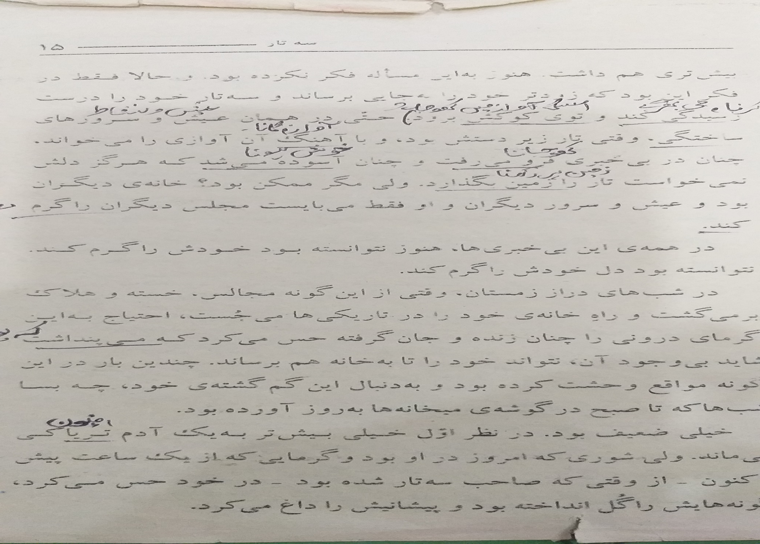

Slide 6
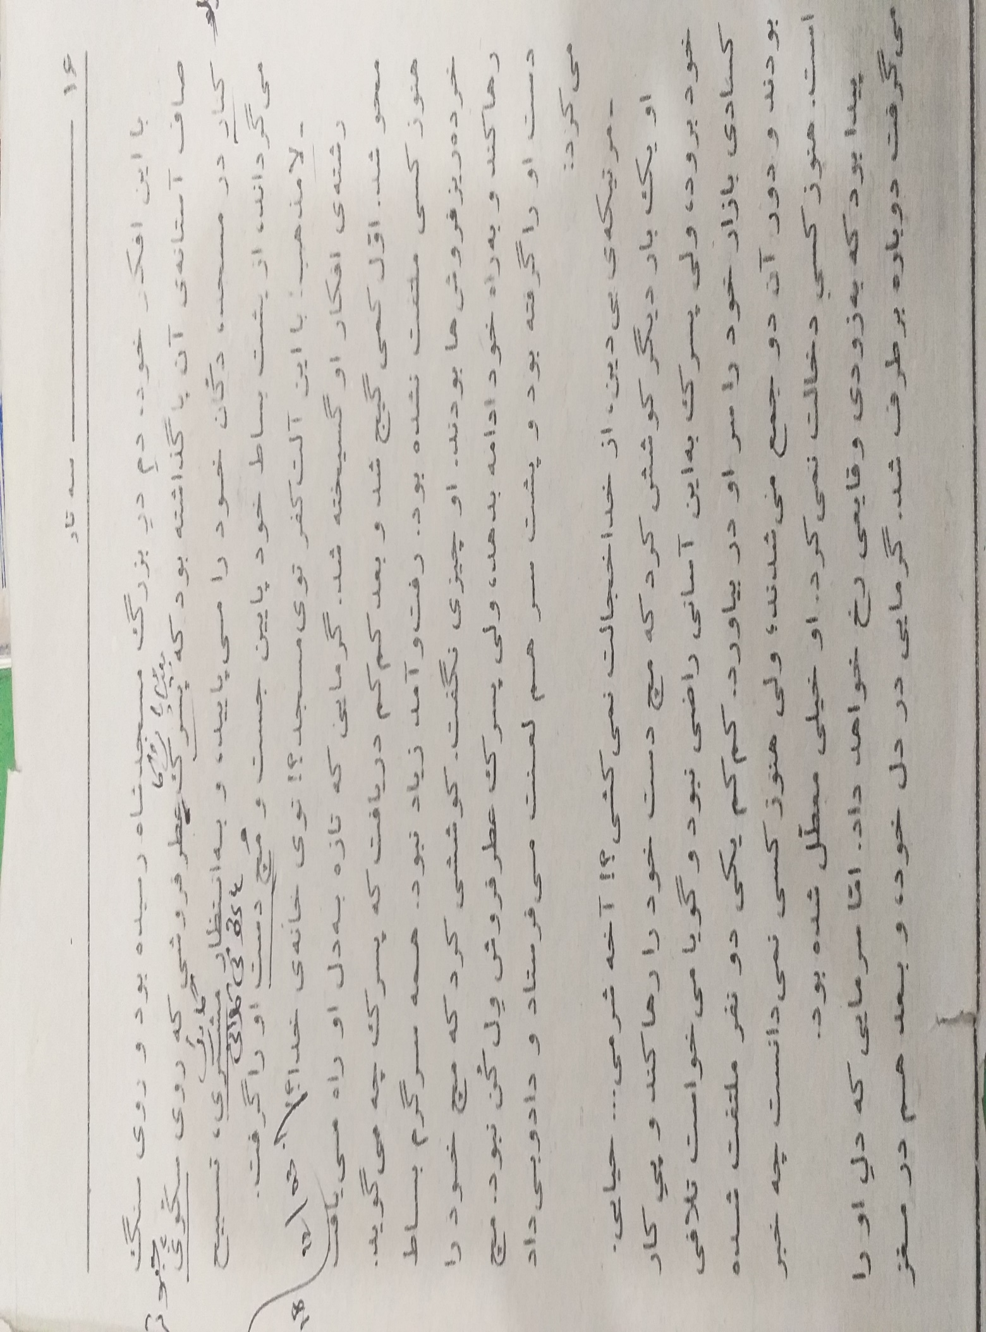

Slide 7
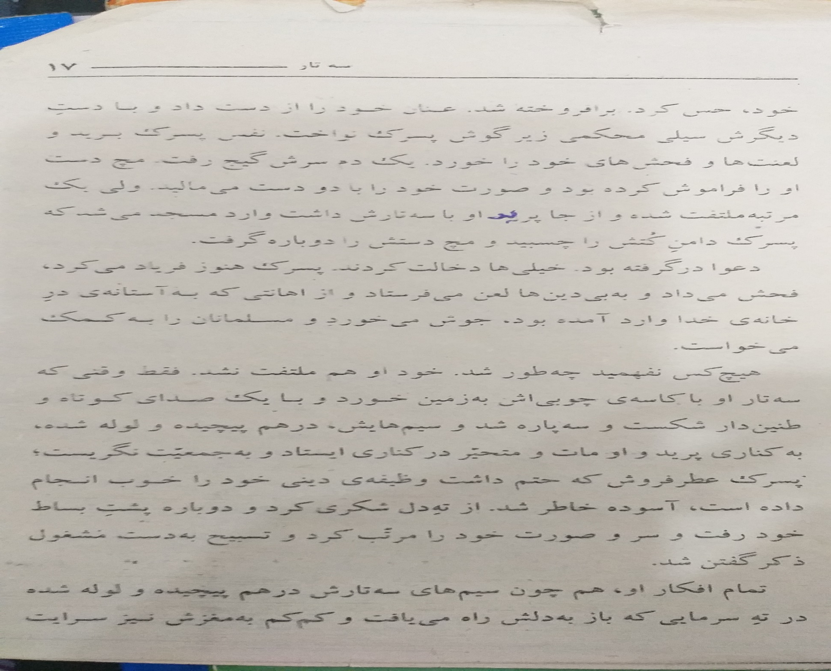

Slide 9
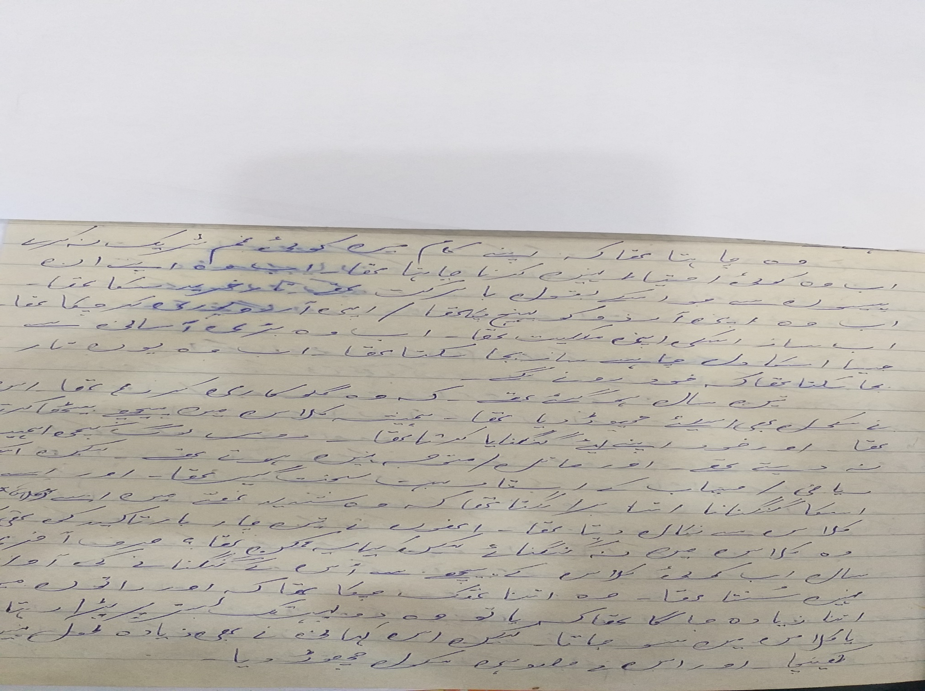

Slide 10
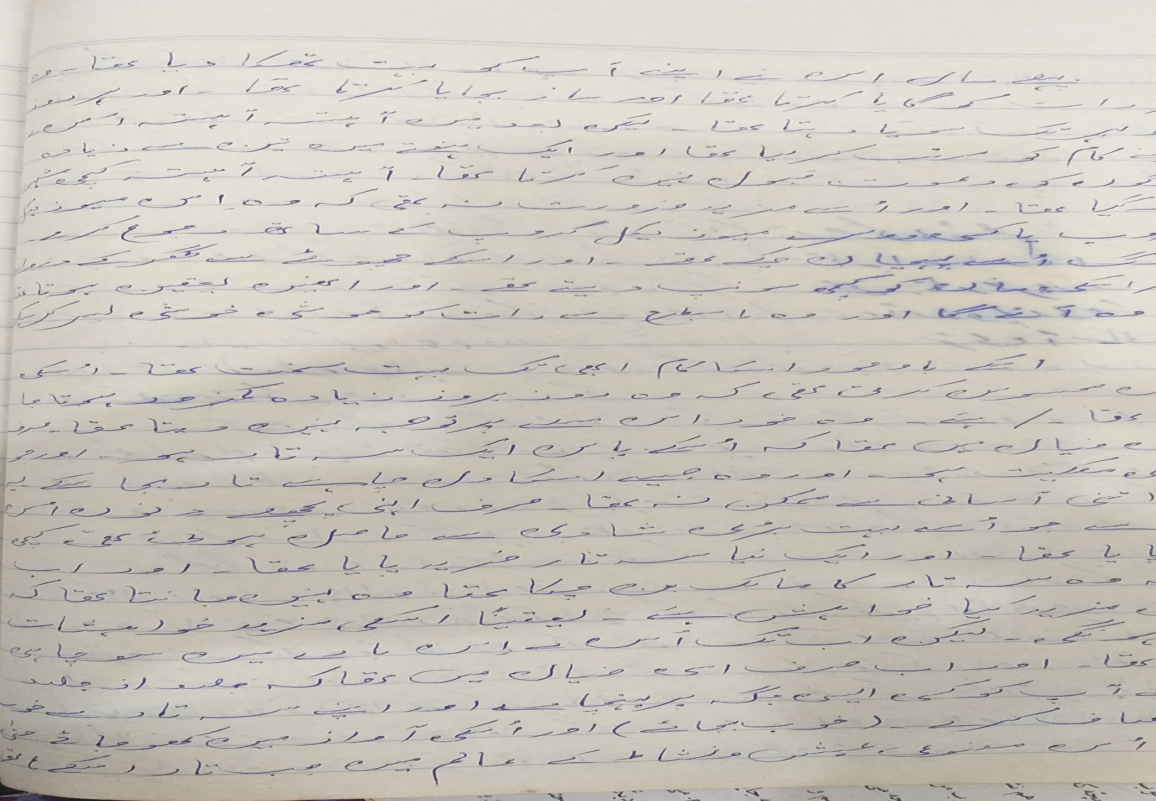

Slide 13
