Slide 1
Modern Persian Literature in Iran-I and Primary Persian Grammar-II Session 2019-2023 Semester: 2nd Major Course Code: 102
Instructor: Dr. Sara Bukhari

Slide 2
درود بر پاکستان
سلامتی پاکستان پر

Slide 4
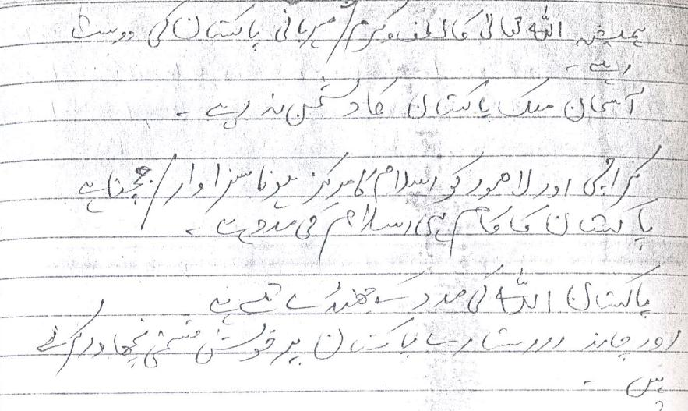
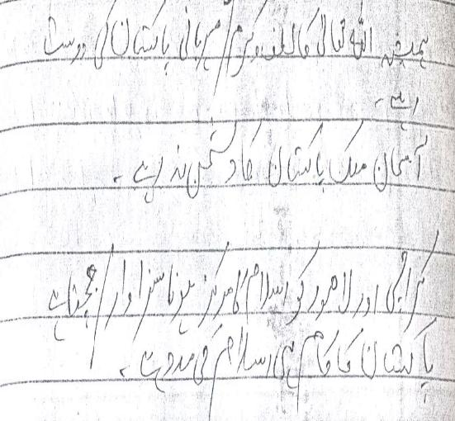

Slide 6
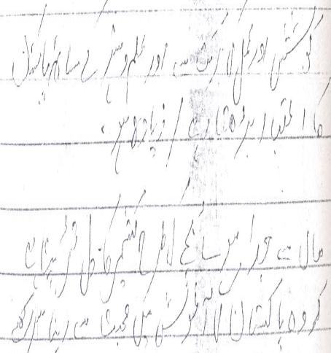

Slide 8
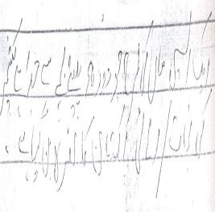
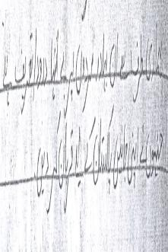

Slide 9
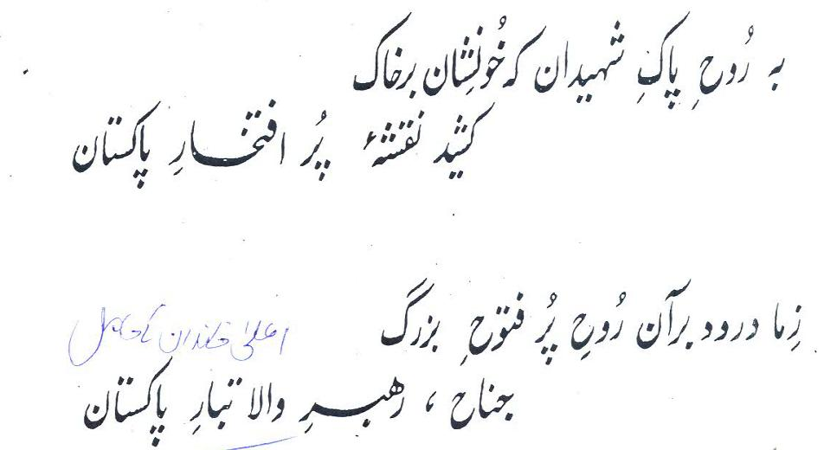

Slide 10
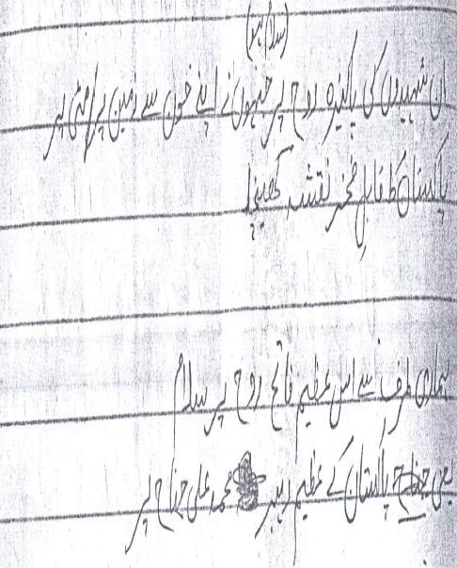

Slide 11
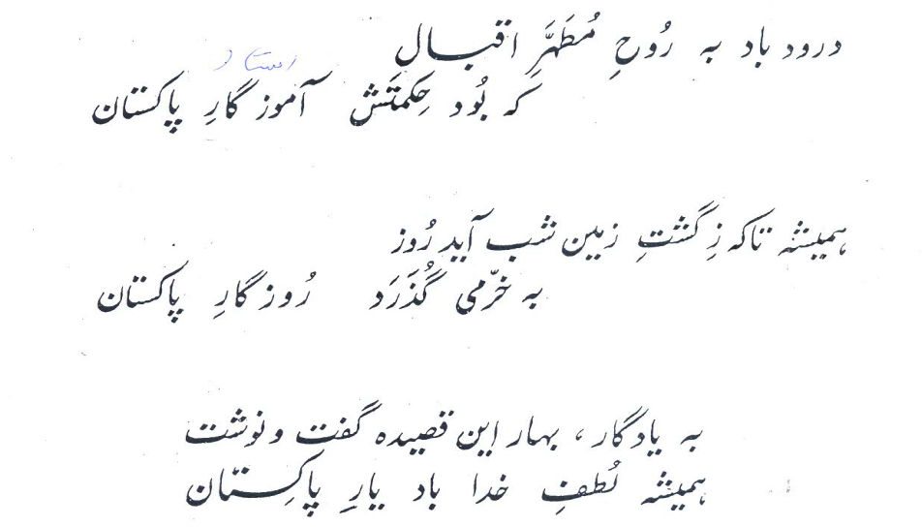

Slide 12
