Slide 1
Modern Persian Literature in Iran-I and Primary Persian Grammar-II Session 2019-2023 Semester: 2nd Major Course Code: 102
Instructor: Dr. Sara Bukhari

Slide 2
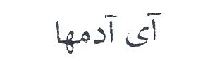
ای لوگو

Slide 3
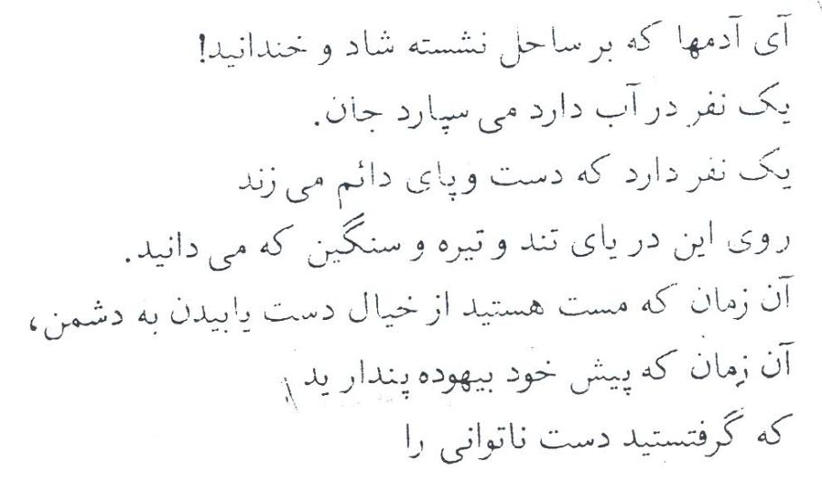

Slide 4
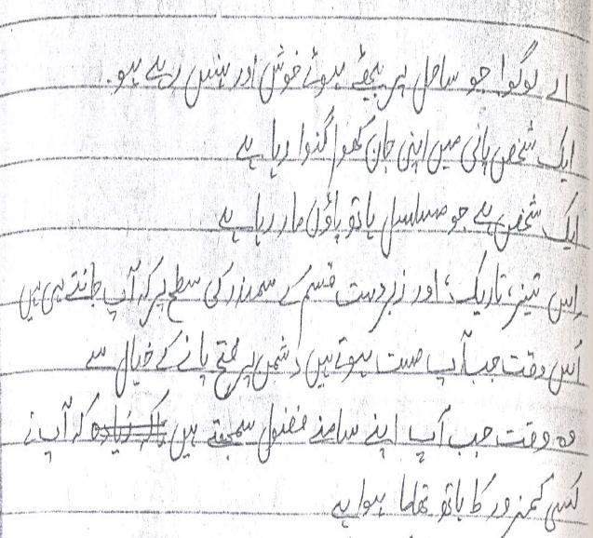

Slide 5
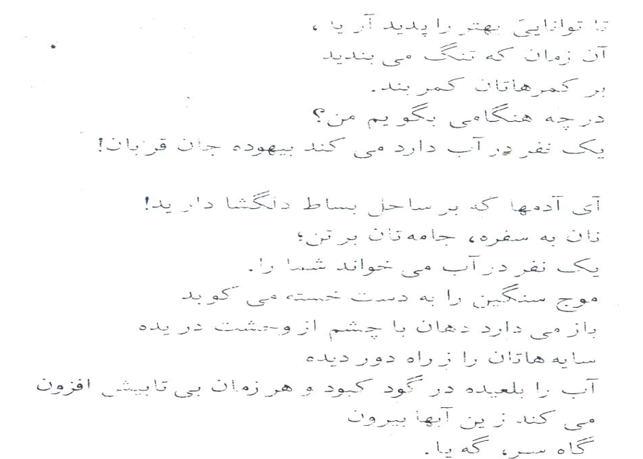

Slide 6
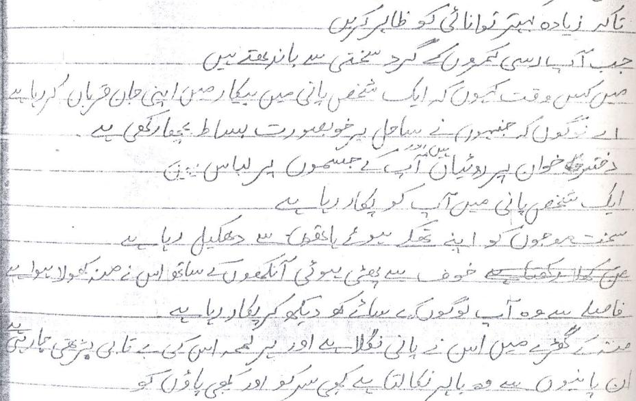

Slide 7
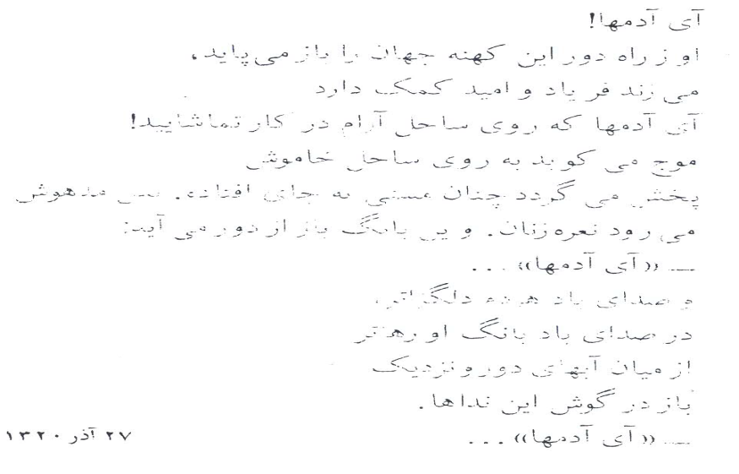

Slide 8
