Slide 1
Spatial Enhancement Filters
Presented by: Iqra Ashraf
Reference Book:
Digital image processing By
R.C.Gonzalez, P.Wintz
Course: Digital Image Processing

Slide 2
Outline
Spatial Filter
Types of Filters

Slide 3
Spatial Filter
In the most basic sense, a filter is a mechanism that removes something from whatever passes through it.
An image filter blocks or passes through image data based on what kind of filter it is.
A low pass filter allows low frequency data, or data that does not change much from pixel to neighboring pixel, to pass through, removing the high frequency data, or data that changes rapidly from pixel to neighboring pixel.
Conversely, a high pass filter allows high frequency data to pass, removing low frequency data.

Slide 4
USES
In image processing filters are mainly used to suppress either the high frequencies in the image, i.e. smoothing the image, or the low frequencies, i.e. enhancing or detecting edges in the image. An image can be filtered either in the frequency or in the spatial domain

Slide 5
Types of Spatial Filters
Image filters have a wide variety of uses, such as
Noise Removal
Edge Enhancement
Edge Detection
Low Pass
High Pass
Haze Reduction
Vertical Edge Detection

Slide 6
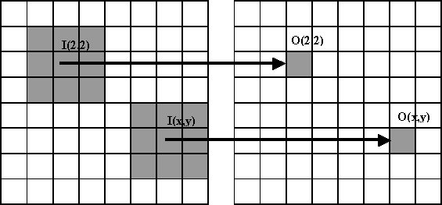
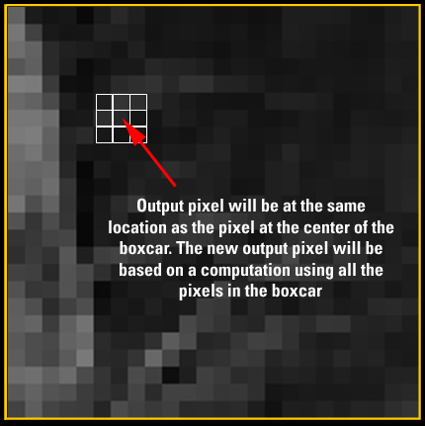
Convolution Window

Slide 7
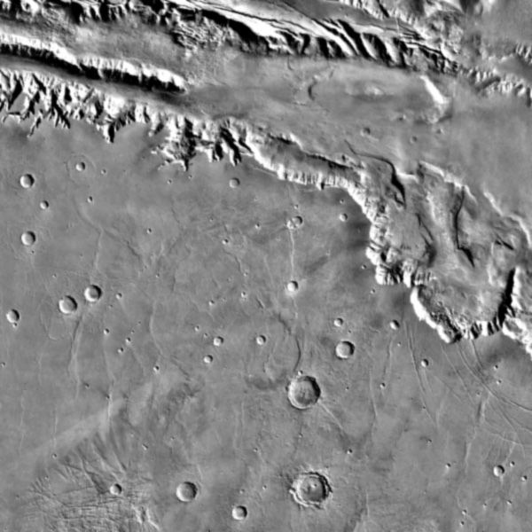
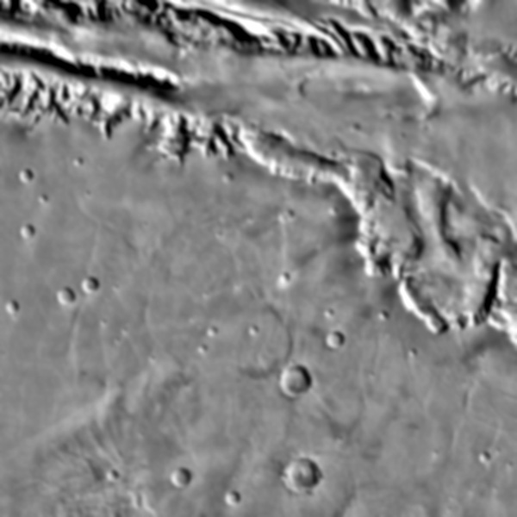
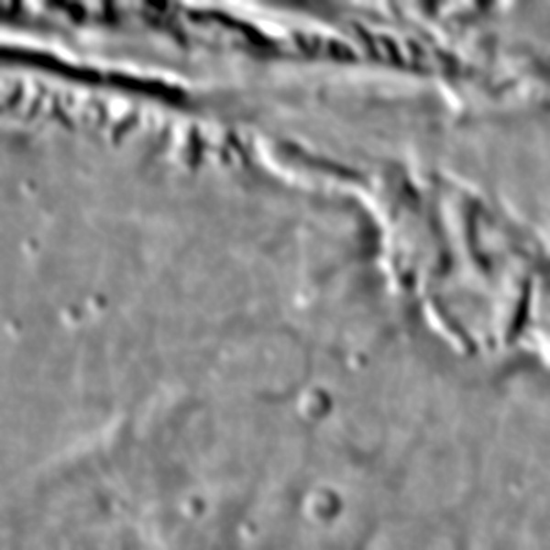
Low Pass Filter (smoothe edges)
3x3 low pass
7x7 low pass
Original
21x21 low pass

Slide 8
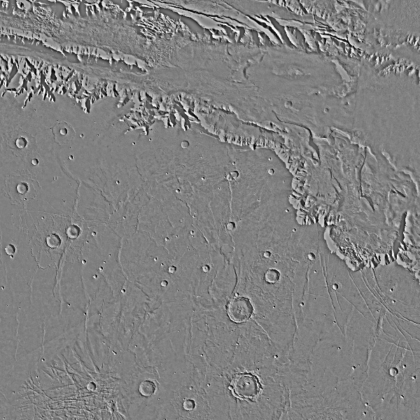
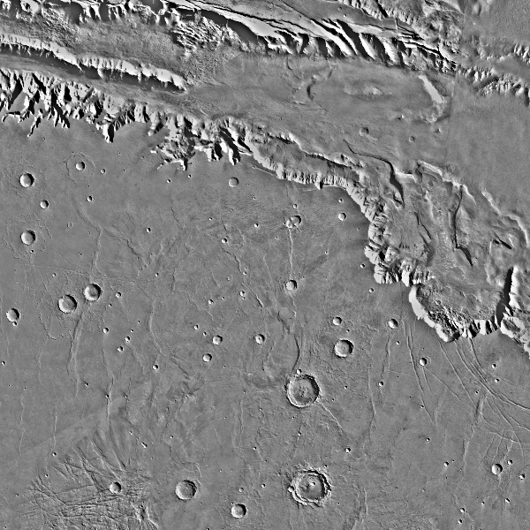
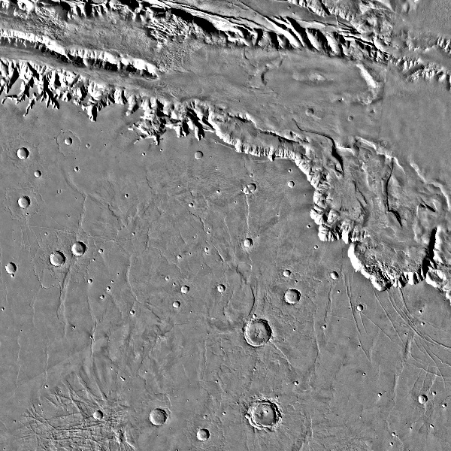
High Pass Filter (enhance edges)
3x3 high pass
7x7 high pass
Original
Original
21x21 high pass

Slide 9
Destripping Removal Filter
Original Image
Low Pass Filter
High Pass Filter
Merged Image

Slide 10
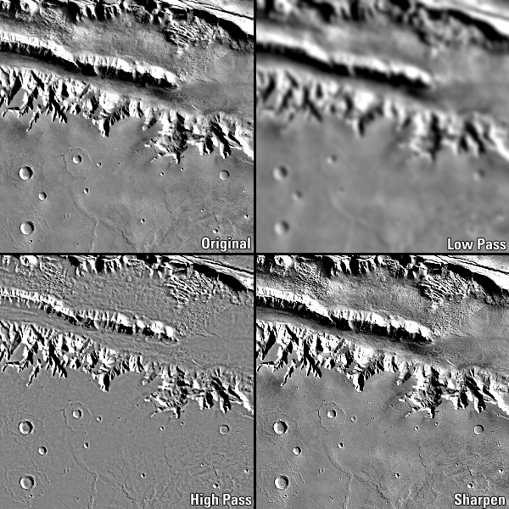

Slide 11
Laplacian filters are derivative filters used to find areas of rapid change (edges) in images. Since derivative filters are very sensitive to noise, it is common to smooth the image (e.g., using a Gaussian filter) before applying the Laplacian. This is called a negative Laplacian because the central peak is negative.
Supported Lab: To better understand applications of spatial enhancement filters consult Lab 4 ( spatial image enhancement present in OCD)

Slide 12
Questions & Discussion

