Slide 1
Types of satellites

Slide 2
LANDSAT
The earth resources technology satellites (ERTS-1 later renamed landsat-1) was the first unmanned satellites design to provide systematic global coverage of earth resources.
Launched by the United States on July 23, 1972. It was primarily designed as an experimental system to test the feasibility of collecting earth resource from satellites.

Slide 3
LANDSAT
Originally there were to be six satellites in the ERTS series.
In 1975, the ERTS program and satellites were renamed Land sat.
The Landsat 4 and 5 satellites were launched in to lower sun synchronized earth orbits of about 700 km and have a return period of 6 days.

Slide 4
SPOT
The SPOT (System pour observation de la Terra) program was begun by France in 1978. It was from the start to be a long term, operational, commercial system and subsequent satellites in the series are already being manufactured.
SPOT has develop in to an international programs with data available from outlets in more than thirty countries.
SPOT has a sun synchronized orbits at an altitude of 832 km and a return periods of 26 days.

Slide 5
Applications
Land sat and more recently SPOT imagery are now routinely used for a wide range of applications.
In geology satellite imagery is used for mapping in mineral and petroleum exploration as well as national mapping programs.
In agriculture, this imagery has been used to estimate the area planted to important food and cash crops and the conditions of crops through the growing seasons.
Landsat imagery is used routinely to estimate crop areas and crop condition.

Slide 6
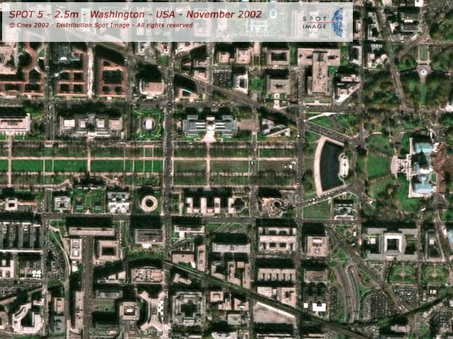

Slide 7
Applications
In forestry Land sat and SPOT data have been used to estimate forest losses caused by fires, clear cutting, and diseases.
They have also been used for quick comparative forest land valuation. SPOT and Landsat are widely used for land use planning. Currently land cover, the detection of change in land use over time, and routine location planning.
Landsat data have been used to monitor rangeland condition, wildlife habitat. These two satellites are also used for identification of water pollution, assessment of damaged caused by natural disaster.

Slide 8
Meteorological satellites
Meteorological satellites provide more frequent coverage. Although designed primarily to collect weather data, they are used routinely for earth resource monitoring over large areas. Such as crop and vegetation condition assessment and the monitoring of desertification. NOAA and GOES satellites operated by United States.

Slide 9
NOAA satellites
A series of sun synchronized polar orbiting satellites was launched by the US Oceanic and atmospheric administration (NOAA). They were designed as operational civilian satellites to provide visual and infrared observation and measurement of the earth’s surface, atmospheric and cloud cover.
NOAA -1 launched in January 1970 altitude of about 14, 50 km. AVHRR data are used to monitor snow coverage, assess snow depths and melting conditions, monitor floods, detect and map forest fires, monitor crop conditions, monitor dust and sandstone. Identify geological events like volcanic eruptions and map regional drainage networks.

Slide 10
GOES satellites
The Geostationary operational Environmental satellites (GOES) provide continuous monitoring of temperature, humidity and cloud cover for weather forecasting.
The satellites orbits at the altitude of 36,000 km. in the same direction as the earth’s rotation. They maintain a stationary position relative to the earth and for this reason are termed as Geo- stationary.

Slide 11
