Slide 1
Formation of other areas:
By 900 million years ago, a triple junction formed as the supercontinent Rodinia started to rift apart.
Between about 800 million and 700 million years ago, it split in half.
This was one of the most significant rifting events of all time, because it opened up the Panthalassic Ocean to the west of Laurentia, a continent that became North America.

Slide 2
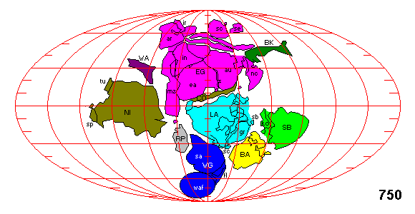
Precambrian Plates and Rodinia
The map shown here depicts the period at 750 m.y.
We can see that the continents are assembled into a supercontinent, only this time North America is in the middle instead of Africa. This earlier supercontinent has been given the name Rodinia.

Slide 3
The global ocean of Mirovia, an ocean that surrounded Rodinia, started to shrink because the Pan-African ocean and Panthalassa were expanding.
Between 650 million and 550 million years ago, another supercontinent was forming, Pannotia, which was shaped like a "V".
Inside the "V" was Panthalassa, outside of the "V" was the Pan-African Ocean and remnants of the Mirovia Ocean.

Slide 4
Most of Panthalassa's oceanic basin and crust has been subducted under the North American plate, and the Eurasian Plate.
Panthalassa's oceanic plate remnants may be the Juan de Fuca, Gorda, Cocos and the Nazca plates, all four of which were part of the Farallon Plate.

Slide 5
The South China Sea opened as Borneo moved away from China.
Also, Japan separated from the mainland, but it is not yet clear whether this was related to the collison of India and Eurasia.

Slide 6
This animation shows the time of start at 60 million years ago.
India pushes blocks of Asiatic crust eastward.
Continental margin rocks smear along the margin of Southeast Asia, while the northern part of India thrusts beneath Tibet.

Slide 7
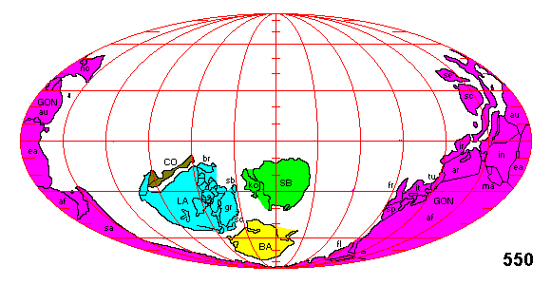
Gondwana land

Slide 8
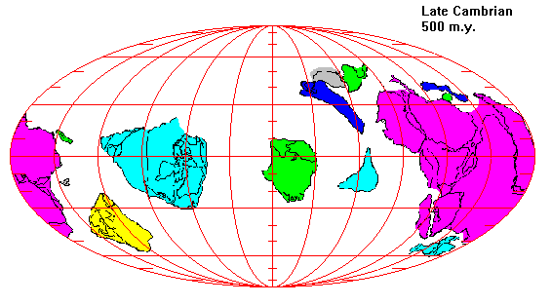

Slide 9
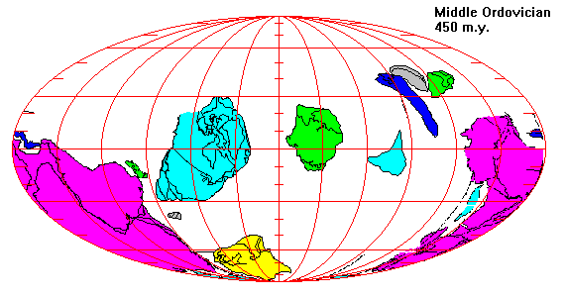

Slide 10
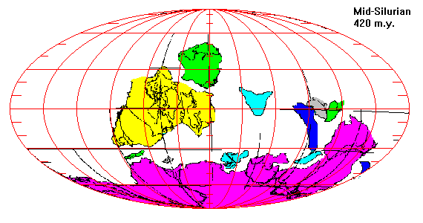

Slide 11
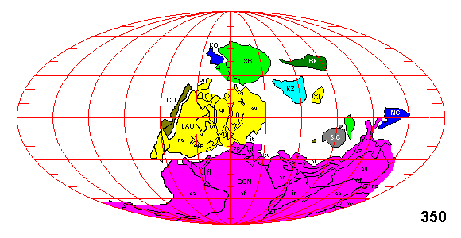
Assembly of Pangaea:

Slide 12
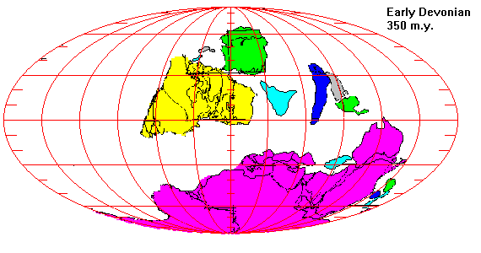

Slide 13
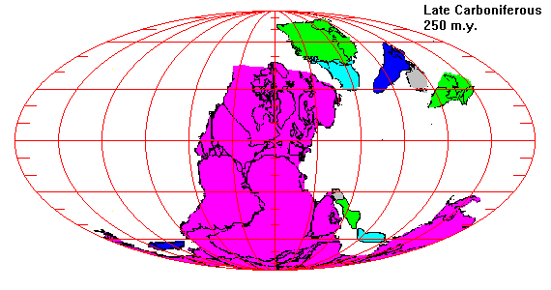

Slide 14
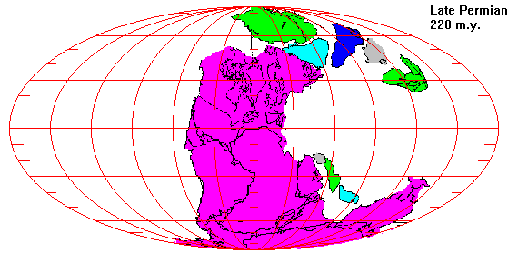

Slide 15
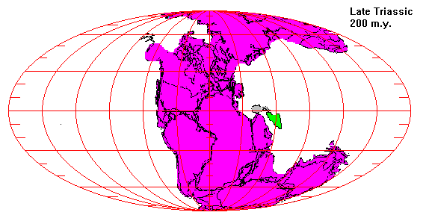

Slide 16
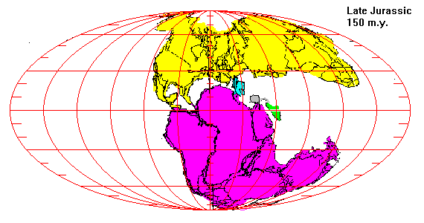

Slide 17
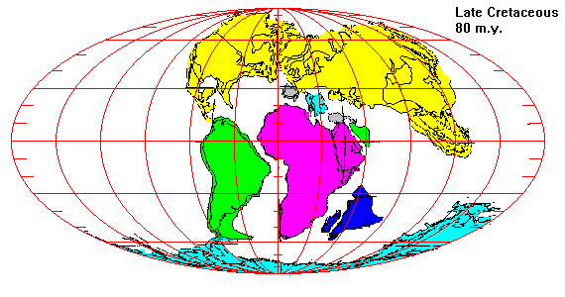

Slide 18
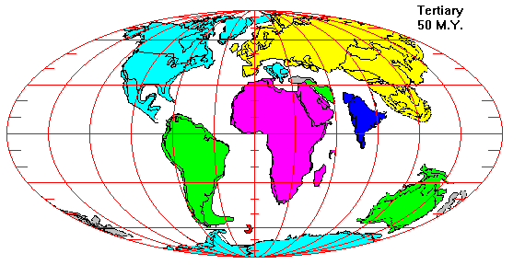

Slide 19
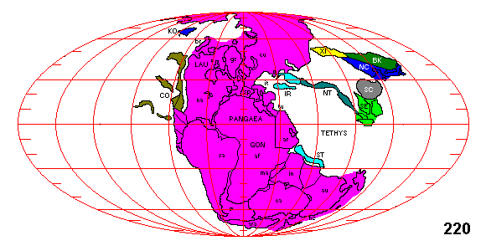
Assembly of Pangaea:
PACIFIC OCEAN & TETHYS SEAS

Slide 20
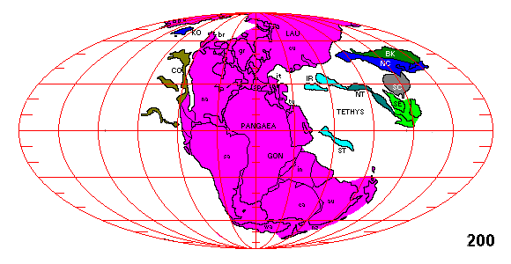

Slide 21
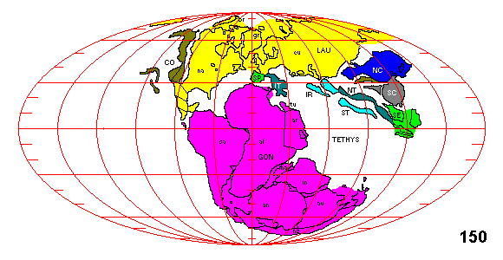

Slide 22
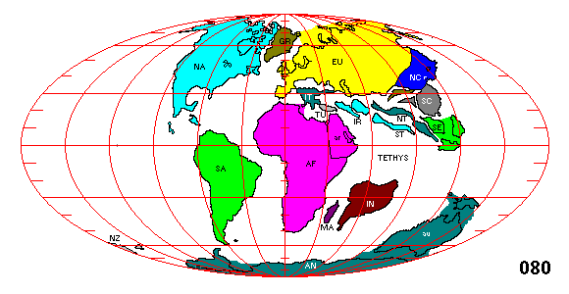

Slide 23
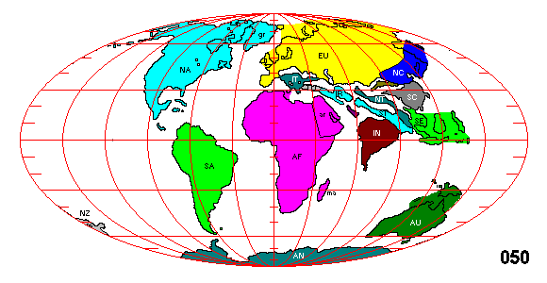

Slide 24
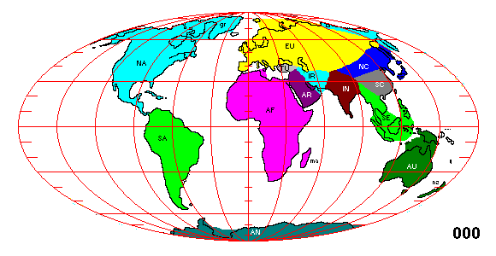

Slide 25
Dynamic Face of the earth:
The map of the Earth is always changing; not only are the underlying plates moving, but the plates also change in size.
The sea level changes over time (as the temperature on Earth varies and the poles melt or freeze to varied extents), covering or exposing different amounts of crust.

Slide 26
Understanding the Origin of Ocean basins
is a trivial subject of study.
It is very essential due to several reasons.
It is also believed that life got originated from the ocean waters.
Oceans play a very significant role on global climate.

