Slide 1
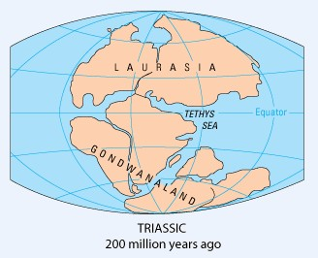
Oceanography

Slide 2
Oceanography is the scientific study of seas and oceans.
It is an interesting and interdisciplinary science.
It includes the subjects like geography, geology, chemistry, physics, biology, climatology and engineering.

Slide 3
Oceanography mainly deals with the following aspects:
Geological features of ocean bottom.
Physical conditions with reference to ocean water & its temperature.
Chemical composition of sea water and Marine sediments.
Biological conditions of marine life (Fauna & Flora)
Role of oceans in controlling global climate, navigation and economy.
The Origin of Ocean basins is an important aspect in oceanography.

Slide 4
Oceanography is sub divided
into
Geological oceanography
Physical oceanography
Chemical oceanography
Biological oceanography

Slide 5
Geological Oceanography deals with several aspects of seas and oceans. The essential aspects are:
Origin of water and air on earth
Theory of continental drift and crustal blocks.
Theory of Plate Tectonics and continuing dynamics of ocean basins.
Spreading of Sea Floor ,
Distribution of Ocean Basins & Coastal geomorphology.

Slide 6
Geological Oceanographic Studies also deal with
Morphology of ocean bottom and relief
Marine sediments and deposits
Coral Reefs and beach processes
Coastal disasters and management
Air-sea interactions.
Study of marine sediments, submarine canyons, underwater topography & Corals.

Slide 7
At present, Earth has about 1.3 billion cubic Km of water.
This amount is present mostly in the seas and oceans.
Earth is called as a blue planet, due to the presence of water.

Slide 8
Three important spheres make the planet earth as a unique
member in the solar system. They are the atmosphere, hydrosphere and the lithosphere. Their combined role lies in the sphere of all living systems.
Water
Air
Earth
Land
Life

Slide 9
First of all, it is necessary to understand
The origin of land, air and water on earth.
Origin of water and air on earth is almost related to each other.
The reason for the occurrence of such ahuge mass of water on the globe, is still a myth and reality.
The reason goes back to the Origin of Earth itself.

Slide 10
is not
The exact mode precisely known.
of origin
Scientists | assume, | both | Primary and
secondary | sources | would | have given
rise to both air and water on the earth.
Two possible sources as internal source (or) external source have been proposed so far.
Some of them are attributed towards the
theories of origin of the earth.

Slide 11
Origin of the Earth- theories
Many theories have been prposed.
“Planetesimal Hypothesis” of 1749 proposed by T.C. Chamberline's on the origin of earth was probably the First idea about the birth of earth.
Later, in 1755, Immanuel Kant has proposed the Ancestral Nebula(mist)- containing cloud of gas and dust, leading to the generation of planets from the Sun.

Slide 12
Hot Gaseous Nebula
Was thought to be rotating with great rapidity, initially.
It also underwent cooling and contraction, due to which the speed increased.
Due to strong centrifugal force along the equator, materials were thrown away as successful rings.
These rings cooled down to form solid and liquidous masses at a later stage.
The same process happened to planets to form their satellites.

Slide 13
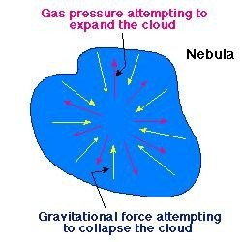

Slide 14
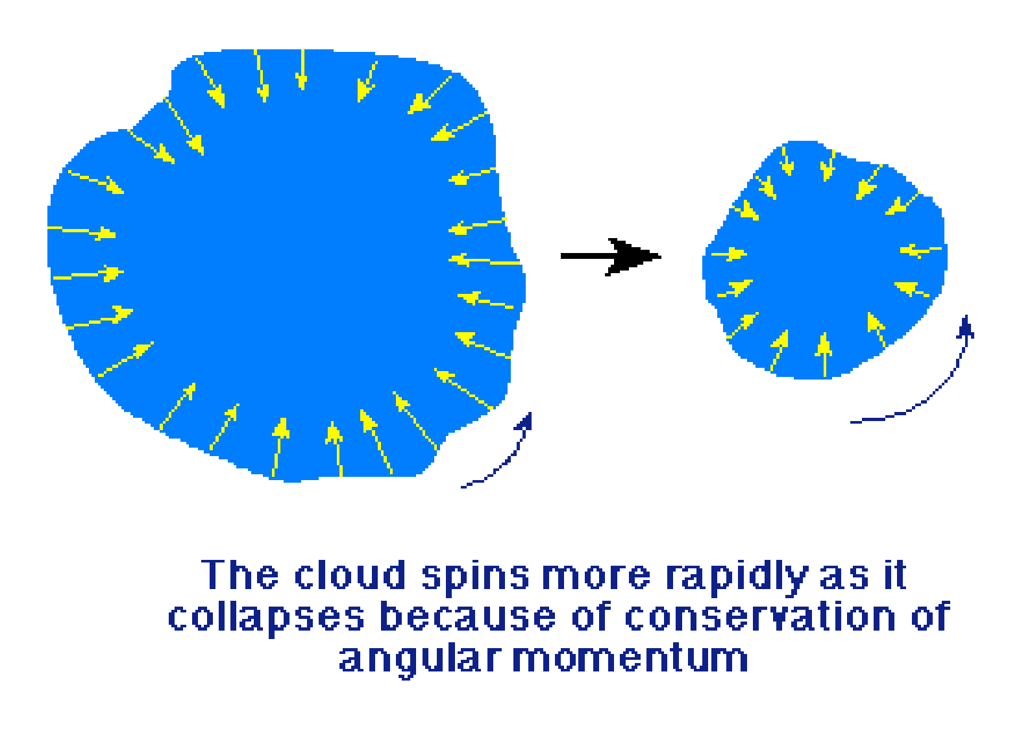

Slide 15
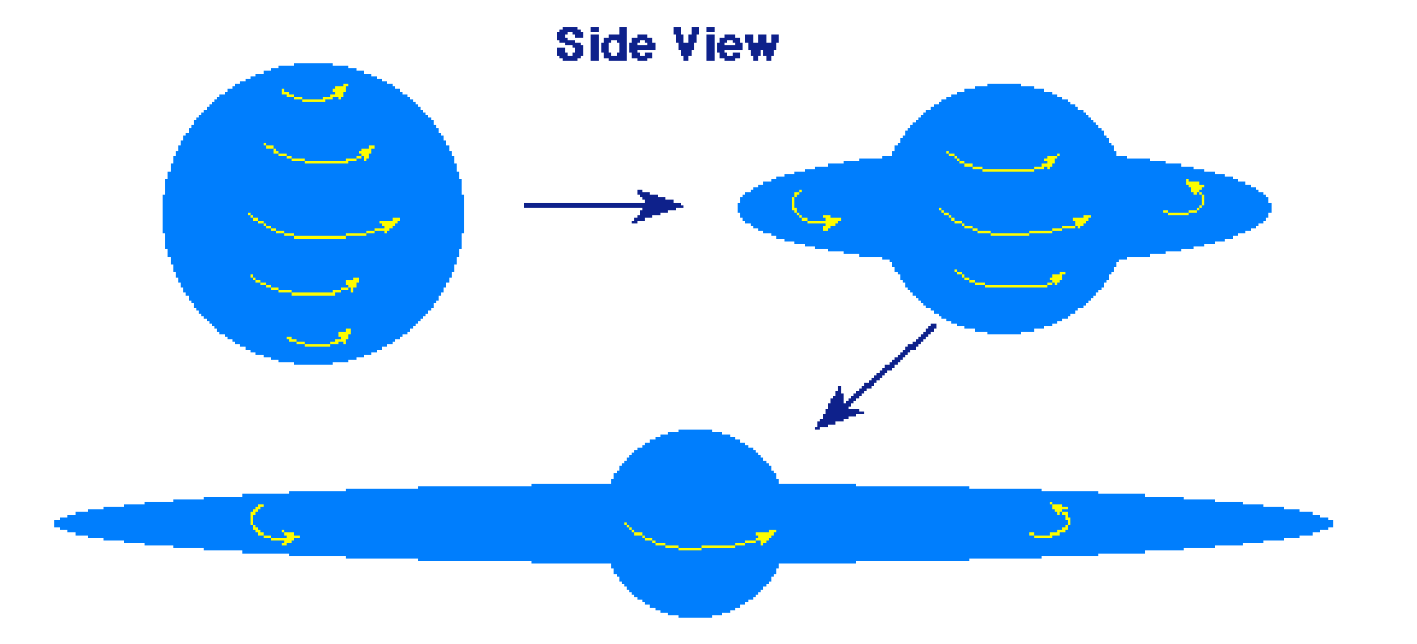
Equatorial bulge

Slide 16
The name Pangaea means "All- earth".
Pangaea was a supercontinent consisting of all of Earth's land masses.

Slide 17
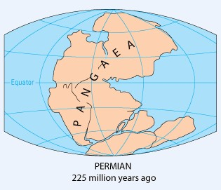

Slide 18
Internal sources:
A sizeable quantity of water would have been available with in the material which formed the Earth initially.
Water molecules would have escaped Earth's gravity more easily when it was less massive during its early stages of formation.

Slide 19
Internal Sources CO₂, water vapor, and other gases.
provided Nitrogen
Many gases were provided by volcanic eruptions, hot springs & Geysers.
All of them are earth-borne sources.

Slide 20
Primitive formed molecules interior
oceans from
were first the water
released from the
and atmospheric
precipitation.
These together
water bodies joined to form seas and
interconnected as oceans over a period of 4.6 billion years.

Slide 21
Extraterrestrial sources
People also attributed that the Earth's water was originated purely from comets.
This was done as a result of measurements of the isotope ratios of hydrogen in the three comets Halley, Hyakutake and Hale-Bopp.

Slide 22
The Shapes
of
Continents on
opposite sides of Ocean was noted
the Atlantic by several
scholars. Even today we amazingly see this feature.
It was in 1596, Abraham Ortelius put forward the Hypothesis of Continental Drift.
In 1858, Antonio-snider-Pellegrini illustrated the closed and opened Atlantic Ocean with a diagram.

Slide 23
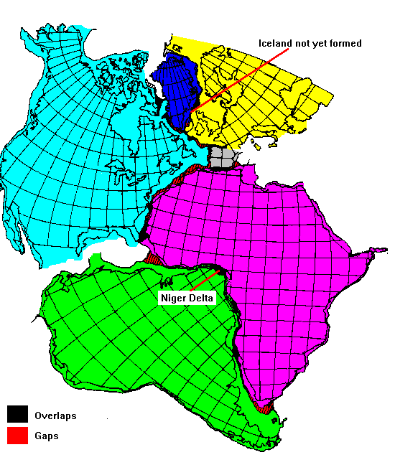

Slide 24
