Slide 1
Fundamental Geography
Course Code : Maj/Geo-101
Course Instructor: Ms. Amna Afzal

Slide 2
Essential Geography Questions
What is geography and why is it important?
What are the tools of geography and how are they used to analyze the physical and human landscapes of the world?
How are historical events influenced by physical and cultural geography?

Slide 3
Geography is the study of:
The earth's surface and the processes that shape it
The connections between places
The complex relationships that develop between people and their environments— physical surroundings.

Slide 4
Geographers are scientists who study the relationship between people and their environments.

Slide 5
The two major branches of geography are
physical geography—study of the physical features
and changes on the earth's surface
cultural geography—study of humans and their ideas, and the impact of human ideas and actions on the earth.

Slide 6
What is the importance of Geography?
help us know more about each other and our cultures,
help us understand our environment and problems associated with it,
help us better understand the ways in which each of us
interacts with, and is dependent on others and the environment,
and help us solve environmental, political, economic, and social problems.

Slide 7
Five themes of geography are
1. Location
What is the location of a place?
2. Place
What is the character of a place?

Slide 8
Five themes of geography are:
3. Environment
How do people interact with the natural environment of a place?
4. Movement
How do
people, goods, and ideas move between places?

Slide 9
5. Regions
How are places similar to, and different from, other places?

Slide 11
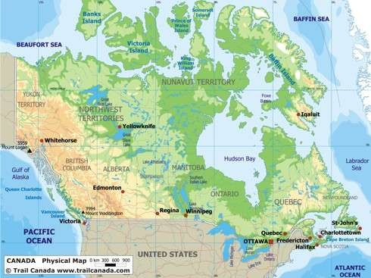
Physical

Slide 12
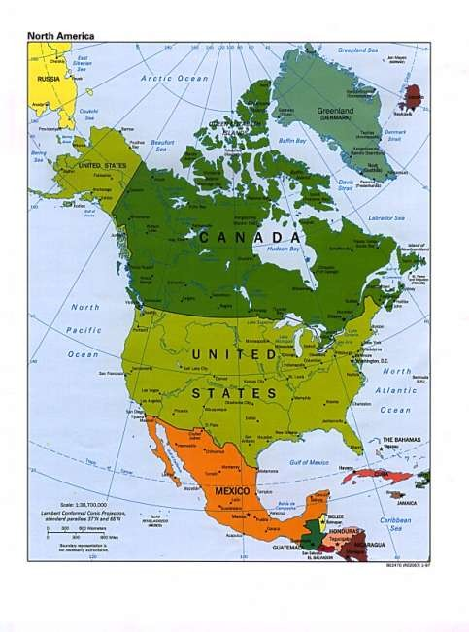
Political

Slide 13
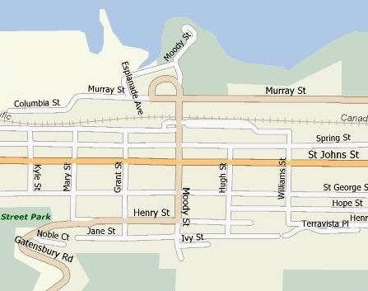
Road

