Slide 1
Chapter No.2 Components of Computer

Slide 2
2.4 Memory Unit
2.4.1 Long term memory(RAM)
2.4.2 Short term memory(ROM)

Slide 3
Memory Unit
A memory is just like a human brain. It is used to store data and instructions. Computer memory is the storage space in the computer, where data is to be processed and instructions required for processing are stored. The memory is divided into large number of small parts called cells. Each location or cell has a unique address, which varies from zero to memory size minus one. For example, if the computer has 64k words, then this memory unit has 64 * 1024 = 65536 memory locations. The address of these locations varies from 0 to 65535.

Slide 4
Types of Memory Unit
Two types:
Long term memory(RAM)
Short term memory(ROM)

Slide 5
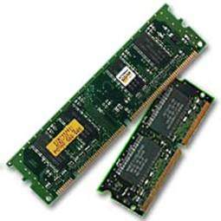
Long term memory(RAM)
RAM (Random Access Memory) is the internal memory of the CPU for storing data, program, and program result. It is a read/write memory which stores data until the machine is working. As soon as the machine is switched off, data is erased.
Access time in RAM is independent of the address, that is, each storage location inside the memory is as easy to reach as other locations and takes the same amount of time. Data in the RAM can be accessed randomly but it is very expensive.
RAM is volatile, i.e. data stored in it is lost when we switch off the computer or if there is a power failure. Hence, a backup Uninterruptible Power System (UPS) is often used with computers. RAM is small, both in terms of its physical size and in the amount of data it can hold.

Slide 6
Types of RAM
Two types of RAM −
Static RAM (SRAM)
Dynamic RAM (DRAM)

Slide 7
Static RAM (SRAM)
The word static indicates that the memory retains its contents as long as power is being supplied. However, data is lost when the power gets down due to volatile nature. SRAM chips use a matrix of 6-transistors and no capacitors. Transistors do not require power to prevent leakage, so SRAM need not be refreshed on a regular basis.
There is extra space in the matrix, hence SRAM uses more chips than DRAM for the same amount of storage space, making the manufacturing costs higher. SRAM is thus used as cache memory and has very fast access.

Slide 8
Characteristic of Static RAM
Long life
No need to refresh
Faster
Used as cache memory
Large size
Expensive
High power consumption

Slide 9
Dynamic RAM (DRAM)
DRAM, unlike SRAM, must be continually refreshed in order to maintain the data. This is done by placing the memory on a refresh circuit that rewrites the data several hundred times per second. DRAM is used for most system memory as it is cheap and small. All DRAMs are made up of memory cells, which are composed of one capacitor and one transistor.

Slide 10
Characteristics of Dynamic RAM
Short data lifetime
Needs to be refreshed continuously
Slower as compared to SRAM
Used as RAM
Smaller in size
Less expensive
Less power consumption

Slide 11
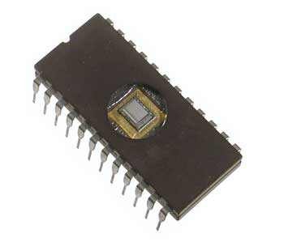
Short term memory(ROM)
ROM stands for Read Only Memory. The memory from which we can only read but cannot write on it. This type of memory is non-volatile. The information is stored permanently in such memories during manufacture. A ROM stores such instructions that are required to start a computer. This operation is referred to as bootstrap. ROM chips are not only used in the computer but also in other electronic items like washing machine and microwave oven.

Slide 12
Advanteges of ROM
Non-volatile in nature
Cannot be accidentally changed
Cheaper than RAMs
Easy to test
More reliable than RAMs
Static and do not require refreshing
Contents are always known and can be verified

Slide 13
Types of ROM
Three types of RAM −
PROM (Programmable Read Only Memory)
EPROM (Erasable and Programmable Read Only Memory)
EEPROM (Electrically Erasable and Programmable Read Only Memory)

Slide 14
PROM (Programmable Read Only Memory)
PROM is read-only memory that can be modified only once by a user. The user buys a blank PROM and enters the desired contents using a PROM program. Inside the PROM chip, there are small fuses which are burnt open during programming. It can be programmed only once and is not erasable.

Slide 15
EPROM (Erasable and Programmable Read Only Memory)
EPROM can be erased by exposing it to ultra-violet light for a duration of up to 40 minutes. Usually, an EPROM eraser achieves this function. During programming, an electrical charge is trapped in an insulated gate region. The charge is retained for more than 10 years because the charge has no leakage path. For erasing this charge, ultra-violet light is passed through a quartz crystal window (lid). This exposure to ultra-violet light dissipates the charge. During normal use, the quartz lid is sealed with a sticker.

Slide 16
EEPROM (Electrically Erasable and Programmable Read Only Memory)
EEPROM is programmed and erased electrically. It can be erased and reprogrammed about ten thousand times. Both erasing and programming take about 4 to 10 ms (millisecond). In EEPROM, any location can be selectively erased and programmed. EEPROMs can be erased one byte at a time, rather than erasing the entire chip. Hence, the process of reprogramming is flexible but slow.

