Slide 1
History of Pakistan Movement (1857-1924) Min/Hist-101
Ms. Nadia Saleem
BS-I (2019-23)
Spring 2020

Slide 2
Unit 1 War of Independence 1857
1.1 Nature and causes

Slide 3
Nature of the War
Mutiny or Independence movement?
It was Mutiny in the opinion of British as they were in the ruling power and those who rebelled or opposed their colonial power were called as Rebels and the opposition breakout which was a civil war is called as Mutiny in British perspective

Slide 4
CONT
War of Independence is an important landmark in the history of Sub-Continent. This War was fought in 1857 by Indians against the British in order to get rid of their domination.
It was an extreme effort made by Indians, but they failed due to certain reasons including mutual jealousies, disunity, and lack of central leadership.

Slide 5
Cont
This war was not spread throughout India, but it was limited to few areas mainly Meerut, Delhi, Kanpur, Lucknow etc.

Slide 6
CONT
The main event which became the immediate cause of the war was the refusal of the Sepoys to use the grease covered cartridges (greased with fat of pig and cow) on January 23, 1857. At the same time, an Indian sepoy killed two British officers at Barrackpore, when he was forced to use greased cartridges.

Slide 7
ABOUT THE NEW CARTRIDGE
A rumor had broaden that the new cartridge enclosed in a paper covered with the fat of cow and pig.
HINDUS MUSLIMS
COW WAS HOLY FOR HINDUS PIG MEAT WAS TABOO BY QURAN

Slide 8
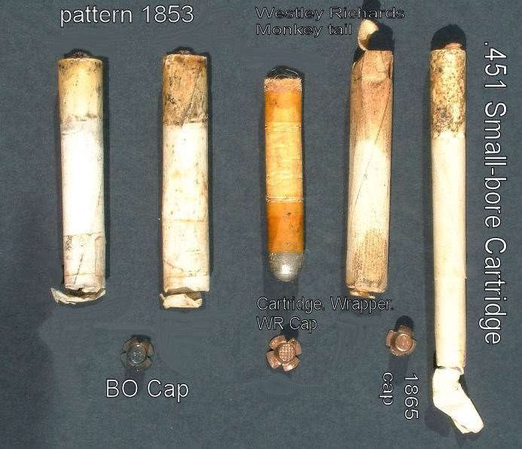

Slide 9
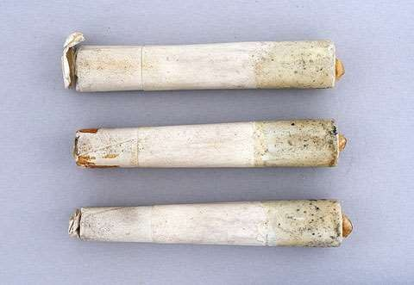

Slide 10
Causes of the war
There were many causes of war of independence
Political causes
Religious causes
Social causes
Military causes
Economic causes

Slide 11
Failure of war of independence

Slide 12
1. Spread in limited areas
One of the reasons of failure of first war of independence was that it was spread in limited areas.
The foremost cause was the sudden start of the war in confusion, without any preparation or proper planning. Secondly since there was an extreme lack of communication and coordination among various groups of freedom fighters who started their uprising according to their own wishes, it became easy for the English troops to curb the revolt of different areas on by one.

Slide 13
2. Lack of unity and planning
The revolt was not properly organized. The leaders of the first war of Independence did not coordinate their efforts at any stage. There was no unity among the freedom fighters. They fought independent of one another. As a result they could not assemble their resources against a common enemy. They were defeated at different places. Bakht Khan was defeated at Delhi, Begum Hazrat Mahal lost at Awadh, Rani Jhansi was routed at Jhansi. Nana Sahib lost at Kanpur and Bahadur Khan was defeated at Bareilly. On the contrary, the British acted under one command, in one direction, with one fixed aim.

Slide 14
3. No unified leadership and discipline
There was also an absence of a capable leader who could organize the scattered forces in to one unit fighting for unified policy and aim. Nana Saheb, Rani Lakshmi Bai, Tantia Tope, Bahadur Khan, Bakht Khan and Kunwar Singh remained confined to their own locality. None of them emerged as the leader of the entire movement. As a result, these freedom fighters lacked discipline and their efforts could not get the required momentum at national level. On the other hand, the British succeeded against the rebels because of the determination and leadership of their military commanders like Havelock, Neill, Nicolson and Hugh Rose.

Slide 15
4. Better resources of the British
The British had better resources than Indians. They were short of not only war equipment but also food and ration. They had to face an enemy which was well equipped and well organized. Nearly 112,000 English soldiers pored in to India and 310,000 were recruited fresh from among the Indians. Indians were fighting mostly with swords and spears, while the English were using better equipped rifles. The telegraph proved very useful to the English. It kept them informed about the movements of rebels and largely helped them in keeping contact among themselves.

Slide 16
Fourthly, English troops were modern and strikingly advanced not only in warfare but also in new ways of swift and speedy communication. They did not have to cross long roads and grounds to deliver a message or order but could simply wire it with a few minutes. The Indians on the other hand were devoid of such means. That’s why they utterly fell behind and got defeated.

Slide 17
7. No support of native rulers
Many native rulers, rather than supporting our freedom fighters, helped the British in suppressing the revolt. The rulers of Patiala, Jind, Gwalior, Hyderabad etc, supported the British by all possible means. The king of Nepal also helped the English by putting his army under the command of the British (Gurkha regiment).

Slide 18
Fifthly, the English had full command on waters due to their advanced navy they got enforcement from their Crimean fronts to counter Indian aggression without any delay. Being equipped with modern weapons especially Enfield rifles they could hunt down Indians who were still fighting with their sticks, swords and daggers to fight their highly powerful opponents.

Slide 19
8. No support of educated Indian and middle class
It is a stark fact that the first war of independence never assumed the shape of a well organized national struggle. The educated Indians and the middle class also did not support the revolt. On the contrary, their feelings were against it. The money lenders and merchants were also against the war as it went against their economic benefits.

Slide 20
9. Non-Cooperation of Sikhs and Punjab
The Sikhs of the Province of Punjab considered the Muslims as their traditional enemies. Thus they decided to support the British in the war of Independence. The Sikh soldiers played a decisive role in the recovery of Delhi from the freedom fighters.

Slide 21
10. No concept of Nationalism
The leaders of the first war of Independence had no concept of nationalism and nation-state. They were fighting for their own regional interests.

Slide 22
11. economic conditions
The economic conditions of Indian troops also entailed an obvious cause of their defeat. On the one hand the war started out of awkwardness, mismanagement and lack of planning and even the emperor was practically penniless who was asking for loans from Delhi landlords but they were determined to save their money, not their freedom. The British troops, on the other hand, had been wealthy because the prosperous regions of India were totally under their control.

