Slide 1
Physics
Types of Semiconductor

Slide 2
SEMICONDUCTOR
A semiconductor is a material that is neither a good conductor or a good insulator but that conducts more electricity when heat, light or voltage is added.

Slide 3
Semiconductors are the materials which behave as insulators at low temperature and conductors at higher temperature.
Conductance of semiconductors increases with increase in temperature.
Silicon and germanium is the example of semiconductor.
Semiconductor behaves as both conductor and insulator due to its conductivity in conduction bands at various temperatures.
All the solids with completely filled valence band and very narrow forbidden band are semiconductor.

Slide 4
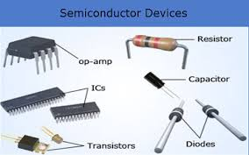

Slide 5
Types of semiconductor
Intrinsic semiconductor
Extrinsic semiconductor

Slide 6
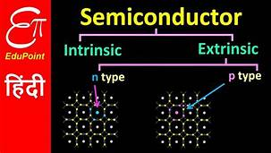

Slide 7
Intrinsic semiconductor
An intrinsic type of semiconductor material made to be very pure chemically. As a result it possesses a very low conductivity level having very few number of charge carriers, namely holes and electrons, which it possesses in equal quantities.

Slide 8
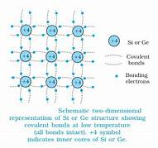

Slide 9
Extrinsic semiconductor
Extrinsic types of semiconductor are those where a small amount of impurity has been added to the basic intrinsic material. This 'doping' uses an element from a different periodic table group and in this way it will either have more or less electrons in the valence band than the semiconductor itself. This creates either an excess or shortage of electrons.

Slide 11
Types:
N type semiconductor
P type semiconductor

Slide 12
N-type semiconductor
An N-type semiconductor material has an excess of electrons. In this way, free electrons are available within the lattices and their overall movement in one direction under the influence of a potential difference results in an electric current flow. This in an N-type semiconductor, the charge carriers are electrons.

Slide 13
P-type semiconductor
A P-type semiconductor material there is a shortage of electrons, i.e. there are 'holes' in the crystal lattice. Electrons may move from one empty position to another and in this case it can be considered that the holes are moving. It is actually harder for holes to move than for free electrons to move and therefore the mobility of holes is less than that of free electrons. Holes are positively charged carriers.

