Slide 1
Forward Biased Junction Diode

Slide 2
Defination: The process by which, a p-n junction diode allows the electric current in the presence of applied voltage is called forward biased p-n junction diode.

Slide 3
Connections: The positive terminal of the battery is connected to the p-type semiconductor material and the negative terminal of the battery is connected to the n-type semiconductor material.

Slide 4
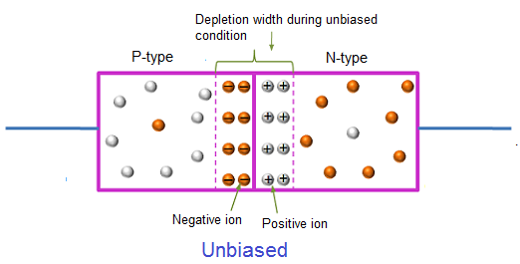

Slide 5
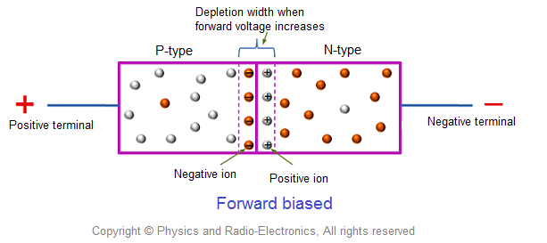

Slide 6
Working:
If the diode is forward biased, then holes will move toward the n-type semiconductor and electrons will move toward the p-type semiconductor and they will diffuse with each other.

Slide 7
P-type: Due to the attraction of positive terminal of source, electrons which participated in covalent bond creations in p-type material, will be attracted towards the terminal. Here numbers of covalent bonds are broken and electrons are shifted towards the positive terminal. Due to the higher concentration of holes adjacent to negative impurity ions layer the electrons of negative ions come out and recombine with those holes and create new holes in the layer. Consequently, the width of this negative ions layer is reduced and finally this layer vanishes.

Slide 8
N-type: Similarly due to the negative terminal of source the free electrons in the n-type region will repeal towards junction where they will find the layer of positive impurity ions and start recombine with these ions and generate free electrons inside the layer. Consequently, the width of positive impurity ions is reduced, and finally, it vanishes.

Slide 9
Result: This way, both layers of ions disappear, and there will be no more depletion layer. After the depletion layer disappeared, free electrons from the n-type region can easily drift to p-type region and holes from p-type region to n-type region in the crystal. Hence, ideally there will be no obstruction of flowing current and the pn junction behaves as the short circuit.

