Slide 1
Half Wave Rectification

Slide 2
Rectifier:
An electrical device which converts an alternating current into direct one by allowing a current to flow through it in one direction only .
The following is a type of rectifier circuit can be used:
Half wave rectifier
Full wave rectifier

Slide 3
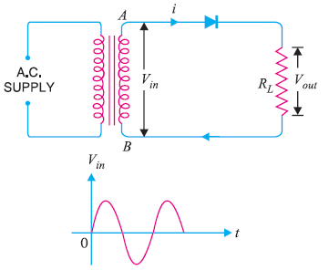
Half wave rectifier circuit diagram

Slide 4
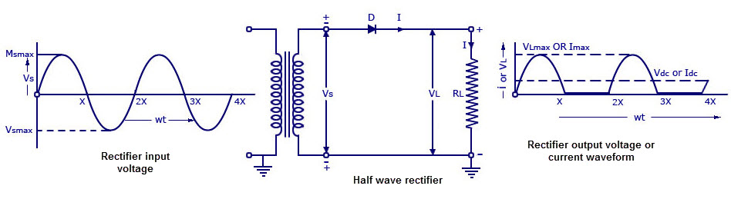
Single half phase rectifier

Slide 5
Half wave rectification
A half wave rectifier is a type of rectifier which converts the (positive current) of the input signal into pulsating DC (direct current) output signal.
In half wave rectification, the rectifier conducts current during positive half cycle of input AC signal only.
Negative half cycle is suppressed.

Slide 6
Half wave rectifier
AC voltage across secondary terminals AB changes its polarity after each half cycle.
During negative half cycle terminals A is negative so diode is reversed biased and conducts no current.
So, current flows through diode during positive half cycle only.
In this way the current flows through load RL in only one direction.

Slide 7
Half wave rectification
Advantages of Half Wave Rectification
Advantage of a half wave rectifier is only that is cheap.
Simple and easy to construct.
It is cheap because of the low number of components involved.
Simple is because of the straight forwardness in circuit design.

Slide 8
Half wave rectifier
Disadvantages of half wave rectifier
Disadvantage is the ripple factor of the half wave rectifier is very high.
The output contains lots of ripples.
The maximum theoretical efficiency is 40%.
The practical value will be quite less than this.
This indicates that half wave rectifier is quite inefficient.

Slide 9
Half wave rectifier
Output frequency of half wave rectifier
Output frequency of half wave rectification is equal to input frequency.
This means when input AC completes one cycle, rectified wave also completes one cycle.
ƒout = ƒin

