Slide 1
Energy Bands

Slide 2
Energy Band
The number of energy levels in a band is equal to the number of atoms in a crystal. Thus, the energy bands in a crystal correspond to the energy levels in an atom and an electron in a crystal can have an energy that falls within one of these bands.

Slide 3
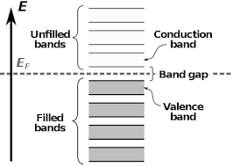
There are some important energy bands,
Valence band
Conduction band
Forbidden band

Slide 4
Valence band
The valence band is the band of electron orbitals that electrons can jump out of, moving into the conduction band when excited. The valence band is simply the outermost electron orbital of an atom of any specific material that electrons actually occupy. This is closely related to the idea of the valence electron.

Slide 5
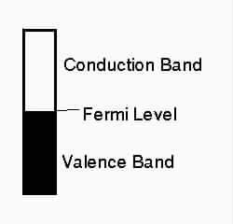
Conduction band
The conduction band is the band of orbitals that are high in energy and are generally empty. In reference to conductivity in semiconductors, it is the band that accepts the electrons from the valence band. The conduction band can be seen in the diagram.

Slide 6
Forbidden band
In solid state physics, an energy gap or band gap, is an energy range in solid where no electron states can exist. It generally refers to the energy difference between the top of the valence band and the bottom of the conduction band in insulators and semiconductors

