Slide 1
MECHANICS Min/B.Eds-CA-204
Ms. Palwsha Javed
BS-IV(2018-2022)
Spring 2020

Slide 2
Buddhist Art of Gandhara
Stupas of Gandhara art

Slide 3
Stupas
Stupa, which was originally a small burial or mound of earth, emerged as an important architectural program. In the course of time, this repository became an object of religious importance and worship. With increasing reverence, the simple, round drum assumed greater prominence and proportion. It developed into a great hemispherical dome which housed within it the relics. According to the Buddhist practice the Stupas were divided into the following categories.
1. Relic Stupa:
in which the relics or remains or ashes of the Buddha or his disciples are placed, or something that is from a past time, place, culture, etc. and belonging to a saint.

Slide 4
2. Object Stupa:
in this type of Stupa, the objects belonging to Buddha and his disciples are placed, such as begging bowl, robe, turban, slippers or important Buddhist belonging to a saint.
3. Commemorative Stupa:
constructed to remember event in the life of Buddha and his disciples. To commemorate officially and give respect to Buddha and his disciples or events from his life.

Slide 5
4. Votive Stupa:
constructed to gain spiritual benefits give or done to honor and thank a god.
5. Model or symbolic Stupa:
to symbolized aspects of Buddhist religious belief. A thing use as an example to follow or imitate.
The Stupa relics originally contained the relics of the Buddha or his disciples. Later on, Stupas were built to commemorate some events to the life of Buddha or other some other great saints.

Slide 6
In due course, the places of the relic and commemorate Stupa became centers of pilgrimage where the Buddhists devotees built votive Stupas as a work of great religious merit.
Before the representation of image of the Buddha, model Stupa carved on stone reliefs indicate his death. This type had symbolic meanings.
When the Stupa was looks upon as an object of homage, it was fenced off by a railing. This practice was not followed in Gandhara.

Slide 7
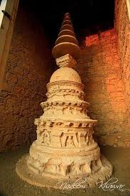
The solid conical structure was raised on a high base, round or square in plan. The bas was decorated with sculptures depicting various scenes in the Buddha’s life. Sometimes, a screen wall was added to protect the sculptures. Rows of sculptures also adorned the main body of the Stupa drum.

Slide 8
The Stupa structure consisted of a base, a cylindrical drum, and a hemispherical dome superimposed by seven disc- shaped umbrellas one above the other, supported on an upright staff which rests firmly inside a square box, called ‘Hermika’. This ‘Hermika’ contains the relics.

Slide 9
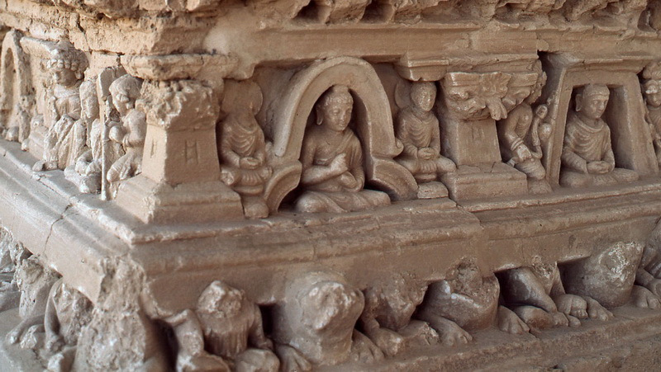
There are numbers of isolated monuments, mainly Stupas and monasteries, scattered about the valley of Texlia. The remains are especially numerous in southern half of the valley. The niches in the Stupas once held figures of the Buddha or of the Bodhisattva in relief. The same kind of decoration is also found in smaller Stupas.

Slide 10
Ashoka was supported to have built thousands of Stupas throughout the India. By the end of the second century B.C. they had grown to huge proportions. Sculptured fragments of early Stupa have been found in India, but the grandeur of this type of structure can be seen best at Sanchi in the state of Madhya Pradesh.
There, on a hill overlooking a wide plane, several Stupas containing sacred relics were built over a period of centuries. Of these, the ‘Great Stupa ’the tallest and the finest, was originally dedicated to Ashoka.

Slide 11
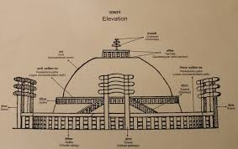
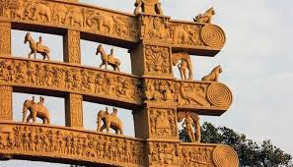
A double stairway leads to the base, a drum about twenty feet high, and permits across to a narrow railed walk around the solid dome, which rises to a height of fifty feet above the ground. Surmounting the dome is a square enclosure from the center of which rises the ‘yasti or mast’. The yasti is itself adored with a series of umbrellas.

Slide 12
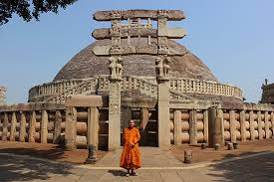
Around the whole structure is a circular stone railing with ornamented gateways. The, Stupa like most Indian structures, has more than one function. Apart from functioning as a container for relics; it is an object of adoration, a symbol of death of the Buddha, and a token of Buddhism in general.

