Slide 1
Bas Relief of Buddhist art
Ms.Palwsha Javed
BS-IV ( 2018-2022)
Spring- 2020

Slide 2
Base relief
Style/ Theme:
Gandhara produce an extraordinary number of base-relief. Some decorated the base of statues or even the rises of a staircase, but by far, the great number was placed and medium Stupas. Carved on separate slab of stone, these were fitted afterwards on to the architecture. Hence they are often quite small, many panels being no more than 15 to 20 cm. the old themes of the ‘Jataka’ ( the story of the former lives of the Buddha ) represented with great interest and the narrative style is very interesting. Many new images were added to the earlier styles of India. The appearance of Buddha formerly suggested by symbols only in human form, changed the composition radically.

Slide 3
Composition:
Generally, however, the compositions are less animated than in early base-reliefs where nature and innocent imagination made the picture livelier. Now the interest centers more and more on the image of the master with a radiating, symmetrical scene in which other figures and attributes serve only the distinguish the episode, or to act as companions to the master who alone seems to be of importance.
Despite the quantity and variety of the works, the same idea are repeated continuously. Long panels usually from a frieze on the square, or round base, or they may be placed one above other on the gable. They are separated by a fixed semi-circular column surmounted by Corinthian capital with acanthus leaves, a

Slide 4
Degenerate classical form. Each story is usually confined to a single scene. The four great miracles of the life of Buddha are found on the smallest Stupas.
The Four Great Miracle of the life of the Buddha:
the four great miracles of the life of Buddha are found on the smallest Stupa.
The birth of the Buddha
Illumination or spiritual awaking
The first sermon
The death of the Buddha

Slide 5
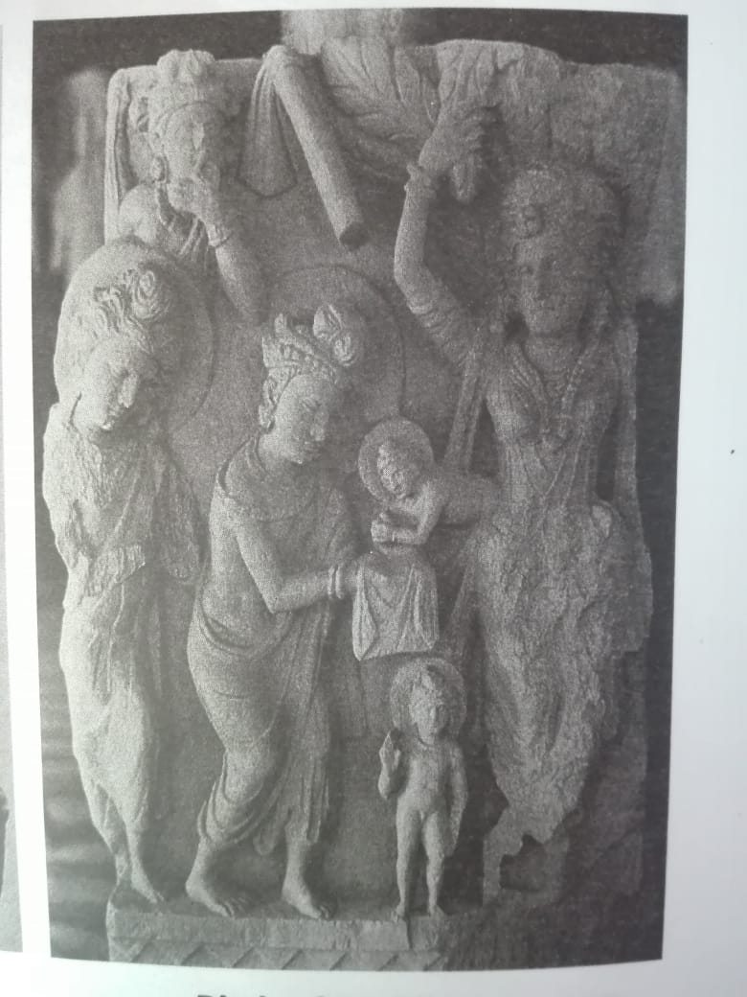
The birth:
this was the first miracle in the life of Buddha and before coming into the world, his mother had a dream that an elephant came which brought rain and fertility to their kingdom. On his birth, the golden sacred water was sprayed on him. The miracle of the birth is successed immediately by the
Bath of Budhisattva. The naked child stands
on a Pedestal looking like a golden
statue and the honor of pouring over
him the sacred water falls by
the gods indra and Brahma.

Slide 6
On of the greatest contribution of the stone carvers, therefore, was either fertile illustration of the different episodes in the life of Buddha. Hellenic tradition were Indianizes in treatment.
It is obvious that the foreign elements in the art of Gandhara tended to diminish as time went on, and that, generally speaking, the sculptures, with most clearly marked Greek character should be considered early, and those most Indianized as comparatively later.

Slide 7
2. Illumination and spiritual awaking:
While he was meditating under the tree in the jungle, the illumination was developed in him which led people to follow him. This awakening of inner sight or soul, which could not see the bitter condition of the humans or the love with humanity.
After leaving his palace, for the next six years, Siddhartha lived an ascetic ( a person who leads an austerely simple life, especially one who abstains from the normal pleasure of life or denies material satisfaction ) life and took part in its practices, studying and meditating using the word of various religious teachers as his guide.

Slide 8
He practiced his new way of life with a group of five ascetics, and his dedication to his quest, was so stunning that the five ascetics became Siddhartha's followers. When answer to his question did not appear, however, he redoubled his efforts, enduring pain, fasting nearly starvation, and refusing water.
Whatever he tries, Siddhartha could not reach the level of satisfaction he sought, until one day a young girl offered a bowel of rice, as he accepted it, he suddenly realized that corporeal austerity was not mean to achieve inner liberation, and that living under harsh physical constraints was not helping him achieve spiritual release. So he had his rice, drank water and bathed in the river. From then on, however, Siddhartha encouraged people to follow a path of balance instead of one characterized by

Slide 9
extremism. He called this path ‘the middle way’.
The Buddha Emerges:
that night, Siddhartha set under the Bodhi tree, vowing to not get up until the truths he sought came to him, and he meditated until the sun came up the next day. He remained there for several days, purifying his mind, seeing his entire life, and previous lives, in his thoughts. During this time, he had to overcome the threats of Mara, an evil demon, who challenged his to became the Buddha. When Mara attempted to claim the enlightened state as his own, Siddhartha touched his hand to the ground and asked the earth to bear witness to his enlightenment, which it did, banishing Mara. And soon a picture begin to form in his mind of all occurred in the universe, and Siddhartha finally

Slide 10
saw the answer to the question of suffering that he had been seeking for so many years. In that moment of pure enlightenment, Siddhartha Gautama became the Buddha.
3. The first sermon:
the first sermon was held when he addressed his followers for the first time after his illumination and spiritual awakening. He is reassuring people and saying that everything will be right.
In his first sermon, the Buddha said,
“ I teach one thing and one thing only: suffering and the end of the suffering,”
Which is the ultimate goal of the Buddhism.

Slide 11
In his first sermon at Deer park, he taught the Four Nobel Truths:
The existence of suffering, the cause of suffering, that the cause of suffering can, and the path to the end of suffering.
What he said:
in the first sermon, the Buddha warns these monks, the Buddha warns these monks over extreme devotion to the indulgence of sense-pleasure as well as self-harm, these two extremes ought not to be practiced by one whose has gone from the household life.
What are these two extremes? There is devotion to the indulgence of sense-pleasures, which is low, common, the way of ordinary people, unworthy and unprofitable; and there is devotion to

Slide 12
Self-torture, which is painful, unworthy and unprofitable.
Avoiding both these extremes, the Buddha has realized that the “Middle path” gives vision. It gives knowledge, and it leads to calm, to insight, to enlightenment, to Nirvana.
And what is the “Middle path”? It is simply the ‘Noble Eight-fold path’, namely, right view, right thought, right speech, right action, right livelihood, right effort, right mindfulness and right concentration.
The Noble Truth:
according to Buddha, “The Noble Truth” of the suffering are, birth, aging, sickness, death, sorrow and mourning,

Slide 13
Pain, grief and despair are all sufferings.
The Noble Truth of the ending of suffering is by the complete closure of that very thirst, giving it up, abounding it, freeing one self from it, and detaching oneself from it.
The Noble Truth of the path leading to the end of suffering is simply the noble eight-fold path.

Slide 14
4. The Death:
this is the last miracle of Buddha.
One of the greatest achievements of the art of the Gandhara was to create an image for the last of the great miracles, the Death of the Buddha, the final death, not followed by any re-birth. As at the birth, the final death is attended by miracles, celestial music, rain of followers,

Slide 15
unreasonable flowering of the teak trees, and a crowd of devas, present in the last movement of the earth, whose figure throng the base-relief.
Even in the smallest sculpture( Death of Buddha, Gandhara ), the artist/sculptors succeed in expressing all the different sentiments of the participants; the Sorrow of those who cannot hear to let their master go,

Slide 16
monks crying in despair, the confident joys of others, devas, monks even laymen, more confident of the impermanence of material things, who rejoice at this entry into Nirvana or non-being.
With the incorporation of the Buddha’s human image into art after the first century, sculptors begun to depict legends surrounding the youth of Siddhartha, including stories of his birth and death. These legends and historic events were eventually consolidated into a clear storyline that usually centers of four main events of the Buddha's life, referred to as the four great Miracles. Thereafter, these four events were frequently depicted

Slide 17
On narrative relief panels. Such panels were often placed around the base of important Stupas and can be considered in chronological order. In the fourth and the final relief, showing the miracle of the Buddha’s journey to nirvana, local person appear above him and express their intense grief. The monks on the other hand, seem to be at peace. One monk sits directly under the Buddha’s bed and calmly meditates, thus signifying his understanding that the Buddha’s passing is not death but rather a release from the endless cycle of rebirth. Large monuments also show other episodes. Generally a seated or standing Buddha occupies the center of the panel, the focal point for nearly all the secondary figures, which stand on each side in more or less equal

Slide 18
Equal numbers. At Gandhara the narration became brief in consequence and interest was centered on the human figure. Importance is given to the Buddha, whose size is enlarged in accordance with the tradition that he had a superhuman stature, or sometimes to express his supernatural grandeur. This superior nature is also suggested by the following symbols:
1. The halo ( a circle of light shown around or above the head of a saint or holy person to present their holiness).
2. The throne where he sits
3. The tree that frame him
4. The canopy above his head

