Slide 1
Greek Temples
Ms. Palwsha Javed
BS-II: (2019-2023)
Spring-2020

Slide 2
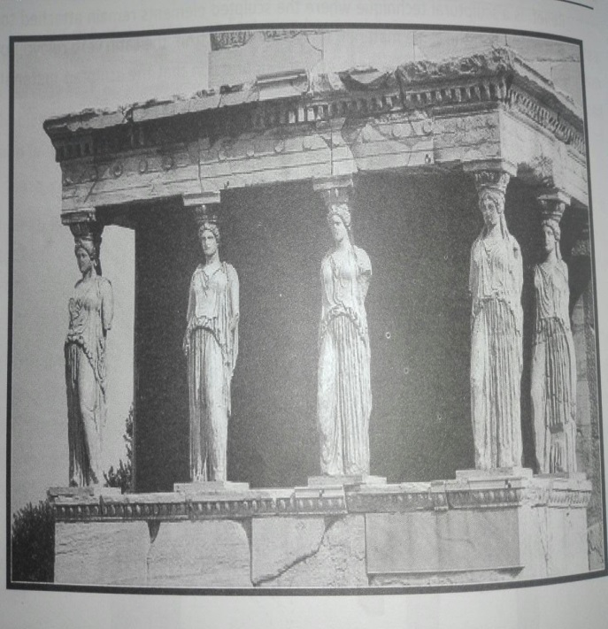
For the Greeks the most important buildings were temples. Some temples were circular in shape, but majority was rectangular. A temple was always built on an elevate platform with steps leading up to it. These steps were too high for human legs, and at one point normal sized steps were cut into them. The main entrance always faced east. In front of the temple was an open portico (porch) supported by columns with a corresponding
portico at the opposite end
of the building. The column
of the portico continued along
the two sides of the temple and
joined the columns of
the portico at the back.

Slide 3
In this way symmetry, was achieved irrespective of the direction from which the buildings was seen.
The low, slanting roof was constructed from wooden beams and
Covered with thin marble or terracotta tiles. Shallow pediments surmounted the whole length of both the east and the west facades. There were very few windows. Light came in mainly through the doorway and skylight.
A Greek temple was considered the private palace of god, and only the priests were allow to entre. The temple was decorated in the brightest of colors. There were statues in front of the buildings and beautiful relief carving, especially on the pediments and frieze.

Slide 4
The temple consisted usually of two chambers. The smaller chamber at the back and the treasury which was used mainly to store the offering made to the gods. The large chamber housed the statue of the god or goddesses to whom the temple was dedicated.
In Athens, the statue of the goddesses of the city received a new dress at each annual festival.

