Slide 1
Greek Painting
Ms. Palwsha Javed
BS-II: (2019-2023)
Spring-2020

Slide 2
Greek geometric and archaic painting is known only through vase painting. It was an important medium until fourth century B.C. Early geometric paintings consisted of geometric shapes. The human body was reduces to simplify parts. The Archaic period was a time of rapid change and development in ancient Greece.
Geometric style, which was characterized by geometric shapes, soon dominated the art of the Greek mainland. Human and animal figures on pottery from this period are depicted in terms of simplified geometric shapes. The geometric style is distinguished by decoration in bands covering the entire surface, and by literally geometric shapes of ornament meanders, checkers, zigzagging and lozenges.
Greek potters increasingly turned away from purely geometric decoration, giving more space to larger and more presentational figures designed to tell a tale. Every thing is shown in strict outline, simplified

Slide 3
For clarity. Figures are flat with triangular torso and pinched waist; humans and horses have essentially the same physique.
Black-Figure Painting:
The technique employed in which black shapes are on the lighter reddish background is called a black figure vase painting.one of the two most important types of Greek vase painting is the black- figure painting.

Slide 4
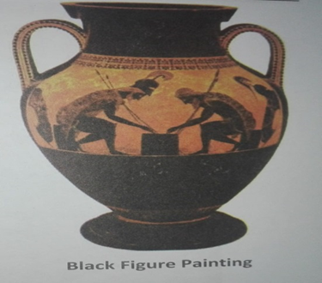
In this style, painting is done with a black glaze on a natural red clay background. In essence, the artist works with drawing the outlines and then filling in the color. Once this color has been applied, detail created by scraping through the black glaze to reveal the red clay beneath.
For example, an Amphora, a two handled vessel named for the Greek word, meaning to carry on both sides, is an example of black figure style. It shows the great warriors and military heroes of the Greeks, playing checkers in their camp.
Black figure painting continued through
most of the archaic period and into the third
quarter of the 6th century B.C., when it begun
to give way to red figure painting.

Slide 5
Red-Figure Painting:
in a red-figure painting the background is filled in with brown black, leaving a base color of red-orange for figures. The basic colors were produced by painting red-brown clay with a thinned mixture of clay that turned black in firing. White and other colors were sometimes added.
During the archaic period, the figures became more lifelike and geometric ornaments were reduced. Scenes from mythology were depicted and ornamentation includes animals, flowers and motifs. The growing interest of creating depth in painting may have contributed to the decline of vase painting after 5th century. Creating depth in the painting on a three dimensional vase is very difficult. As for depth in vase painting works against the forms of the vase.

Slide 6
Although red figure painting continued and there was an increase tendency to use delicate colors and light linear drawings on vase with white grounds. Figures became rounder, softer and more flexible. Objects were drawn with more foreshortening and eye appear in profile for the first time. During Hellenistic period, wall painting was widely done. Scenes for depiction were chosen from mythology and everyday life, with a more humanistic touch.

