Slide 1
unit 1: invertebrates introduction and phylum protozoa topic: classification and disease causing protozoa B.Ed (hons) secondary semester IV subject: biology IV (minor) course title: invertebrates diversity represented by: Ms sidra younis department of education (planning and development) Lahore college for women university, Lahore

Slide 2
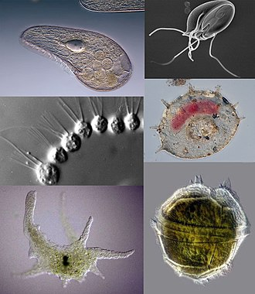
Phylum protozoa
Distinguish features:
Phylum protozoa belongs to kingdom Protista.
They are known as acellular or non cellular organism.
A protozoans body consists of only mass of protoplasm , so they are called acellular or non-cellular animals.
They are the simplest and primitive of all the animals with very simple body organization , i.e. protoplasmic grade of organization.
Body of protozoa is either naked or covered by a pellicle.

Slide 3
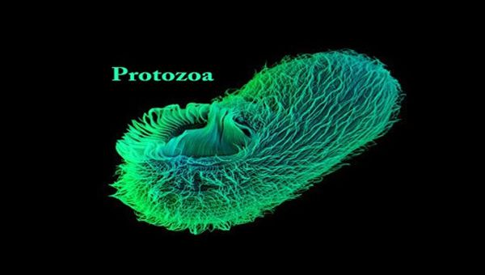
Protozoa are animal like because they move
Some are autotrophs, and some are parasitic mostly live in the host.
They are present in water as well as moist area.
They are asymmetrical, having no symmetry mostly.
Two types of nucleus present;
Micronucleus
Macronucleus

Slide 4
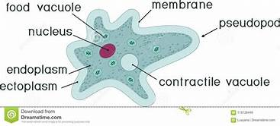
Contractile and food vacuole is present.
In protozoans inner outer skeleton is absent.
They are brainless.
Holophitic , holozoic , saprophytic and parasitic on the base of nutrition.
Respiration is of two types;
Aerobic respiration
Anerobic respiration

Slide 5
Classification of protozoa
Phylum protozoa is classified into four classes on the basis of locomotary organs

Slide 6
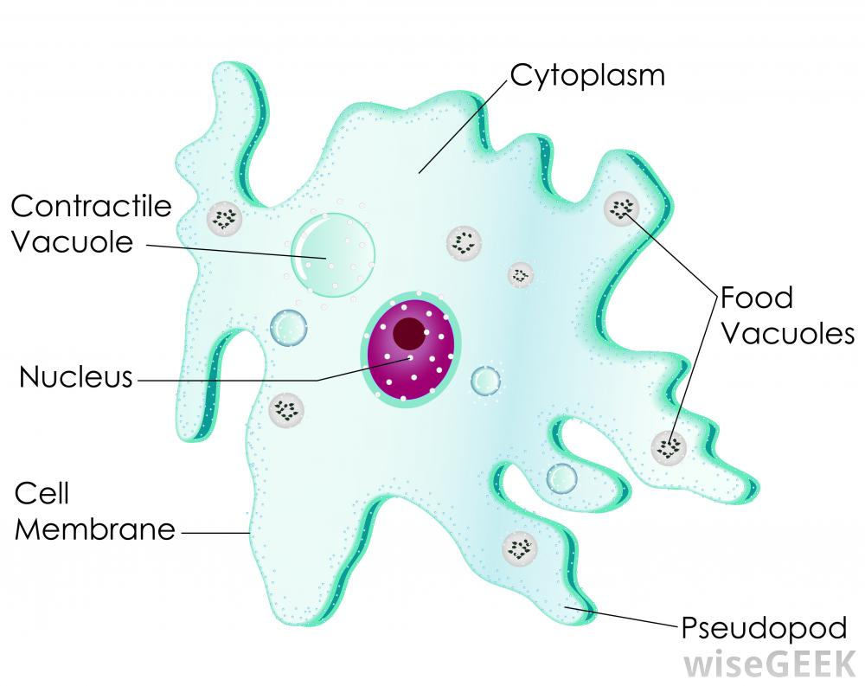
Class 1:
Rhizopoda
Example: Amoeba , paramecium
Mostly free living or some are parasitic endoparasite.
Contractile vacuole may be present or absent .
Locomotary organelles are pseudopodia which also help in food capturing .
Body is without a pellicle, and has no fixed shape.
Protoplasm is differentiated into ectoplasm and endoplasm .
Single nucleus is found in the endoplasm
Nutrition is holozoic and parasitic in few forms .

Slide 7
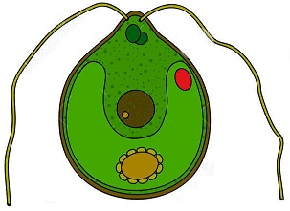
Class : 02
Mastigophora /Flagellata
Example: volvox , noctiluca , trichomonas ,giardia etc.
Usually free living but few are parasitic forms.
One or more flagella usually present for locomotion or food capturing or attachment or protection.
Some forms are green due to the presence of chloroplasts (e.g. , euglena )
Asexual reproduction occurs by longitudinal binary fission. No conjugation.
Single nucleus present in a cell.

Slide 8
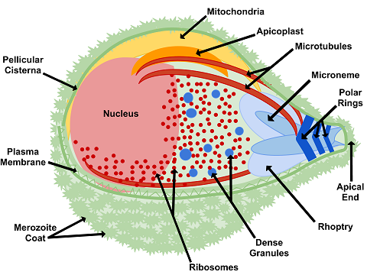
Class : 03
Sporozoa
e.g. , monocystis, plasmodium etc
They are exclusively endoparasites.
Locomotary organelles are absent.
Body is covered by a thick pellicle.
Nutrition is saprophytic and contractile vacuole is absent.
Sexual reproduction takes place by gamete or spore formation .

Slide 9
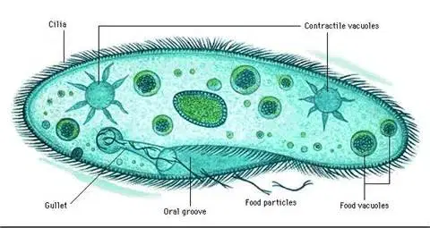
Class : 04
Ciliata
Example: opalina , nyctotherus , paramecium etc. .
They may be either free living or endoparasite.
Nucleus may be one, two or many in number.
Body organization is complex.
Body shape and size is definite and is covered with a pellicle.
Cilia are the locomotary organelles.
They have a holozoic mode of nutrition.
Small micronucleus is reproductive in function whereas large macronucleus is vegetative in function.
Asexual reproduction occurs by transverse fission and sexual by conjugation.

Slide 10
Classes of protozoa

Slide 11
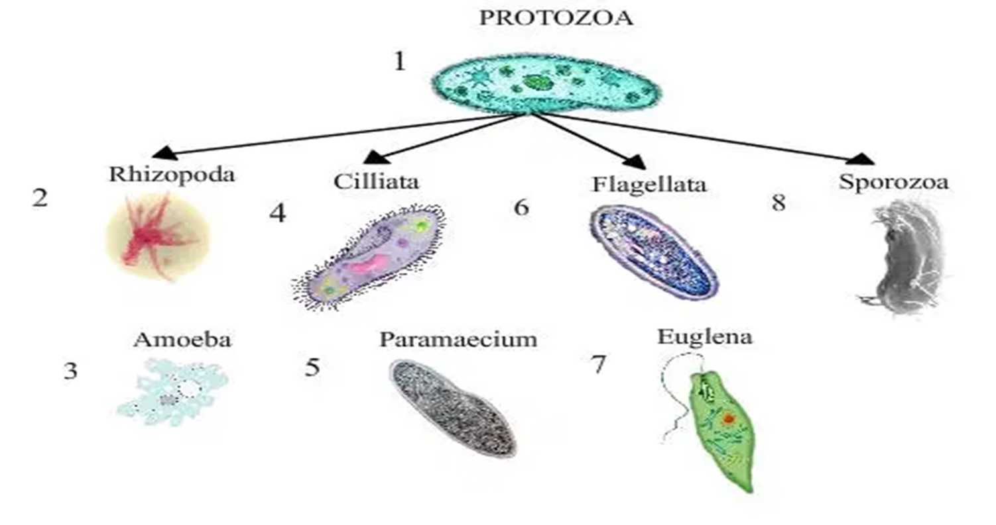

Slide 12
A: amoeba
This group includes all the free living freshwater, marine and soil amoebas. It also has some parasites of animals.
They are unicellular.
Amoeba lack flagella. They move by forming specialized cytoplasmic projections called pseudopodia (false foot).
Example : The intestinal parasite , entameoba histolytica , causes amoeboic dysentery in humans.

Slide 13
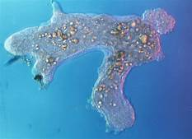
The Giant Amoeba:
The giant amoeba Pelomyxa palustris is the most primitive amoeba. This species has multiple membranous-bound nuclei. Such organelles are not present in any of the eukaryote. The giant amoeba obtains energy from methanogenic bacteria. These bacteria live inside the giant bacteria. Giant amoeba lives inside the mud at the bottom of freshwater ponds.

Slide 14
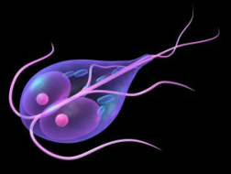
B: zoo flagellates
These protists are mostly unicellular. A few organism are colonial.
They have spherical or elongated bodies.
Zoo flagellates have single central nucleus.
They possess one to many long , whips like flagella for locomotion.
They obtain their food by ingesting living or dead organisms.
They may symbionts , parasites or free living.

Slide 15
Symbionts
Trichonymphas are complex and specialized flagellates.
Having many flagella.
Live as symbionts in the guts of termites.
Helps termites in the digestion of dry wood
Free living flagellates
Choanoflagellates are sessile, marine or freshwater flagellates.
Attached by a stalk.
These organisms are most important for evolutionary point of view as they have striking similarities with the collar cells of the sponges.
Parasitic flagellates
It causes diseases.
For example : trypanosoma is a human parasite.
Causes African sleeping sickness disease.
Transmitted by infected tsetse fly.

Slide 16
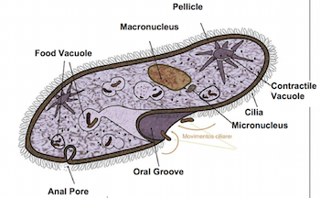
C: ciliates
Ciliates are unicellular organisms.
Flexible outer covering called pellicle.
Gives them a definite shape.
This shape can be changed.
Body covered with cilia.
These cilia are fine , short, hair like structures.
Cilia help the organism to move forward, move backward and turn around.
Some ciliates are sessile and remain attached with the rock or other surfaces.

Slide 17
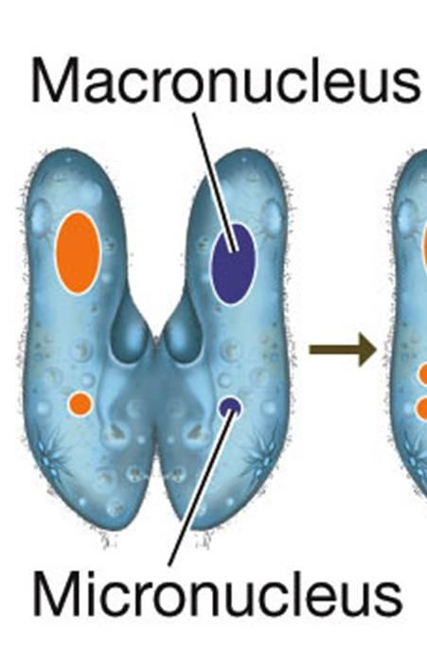
9. Most ciliates ingest bacteria and other tiny protists.
10. Having special organelles called contractile vacuole. Regulate water movement in fresh water ciliates.
11. All other protozoans have single nucleus but ciliates have two kinds of nuclei:
Micronuclei; they are small, diploid nuclei. Each ciliate have one or more micronuclei. They are involved in sexual reproduction.
Macronuclei; it is a large and polyploid nucleus. Controls cell metabolism and growth.
12. Most ciliates undergo sexual reproduction called conjugation.

Slide 18
d. Foraminiferans and actinopods
Marine protozoans produce shells or tests.
Tests of foraminiferans are made up of calcium carbonate.
While tests of actinopods are made up of silica.
Shell or tests contain pores through which cytoplasmic projections come out.
Dead foraminiferans sink to the bottom of the ocean.
They form grey mud.
Old and dead foraminiferans are changed into limestone deposits.

Slide 19
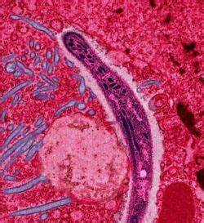
e. apicomplexans
Large group of parasitic protozoa.
Causes serious diseases in man such as malaria.
They lack locomotary organs.
They move by flexing.
They develop spore at some stage of their life.
Many apicomplexans spend their life in two or more hosts.
Example: plasmodium

Slide 20
Plasmodium
It causes malaria.
Enters into human body of man by the biting of female anopheles mosquito.
First enters into liver cells, then enters red blood cells.
RBC bursts and releases many parasites.
Millions of RBC caused the symptoms of malaria.
Symptoms are chill and high fever.

Slide 21
Disease causing protozoa
Many protozoa cause diseases in animals and humans.
Plasmodium, which causes malaria.
Others like trichomonas, caused sexually transmitted diseases.
Relatively benign and 100% curable.
Vast majority of the species, through, are completely harmless.

Slide 22
Protists and human diseases
Most protists diseases in humans are caused by animal-like protists, or protozoa.
Protozoa make us sick when they become human parasites.
Examples
Three examples of parasitic protozoa are described below:
Trypanosoma protozoa
Giardia protozoa
Plasmodium protozoa

Slide 23
Tripanosoma protozoa
Members of the genus Trypanosoma are flagellate protozoa that cause sleeping sickness , Common in Africa
Also cause Chagas disease, common in South America.
Parasites are spread by insect vectors.
Enters a persons blood when the vector bites.
Then spread to other tissues and organs.

Slide 24
Giardia protozoa
Flagellate protozoa that cause giardiasis.
Parasite enter the body through food or water that has been contaminated by feces of infected people or animals.
Protozoa attach to the lining of the hosts small intestine
Prevent the host from fully absorbing nutrients.
Also cause diarrhea , abdominal pain , and fever.

Slide 25
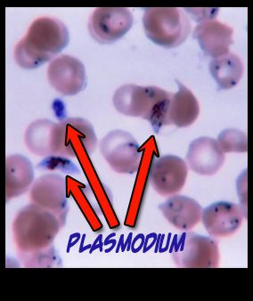
Plasmodium protozoa
Plasmodium protozoa causes malaria.
Parasites are spread by a mosquito vector.
Parasite enter a hosts blood through the bite of an infected mosquito.
Malaria is common in tropical and subtropical climates throughout the world.
Kills several million people each year, most of them children.

Slide 26
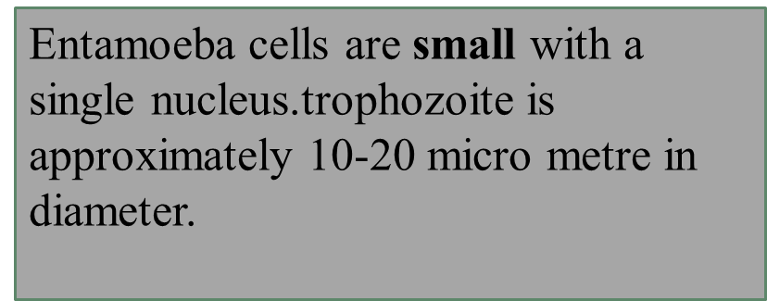
Entamoeba
Entameoba is a genus of amoebozoa found as internal parasites or commensals of animals.
Having a simple life cycle
Divides by simple binary fission .
Almost all specie form cysts.

Slide 27
Primary infection
Secondary infection
Primary infection of the large intestine with E.histolytica (amebiasis) is often asymptomatic.
However , diarrhea , abdominal pain, and fever may result from invasion and ulceration of intestinal wall.
Secondary infection occurs in the liver, lungs , brain and spleen after the amoebas enter the circulation by way of the portal vein and abscesses in these tissues.

Slide 28
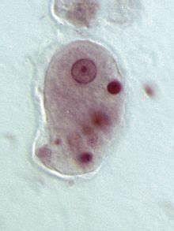
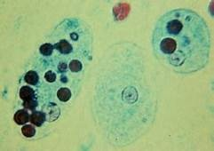
Entamoeba histolytica

