Slide 1
Unit 2: Phylum porifera Topic: Example sycon B.Ed (Hons) Secondary Semester IV Subject: Biology IV (Minor) Course Title: Invertebrates Diversity Represented By: Ms Sidra Younis Department of Education(Planning and Development)
Lahore College for Women University,Lahore

Slide 2
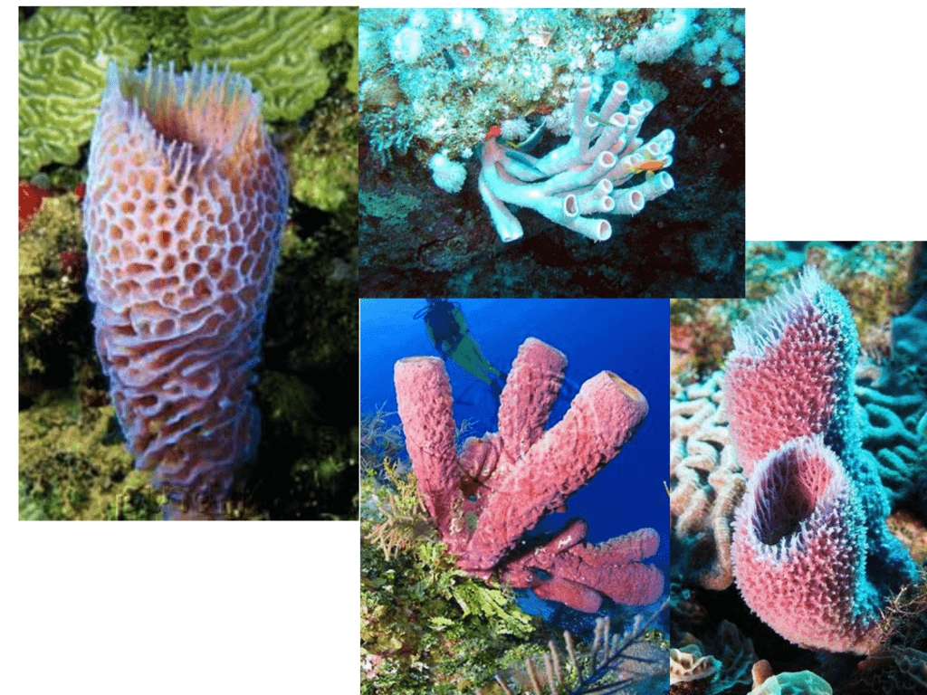
Phylum porifera:
Porifers are the most primitive animals.
DEFINITION:
The porifers are pore-bearing animals,
(Latin porus =pore, ferre = to bear),
commonly called the sponges.

Slide 3
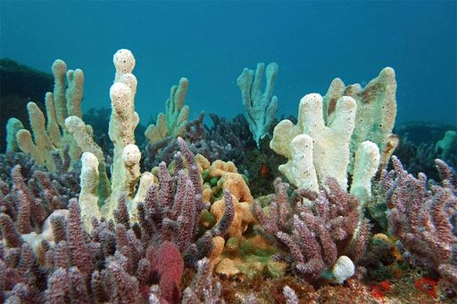
General characteristics:
Kingdom: Animalia
Habitat: Aquatic, mostly marine, few are terrestrial
Habit: They are solitary or colonial.
Grade of organization: cellular grade of body
Shape: Body shape is variable, mostly cylinder shaped
Symmetry: Asymmetrical or radially symmetrical.

Slide 4
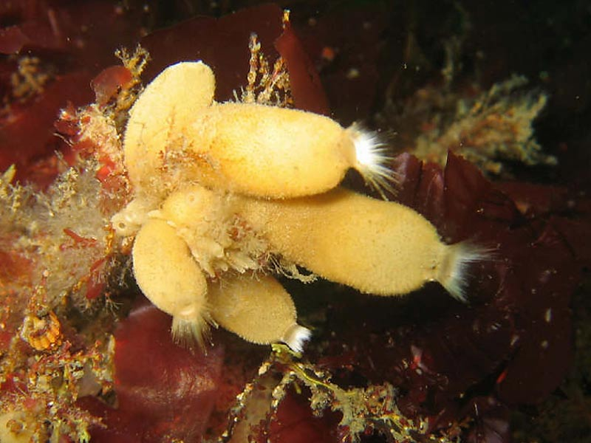
Example: sycon
Sycon is a genus of calcareous sponges. These sponges are small, and are tube-shaped and often white to cream in colour.
Scientific name: Sycon
Class: Calcarea
Order: Leuocosolenida
Phylum: Porifera
Kingdom: Animalia
Rank: Genus

Slide 5
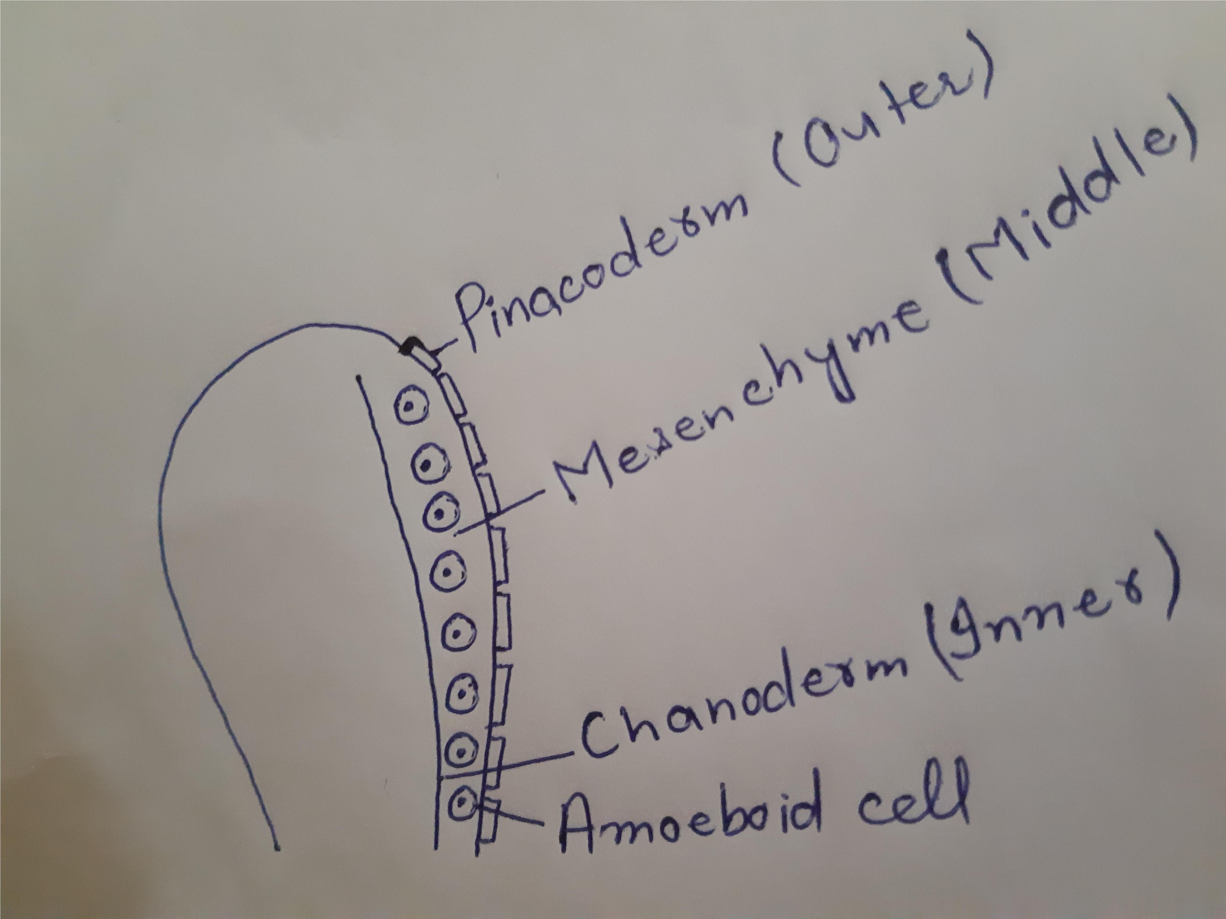
Structure:
The body is divided into two layer:
Outer dermal layer also called pinacoderm.
Inner gastral flagellated epithelium layer also
called choanoderm.
In between these two layers is present
mesenchyme.

Slide 6
Layers:
The outer dermal layer can be further classified into two main parts called
Potocyte
Pinacocytes.
Potocyte are the tubular cells that form the opening of dermal layer
Pinacocytes are polygonal cells that cover the entire outer surface of the sycon
The gastral layer that has two kinds of cell:
Epithelial cell
Chanocytes

Slide 7
Explanation:
Between the choanocytes thin epithelial cells are present. Because of the epithelial cells the inner gastral layer is complete.
Choanocytes are round in shape and contain flagellum that helps to perform different function like that of respiration and digestion.
Mesenchyme on the other hand contains many types of other cells that serve different function in this invertebrate.
Scleroblast secrete different types of spicules which can be either calcareous, siliceous or made of spongin fiber.

Slide 8
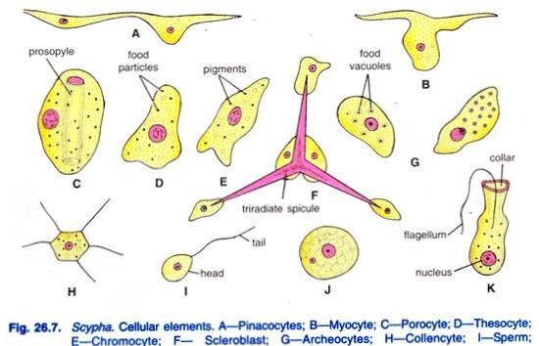
Types:
Chromocytes which is involved in giving
pigmentation to the cell.
Thesocyte that have all the reserved food
material for the animal body.
Archeocyte that are involved in the process of
reproduction by giving rise to sex cell of the body.
Myocyte that guard and regulate the apertures of the animal body.

Slide 9
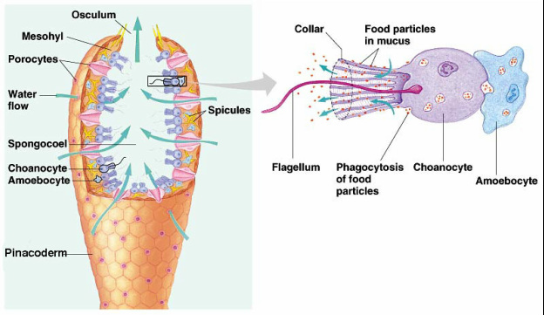
Chanocytes:
Choanocytes or collar cells are present
below the mesohyl.
They form the lining of the inner chamber.
Choanocytes are flagellated cells.
They have a collar like ring of microvilli
surrounding a flagellum.
Microfilaments connect the microvilli.

Slide 10
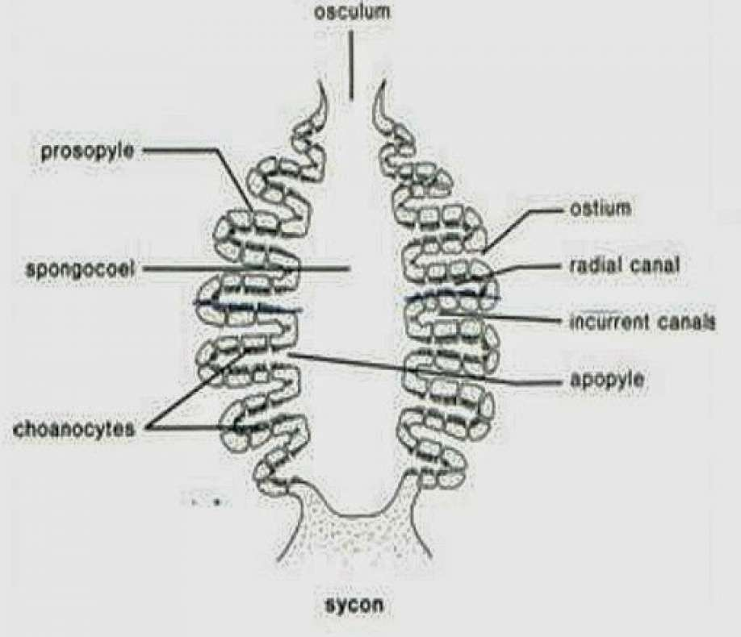
Ostia and osculum:
Water enters the body via ostia. and enters the
incurrent canals from where it passes into radial
canals through prosopyles.
From radial canals, water enters the excurrent
canal through apopyles.
Water reaches to spongocoel through the gastral
ostia and passes out by osculum.

Slide 11
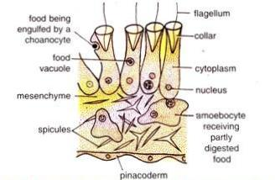
Nutrition:
Sponges feed on particles with size from 0.1 to 50 pm.
Their food consists of bacteria, microscopic algae,
protists and other suspended organic matter.
The preys are slowly drawn into the sponge and digested.
A few species of sponges are carnivores.
It captures small crustaceans with the help of these
spiculces.

Slide 12
Canal System:

Slide 13
Respiration and Excretion:
Respiratory organs are absent in sycon.
Respiration is by simple diffusion, between the
cells of sponge and water.
In sycon excretory organs are absent.
It is done by diffusion.
Some people say the excretory wastes will go out of the body through excurrent water.

Slide 14
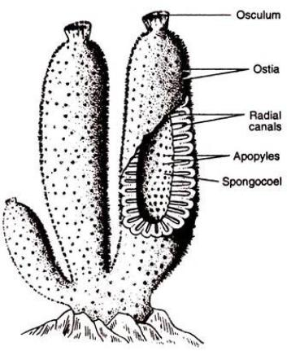
Diagram:
A large volume of water circulates of through these canals.
All sponge cells are in close contact with water.

Slide 15
Digestion:
The digestion is intracellular.
The food particles are usually captured by the choanocytes.
Digestion takes place in the choanocytes.
The digested food is passed to other cells.
The reserve food is stored in the form of fats, glycogen
and protein the thesocyte.

Slide 16
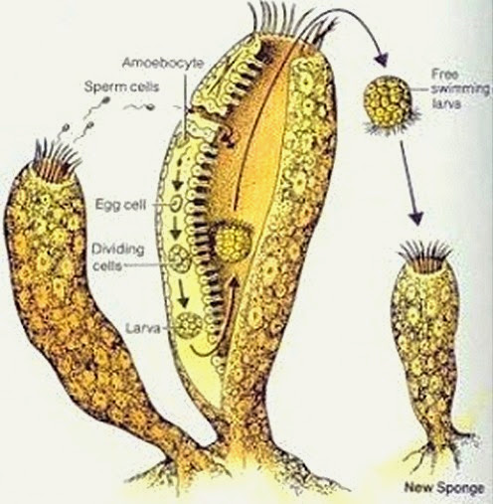
Reproduction:
Reproduction takes place by both
asexual (budding and regeneration) and
sexual (by ova and sperms).
Fertilization is internal.
Budding is the common asexual method.
Sexual reproduction is carried on by the
development of sperms and ova.

Slide 17
Special Cells:
Pinacocytes:
These cells are the "skin cells" of sponges.
They line the exterior of the sponge body wall.
They are thin, leathery and tightly packed together.
Chanocytes:
These distinctive cells line the interior body walls of sponges.
These cells have a central flagellum that is surrounded by a collar of microvilli.

Slide 18
Mesenchyme:
Choanocytes are versatile cells.
Some sponges the choanoflagellates develop into gametes.
Mesenchyme:
Between the two layers is a thin space called mesenchyme or mesohyl.
The mesenchyme consists of a proteinaceous matrix, some cells, and spicules.

Slide 19
Archaeocytes:
Archaeocytes are very important to the functioning of a sponge.
These cells are totipotent, which means that they can change into all of the other types of sponge cells.
In some sponges, archaeocytes develop into gametes.
Sclerocytes:
The secretion of spicules is carried out by sclerocytes.
Other cells, called spongocytes, secrete the spongin skeletat fibres when those are present.

Slide 20
MYOCYTES AND POROCYTES:
Poriferans do not have any muscle cells, so their movement is rather limited.
However some poriferan cells can contract in a similar fashion as muscle cells.
Myocytes and porocytes which surround canal openings and pores can contract to regulate flow through the sponge.

Slide 21
Cells:

Slide 22
Economic Importance:
As Food:
Sponges are rarely taken as food by other animals because of their bad taste, odour and sharp spicules.
However, crustaceans are found leading parasitic life on them and some molluscs like nudibranchs depend upon them for their diet.
As Commensals:
After dying it make structure like shell they protect other animals.

Slide 23
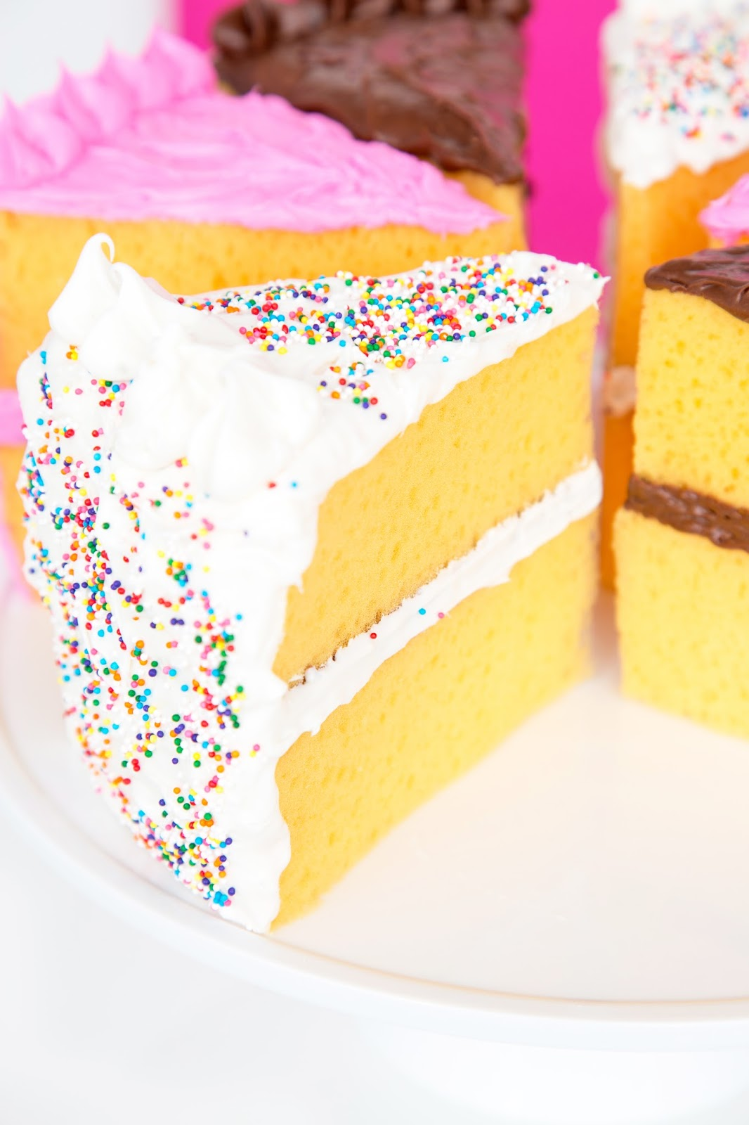
As Food:

Slide 24
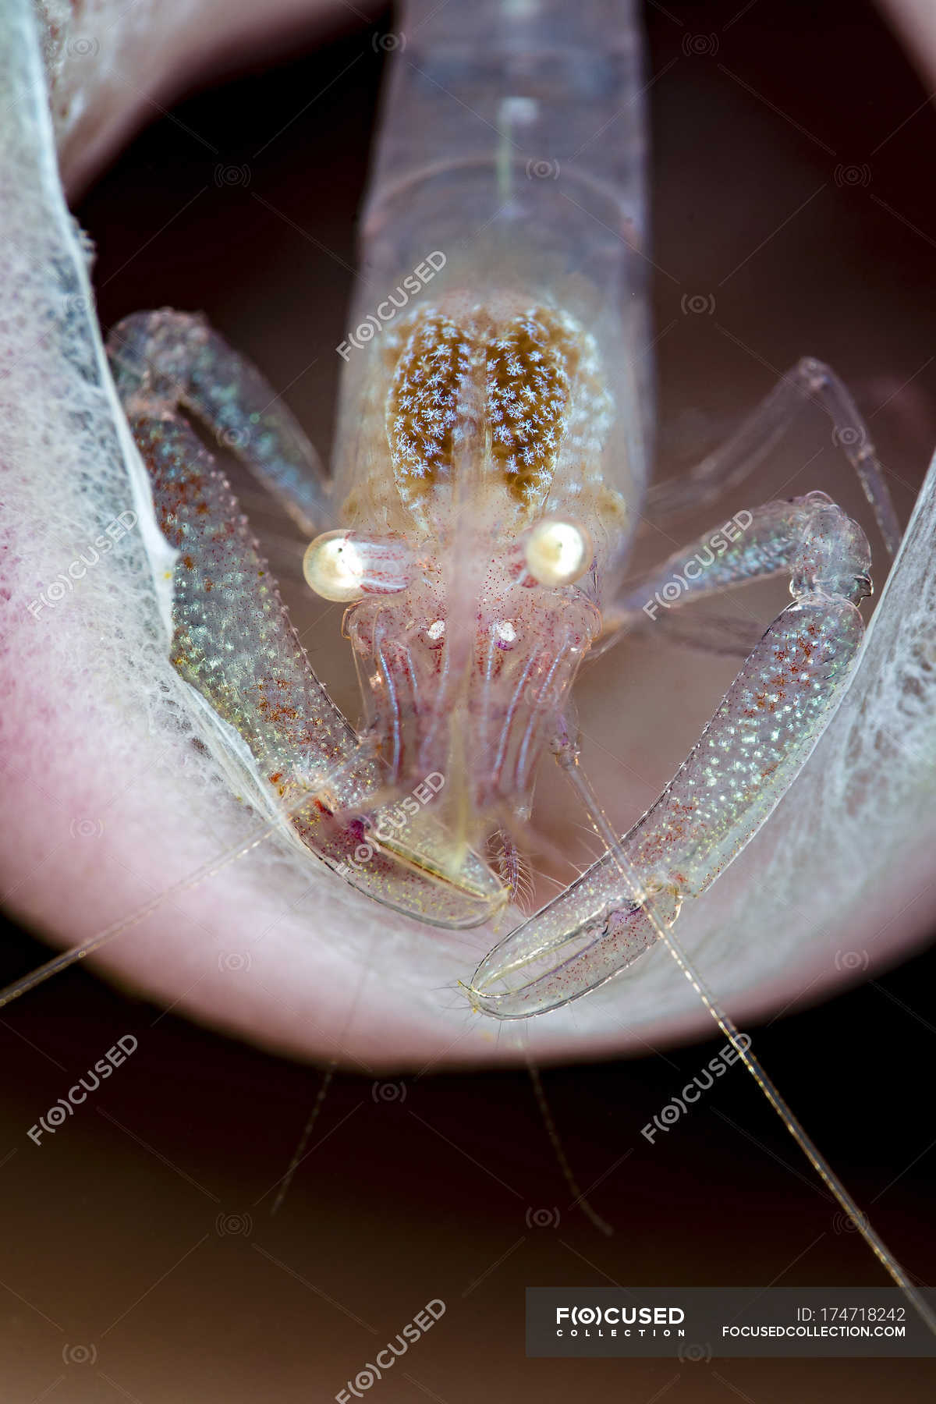
As Commensals:

Slide 25
Explanation:
In addition to the protection, the animals living inside the sponge body get a rich food supply from the water circulating through them.
These animals do not cause any apparent harm to sponges, they are regarded as commensals.
Other Uses:
The dried, fibrous skeleton of many sponges like Spongia, Hippospongia and Euspongia are used for the purpose of bathing, polishing, washing cars, walls, furniture’s, and scrubbing floor etc.

Slide 26
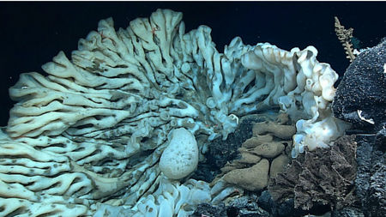
Decorative pieces:
The skeleton of some sponges like Euplectella are of great commercial value and used as decorative pieces.

Slide 27
Harmful sponges:
Only a few sponges are harmful.
They may cause the death of some sessile animals by growing over them and cutting off their food and oxygen supply.
The boring sponges, like Cliona attach themselves to the shells of oysters, clams, and barnacles, etc.
The boring sponges also cause great harm to oyster beds.
The boring sponges also destroy rocks by penetrating into them and breaking them into pieces.

