Slide 1
Unit 7: Soil Factor and Biogeochemical Cycle Topic: Major Vegetation of Pakistan B.Ed (Hons) Secondary Semester: III Subject: Biology III Minor Course Title: Plant Physiology and Ecology Represented By: Ms Sidra Younis Department of Education (Planning and Development) Lahore College For Women University, Lahore

Slide 2
Vegetation
It refers to the ground cover provided by plants.
Natural vegetation:
Refers to a plant community which has grown naturally without human aid.
2- Local vegetation:
Assemblages of plant species and the ground cover they provide

Slide 3
Tropical vegetation:
Tropical vegetation is any vegetation in tropical latitudes.
Plant life that occurs in climates that are warm year-round is in general more biologically diverse that in other latitudes.
Some tropical areas may receive abundant rain the whole year round, but others have long dry seasons
These seasonal droughts have great impact on the vegetation.

Slide 4
Dry tropical forest vegetation:
1- Climate
Temperatures are high
2- Soils:
Soils are essentially like those of tropical rain forests, with the same processes.
3- Vegetation:
The deciduousness of most tree species.
Tree canopy is lower (10-30m).
The trees less dense where drought is more extreme.
The trees have thicker, more ridged, bark; deeper roots.

Slide 5
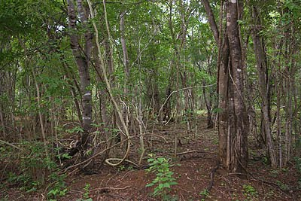
4- Plant Adaptations:
Trees have thicker bark (antifire adaptation),
Thicker and smaller leaves (antidesiccation adaptation),
Thorns (antiherbivore adaptation),
Longer roots (to reach deeper water table),
Dry tropical forest:

Slide 6
Tropical dry deciduous forests:
Forests of low or moderate height consisting almost entirely of deciduous species.
Their canopy is typically light though it may appear fairly dense and complete during the short rainy season
Not occur extensively in Pakistan but there are limited areas in the Rawalpindi foothills carrying this vegetation type.

Slide 7
Tropical Thorn forests:
A thorny forest is a dense, scrub-like vegetation characteristic of dry subtropical and warm temperate areas with a seasonal rainfall averaging 250 to 500 mm.
This vegetation covers a large part of:
Southwestern North America
and southwestern Africa
And smaller areas in Africa, South America, and Australia.

Slide 8
Vegetation in Thorn forest:
The major tree species are:
Prosopis cineraria (Jhand),
Capparis decidua (Karir, Karil),
Zizyphus mauritiana (Ber),
Tamarix aphylla (Farash) and Salvadora oleoides (Pilu, wan)
A characteristic pioneer vegetation is developed on inland sand dunes and the semi-deserts of the areas of least rainfall.

Slide 9
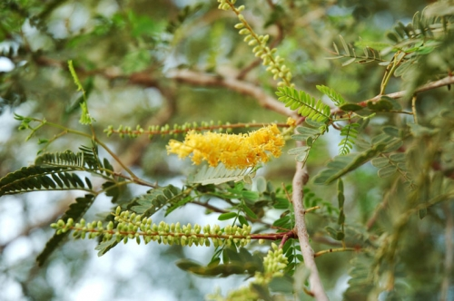
Climate:
The climate varies from semi-arid (250 to 750 mm rainfall) to arid (less than 250 mm rainfall). The summer temperature in this tract is as high as 50°C.
Prosopis cineraria tree:

Slide 10
MOIST TEMPERATE FORESTS
Distinct sub-type of North American coniferous forests.
Also called temperate rain forests.
Temperature, humidity and often moist conditions encourage the development of mossy, moisture loving plants layer under the giant trees of coast redwood, western red cedar.

Slide 11
HIMALAYAN MOIST TEMPERATE FORESTS:
Develop in the areas of lesser rain fall, up to 45 meters tall.
Dominant element of vegetation are oak and conifers, under growth is shrubby.
Ever green forests of conifers fall in this category, under growth is rarely dense consist of both ever green and deciduous species.
These forest occur between 1500m and 3000m elevation in the western himalayas except where the rainfall fall below 1000mm.
Divided in 2 zones upper zone and lower zone in which definite species of oak and conifers dominate

Slide 12
HIMALAYAN DRY TEMPERATE FORESTS:
Predominantly coniferous forest with xerophytic shrubs.
These forest found in dry ranges of Himalayas where precipitation is below 100cm.
These forests found at the altitude of 3000m to 4000m in the western Himalayas.
Commonly found species belong to indigofera, cannabis, several epiphytic mosses, lichens etc.

Slide 13
SUB-ALPINE VEGETATION:
Subalpine zone is the biotic zone below the tree line.
Species in this zone depend on the location of the zone on earth. Meadows are present.
Conditions favorable for subalpine vegetation are heavy snow, high humidity of soil and air, summer precipitation and good surface drainage.
It depends on the geographical location of the mountains.
The destruction of forest artificially lowers the boundary of subalpine vegetation and changes its composition.

Slide 14
SUB-TROPICAL VEGETATION:
Natural vegetation
Subtropical areas are mainly evergreen trees, bushes, and shrubs
Hardy evergreen trees like pine and spruce
These evergreens are more delicate
Plants here are evergreens is because of the long months of warmth and regular rain

Slide 15
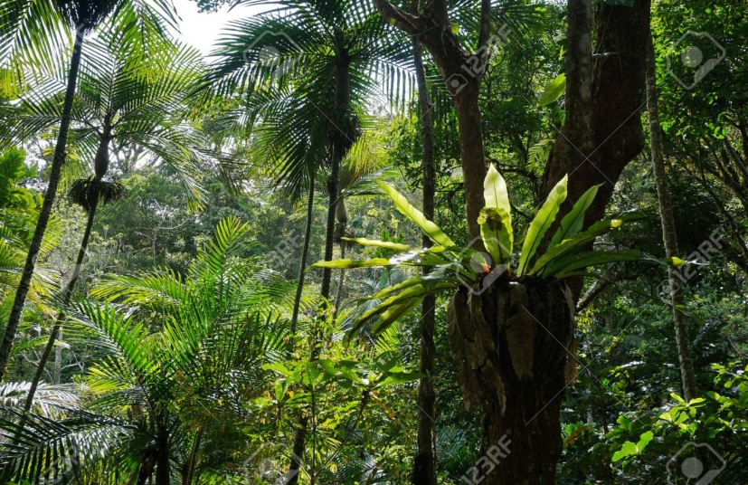
What are the temperatures like
Hot humid summers and mild winters
Summer the average temperature is between 70 and 80 degrees
Coldest month usually averages 45-50 degrees.

Slide 16
Dry sub-tropical sub-mountainous vegetation
Vegetation includes trees and shrubs
Trees may show solid growth and shrubs are sharp
Average rain fall in this region is 10 – 36 inches
Humidity is low annual mean humidity is 50%
Temperature rises to 40°C in summer
Area includes Siwalik Hills and Baluchistan Plateau

Slide 17
Sub-tropical broad leaved evergreen forest
Broad-leaved evergreen forest
Broad-leaved forests occur in the formation types
(a)Broad-leaved evergreen
(b)Broad-leaved deciduous
This forest type requires plentiful, well-distributed rainfall

Slide 18
Sub-tropical pine forest
Tropical pine forests are confined to Nepal, Bhutan, states of Jammu and Kashmir
Pine forests are mainly classified into types
Lower Siwalik Chir Pine Forest and Upper (Himalayan) Chir pine forest
The variety of life forms i.e. Flora and fauna

Slide 19
Temperature-Vegetation
Temperature is one of the three major influences on global patterns of plant growth
With available sunlight and water
Temperature determines wheather
Where vegetation is dense, the land surface temperature never rises above 35 degrees Celsius

Slide 20
DRY TEMPERATE FORESTS
Unfavorable climate
Have less number of plants
This area has bare soil
Plants are mostly Xerophytic
Region includes Suleiman Range,Karakoram Range
This region has long cold winter, Temperature becomes lower than zero
Some of these areas are covered by snow

