Slide 1
Unit 2: Bacteria and Cynobacteria
Topic: General Characteristics of Cynobacteria
B.Ed (Hons) Secondary
Semester: II
Subject: Biology II (Minor)
Course Title: Diversity of Plants
Represented By: Ms Sidra Younis
Department of Education (Planning and Development)
Lahore College for Women University, Lahore

Slide 2
General Characteristics of Cynobacteria
Cyanobacteria are prokaryotic oxygenic phototrophs that contain a green pigment called chlorophyll and a blue photosynthetic pigment called phycobilins.
Prokaryotic means they don't have a membrane-bound nucleus, mitochondria or other type of membrane-bound organelle (like true algae do).
A phototroph is an organism that uses energy from the sun to synthesize organic compounds for food.
They are commonly known as blue green algae because of dominant blue photosynthetic pigment in their chromatophores.

Slide 3
Habitat:
The members of cynobacteria are found in fresh water, ponds, ditches, drains and moist soils.
A few species are endophytes that live in the cavities of other plants, usually bryophytes, for example Nostoc is found in the thallus of Anthoceros.
Only few forms are marine.
They are also found in hot water streams.

Slide 4
Blue green algae covered the surface of lake

Slide 5
Cell Structure:
Only few forms are unicellular, while majority of them are multicellular and some members form colonies. The cell are embedded in gelatinous sheath.
Gelatinous sheath is a covering found, generally around the cells in colonies of cyanobacteria. It holds the cells in colonies together. When cells of blue green algae unites together, they secrete this thick fluffy layer, Gelatinous sheath is a protective covering present around the colonies of blue green algae.

Slide 6
CONT….
A single row of cell in each colony is called trichome and trichome with mucilage form the filament.
Plastids are absent. The pigments are found in the cytoplasm called as chromatoplasm.
Cells are blue in color due to the presence of phycocyanine (blue pigment), chlorophyll, carotene and phycoerytherin.
The cells are without any mitochondria, endoplasmic reticulum and Golgi bodies.
A definite nucleus is absent and nuclear material is present as central body, which lack nucleus.

Slide 7
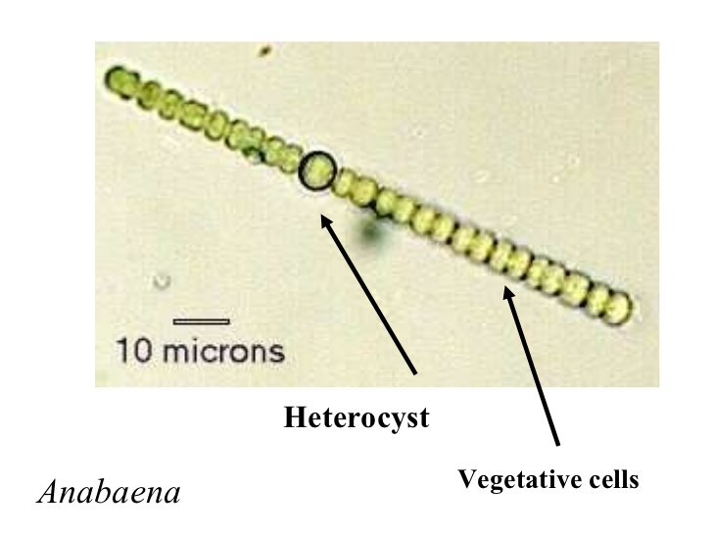
CONT…
Heterocytes are specialized nitrogen-fixing cells formed during nitrogen starvation by some filamentous cyanobacteria (Nostoc and Anabaena).
Heterocyst cells are slightly larger size and with a more thickened wall than the vegetative cells.

Slide 8
CONT….
Reserve food in the form of sugars and glycogens. Minute oil drops are also present.
Some members such as Anabaena can fix nitrogen into nitrates.
Cyanobacteria blooms can colour a body of water. For example, many ponds take on an opaque shade of green as a result of overgrowths of cyanobacteria, and blooms of phycoerythrin-rich species cause the occasional red colour of the Red Sea.
Cyanobacteria blooms are especially common in waters that have been polluted by nitrogen wastes; in such cases, the overgrowths of cyanobacteria can consume so much of the water’s dissolved oxygen that fish and other aquatic organisms perish.

Slide 9
CONT….

Slide 10
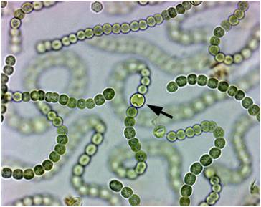
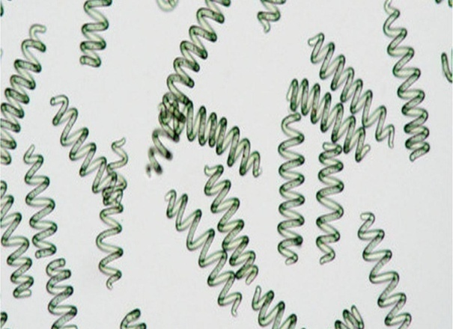
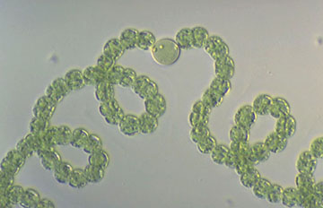
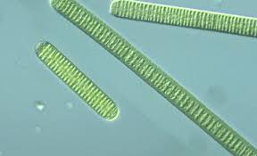
Examples
Nostoc Spirulina
Anabaena Oscillatoria

Slide 11
Economic Importance:
Many members fix or convert atmospheric nitrogen into usable forms through nitrogen fixation can be helpful in agriculture.
Cynobacteria have symbiotic relationship with protozoa, fungi, and nitrogen fixing species form associations with angiosperms. They are photosynthetic partner in most of lichen association. eg., Anabaena azollae colonizes the floating water fern.
Cyanobacteria also colonizes the roots of higher plants.
Its use as food, Spirulina are sold in market due to their nutritive value. Spirulina tablets are sold all over the world as “health food”

