Slide 1
Unit 1: Biology Introduction Topic: Scientific Method B.Ed (Hons) Secondary Semester: I Subject: Biology I (Minor) Course Title: General Biology Represented By: Ms Sidra Younis Department of Education (Planning and Development) Lahore College for Women University, Lahore

Slide 2
Scientific Method
Definition
“Scientific method was first recorded in 1850 -1855. Scientific method is a method of a research in which a problem is identified, related data are collected and the hypothesis is observational tested.”
Steps of Scientific Method
Observations
Question
Hypothesis
Experiment
Data analysis
Conclusions

Slide 3
1: Observation
As the first step in solving the problem the people recalls the pervious observation or makes the new one. An observation is the process of observing something or someone. Any data can be noted during experiment can be called as observation. Observation can be of two types
Qualitative observation:
Qualitative observation is an observation in which we observe the quality of an object.
Quantitative observation:
Quantitative observation is an observation in which we observe the quantity of an object.
2: Question
Once you’ve made observation, you must formulate a question about what you have observed. A scientific question is a question that may lead towards hypothesis and help us in answering the reason of a question. There are some certain characteristics
It should be testable.
It should have answers.

Slide 4
3: Hypothesis
In scientific method a hypothesis, is a testable statement about the relationship between two or more variables explanation for some observed phenomenon. The basic idea of hypothesis is that there is no fixed outcome. Hypothesis can have following characteristics
It should be a tentative idea.
It should be kept as simple as possible.
It should be testable.
4: Experiment
After hypothesis, experimentation is the most basic step of the scientific method. A person performs experiments to see if hypothesis are true or not. Through experiments, a person learns which hypothesis is correct. The incorrect hypothesis is rejected and the correct one is accepted.

Slide 5
5: Data analysis
After performing an experiment and collecting data, the person uses it to draw a conclusion about the strength of the hypothesis. If the data proves the hypothesis correct, the question is answered. But if the data disproves the hypothesis, the person should research again to form a hypothesis and experiment to test it.
6: Conclusion
The final step of the scientific method is conclusion. Publishing of results is an important part of scientific method. This is the step in which all the results from the experiment are analyzed.

Slide 7
Example: Malaria
Malaria is derived from two words “Mala means bad” and “Aria means air”. Malaria is a serious fatal disease that infects a mosquito which feeds on humans. People who are suffering from malaria are very sick. Its symptoms are high fever, shaking- chills and flu like illness.
1: Observation
In nineteenth century, many different causes of malaria were suggested. There were some major observations about malaria.
Malaria and marshy areas have some relation.
Drinking the water of marshes does not cause malaria.
Plasmodium is seen in the blood of malarial patients.
2: Question
Can plasmodium cause malaria?

Slide 8
3; Hypothesis
Scientist uses whatever information they can get at that time and with the help of observation they made one or more hypothesis and hypothesis was
“Plasmodium is the cause of malaria”
4: Deduction
Scientist does not know whether his hypothesis is correct or not. One of the deductions from the above hypothesis was;
“If plasmodium is the cause of malaria, then all persons ill with malaria should have Plasmodium in their blood”
5: Experiment
In the next step, the scientists perform experiment to test the deduction which was designed as;
Scientist examined the blood of 100 malarial patients and 100 healthy persons under the microscope.

Slide 9
6: Data analysis
The results of the experiments showed that all malarial patients had plasmodium in their blood while seven out of hundred healthy people also had plasmodium in their body that is the incubation period, incubation period is a period between the entry of parasite in host and the appearance of the symptoms.
7: Conclusion
The quite convincing result proved the hypothesis was true “Plasmodium is the cause of malaria.

Slide 10
Life Cycle of Malaria
The natural history of malaria involves cyclical infection of humans and female Anopheles mosquitoes. In humans, the parasites grow and multiply first in the liver cells and then in the red cells of the blood. In the blood, successive broods of parasites grow inside the red cells and destroy them, releasing daughter parasites (“merozoites”) that continue the cycle by invading other red cells.
The blood stage parasites are those that cause the symptoms of malaria. When certain forms of blood stage parasites (gametocytes, which occur in male and female forms) are ingested during blood feeding by a female Anopheles mosquito, they mate in the gut of the mosquito and begin a cycle of growth and multiplication in the mosquito. After 10-18 days, a form of the parasite called a sporozoite migrates to the mosquito’s salivary glands.

Slide 11
Cont…….
When the Anopheles mosquito takes a blood meal on another human, anticoagulant saliva is injected together with the sporozoites, which migrate to the liver, thereby beginning a new cycle.
Thus the infected mosquito carries the disease from one human to another (acting as a “vector”), while infected humans transmit the parasite to the mosquito, In contrast to the human host, the mosquito vector does not suffer from the presence of the parasites.

Slide 12
Steps of Malarial Cycle:
Malaria infection begins when an infected female Anopheles mosquito bites a person injecting Plasmodium parasites, in the form of sporozoites, into the bloodstream.
The sporozoites pass quickly into the human liver.
The sporozoites multiply asexually in the liver cells over the next 7 to 10 days, causing no symptoms.
In an animal model, the parasites, in the form of merozoites, are released from the liver cells in vesicles, journey through the heart, and arrive in the lungs, where they settle within lung capillaries. The vesicles eventually disintegrate, freeing the merozoites to enter the blood phase of their development.
In the bloodstream, the merozoites invade red blood cells (erythrocytes) and multiply again until the cells burst. Then they invade more erythrocytes. This cycle is repeated, causing fever each time parasites break free and invade blood cells.

Slide 13
Cont……
6. Some of the infected blood cells leave the cycle of asexual multiplication. Instead of replicating, the merozoites in these cells develop into sexual forms of the parasite, called gametocytes, that circulate in the blood stream.
7. When a mosquito bites an infected human, it ingests the gametocytes, which develop further into mature sex cells called gametes.
8. The fertilized female gametes develop into actively moving ookinetes that burrow through the mosquito's midgut wall and form oocysts on the exterior surface.
9. Inside the oocyst, thousands of active sporozoites develop. The oocyst eventually bursts, releasing sporozoites into the body cavity that travel to the mosquito's salivary glands.
10. The cycle of human infection begins again when the mosquito bites another person.

Slide 14
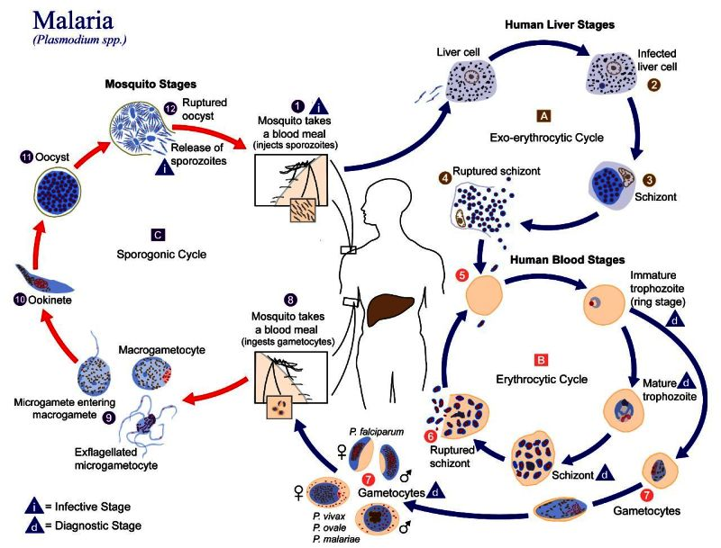
6.

