Slide 1
Unit 5: Genetics Topic: Chromosome ABERRATIONS B.Ed (Hons) Secondary Semester: I Subject: Biology I (Minor) Course Title: General Biology Represented By: Ms Sidra Younis Department of Education (Planning and Development) Lahore College for Women University, Lahore

Slide 2
INTRODUCTION
Chromosome aberrations are departures from the normal set of chromosomes either for an individual or from a species. They can refer to changes in the number of sets of chromosomes (ploidy), changes in the number of individual chromosomes (somy), or changes in appearance of individual chromosomes through mutation-induced rearrangements. They can be associated with genetic diseases or with species differences.
Chromosomal aberrations involve two types of changes:
Changes in number of genes in a chromosome.
Changes involving arrangement of genes.

Slide 3
CONT....
1. Changes in the number of genes in a chromosome:
(i) Deletion or Deficiency:
It is due to loss of a part of a chromosome. The chromosome becomes shorter due to loss of one or more genes (Fig. 1).
(ii) Duplication:
Duplication of chromosome may take place due to attachment of some deleted part of another chromosome with it. This brings addition of some new genes not belonging to it.
2. Changes in the arrangement of genes in a chromosome:
(i) Inversion:
An inversion is produced when there are two breaks in a chromosome and the intercalary segment reunites in reverse order i.e., the segment rotate by 180°. For example, if the gene sequence in the original chromosome is ABCDEFGH, it may change to ADCBEFGH (Fig.1). If the inverted segment includes the centromere, the inversion is called pericentric inversion; if it does not include centromere the inversion is called as paracentric inversion.

Slide 4
CONT....
(ii) Translocation:
Translocation involves transfer of a segment of a chromosome to a different part of the same chromosome or to a different chromosome. In the later case the transfer may take place between non-homologous chromosomes (Fig. 1). The chromosomal aberrations described above are the outcome of defective meiotic division and result in changed sequence of genes. The genes in new or changed location may alter the phenotypic expression or may even cause death of the individual.

Slide 5
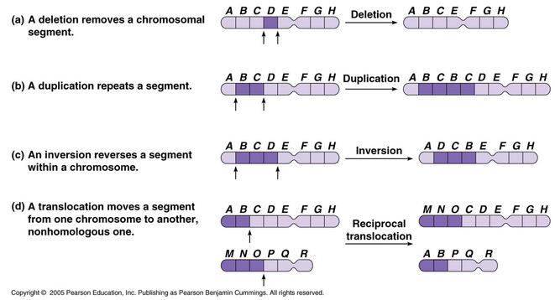

Slide 6
CONT....
Changes in the number of chromosomes (Aneuploidy and Euploidy)
Changes in chromosome number can occur by the addition of all or part of a chromosome (aneuploidy), the loss of an entire set of chromosomes (monoploidy) or the gain of one or more complete sets of chromosomes (euploidy). Each of these conditions is a variation on the normal diploid number of chromosomes. Each of these can have drastic effects on phenotypic expression.
Aneuploidy - the abnormal condition were one or more chromosomes of a normal set of chromosomes are missing or present in more than their usual number of copies.
Aneuploidy is the presence of an abnormal number of chromosomes in a cell, for example a human cell having 45 or 47 chromosomes instead of the usual 46. Down syndrome is common example of aneuploidy,

Slide 7
CONT....
Monoploidy - the loss of an entire set of chromosomes.
Euploidy - an entire set of chromosomes is duplicated once or several times.
The different conditions of aneuploidy are:
Nullisomy - the loss of both pairs of homologous chromosomes; individuals are called nullisomics and their chromosomal composition is 2N-2
Monosomy - the loss of a single chromosome; individuals are called monosomics and their chromosomal composition is 2N-1
Trisomy - the gain of an extra copy of a chromosome; individuals are called trisomics and their chromosomal composition is 2N+1
Tetrasomic - the gain of an extra pair of homologous chromosomes; individuals are called tetrasomics and their chromosomal composition is 2N+2.

