Slide 1
Unit 5: Genetics
Topic: Chromosome Morphology and Karyotype Analysis
B.Ed (Hons) Secondary
Semester: I
Subject: Biology I (Minor)
Course Title: General Biology
Represented By: Ms Sidra Younis
Department of Education (Planning and Development)
Lahore College for Women University, Lahore

Slide 2
Introduction
A chromosome is a structure that occurs within cells and that contains the cell's genetic material. That genetic material, which determines how an organism develops, is a molecule of deoxyribonucleic acid (DNA).
A molecule of DNA is a very long, coiled structure that contains many identifiable subunits known as genes. In prokaryotes, or cells without a nucleus, the chromosome is merely a circle of DNA.
In eukaryotes, or cells with a distinct nucleus, chromosomes are much more complex in structure.
Each chromosome has a constriction point called the centromere, which divides the chromosome into two sections, or “arms.” The short arm of the chromosome is labeled the “p arm.” The long arm of the chromosome is labeled the “q arm.” The location of the centromere on each chromosome gives the chromosome its characteristic shape, and can be used to help describe the location of specific genes.

Slide 3
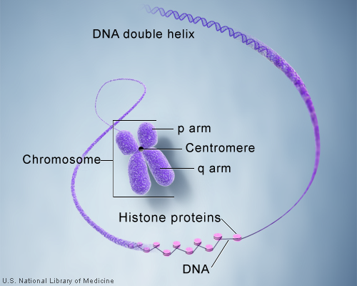

Slide 4
Chromosome Morphology
The number and position of centromeres is variable, but is definite in a specific chromosome of all the cells and in all the individuals of the same species. Thus, according to the number of the centromere the eukaryotic chromosomes may be acentric (without any centromere), mono centric (with one centromere), dicentric (with two centromeres) or polycentric (with more than two centromeres).
The centromere has small granules and divides the chromosomes into two or more equal or unequal chromosomal arms.
According to the position of the centromere, the eukaryotic chromosomes may be rodshaped (telocentric and acrocentric), J-shaped (submetacentric) and V-shaped (metacentric).
During the cell divisions the microtubules of the spindle are get attached with the chromosomal centromeres and move them towards the opposite poles of cell.

Slide 5
CONT…
Beside centromere, the chromosomes may bear terminal unipolar segments called telomeres. Certain chromosomes contain an additional specialized segment, the nucleolus organizer, which is associated with the nucleolus.

Slide 6
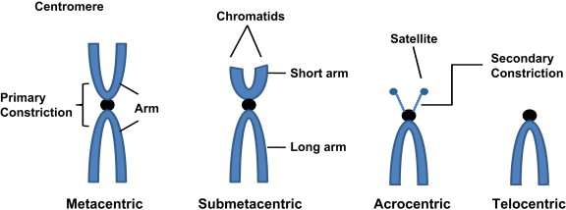

Slide 7
Karyotype
Karyotype is a test to identify and evaluate the size, shape, and number of chromosomes in a sample of body cells. Extra or missing chromosomes, or abnormal positions of chromosome pieces, can cause problems with a person's growth, development, and body functions.
What is a Karyotype?
Most living things have chromosomes, or units of genetic information, in their cells. The number and appearance of chromosomes vary among species. A karyotype is the number, size, and shape of chromosomes in an organism. To determine the karyotype of an organism, scientists must follow these steps:
Collect a cell from an individual.
Induce the cell to divide.
View the cell under a microscope.
Stop cell division in metaphase when chromosomes are easiest to see.
Stain the chromosomes to make them visible.

Slide 8
ANALYSIS OF KARYOTYPE
It is often easier to understand a karyotype if a picture is taken. A karyogram is a photograph of an organism's chromosomes, in which the chromosomes have been sorted and arranged by size.
Humans have a total of 46 chromosomes (23 from each parent), which you can see in the karyograms. In karyograms, homologous chromosomes, or pairs of chromosomes that are the same size and shape, are grouped together. Humans have 22 of these pairs called autosomes.
Autosomes are chromosomes that have genes for everything but the determination of the sex. In humans, autosomes are numbered 1 through 22, and you have two of each number because one came from your mom and one came from your dad. Chromosome 1 is the largest, and chromosome 22 is the smallest.

Slide 9
CONT…
Autosomes only account for 44 of your total chromosomes, so what are the other two? The remaining two chromosomes in humans are called sex chromosomes because they are the ones that determine whether you are male or female. They are placed after autosomes in a karyogram.
Sex chromosomes are not numbered, but instead they are given the letters X and Y. If someone has two X chromosomes, then they will be female. If someone has an X and a Y chromosome, then they will be male.

