Slide 1
Unit 4: Cell Division Topic: Meiosis B.Ed (Hons) Secondary Semester: I Subject: Biology I (Minor) Course Title: General Biology Represented By: Ms Sidra Younis Department of Education(Planning And Development) Lahore College for Women University, Lahore

Slide 2
Meiosis
Meiosis is the process in eukaryotic, sexually-reproducing animals that reduces the number of chromosomes in a cell before reproduction. Many organisms package these cells into gametes, such as egg and sperm. The gametes can then meet, during reproduction, and fuse to create a new zygote. Because the number of alleles was reduced during meiosis, the combination of two gametes will yield a zygote with the same number of alleles as the parents. In diploid organisms, this is two copies of each gene.

Slide 3
Phases of Meiosis I
Prophase I
Prophase I, the first step in meiosis I, is similar to prophase in mitosis in that the chromosomes condense and move towards the middle of the cell. The nuclear envelope degrades, which allows the microtubules originating from the centrioles on either side of the cell to attach to the kinetochores in the centromeres of each chromosome. Unlike in mitosis, the chromosomes pair with their homologous partner. This can be seen in the red and blue chromosomes that pair together in the diagram. This step does not take place in mitosis. At the end of prophase I and the beginning of metaphase I, homologous chromosomes are primed for crossing-over.

Slide 4
Cont…
Between prophase I and metaphase I, homologous chromosomes can swap parts of themselves that house the same genes. This is called crossing-over and is responsible for the other law of genetics, the law of independent assortment. This law states that traits are inherited independently of each other. For traits on different chromosomes, this is certainly true all of the time. For traits on the same chromosome, crossing-over makes it possible for the maternal and paternal DNA to recombine, allowing traits to be inherited in an almost infinite number of ways.

Slide 5
Cont…
Metaphase I
In metaphase I of meiosis I, the homologous pairs of chromosomes line up on the metaphase plate, near the center of the cell. This step is referred to as a reductional division. The homologous chromosomes that contain the two different alleles for each gene are lined up to be separated. As seen in the diagram above, while the chromosomes line up on the metaphase plate with their homologous pair, there is no order upon which side the maternal or paternal chromosomes line up.

Slide 6
Cont…
Anaphase I
Much like anaphase of mitosis, the chromosomes are now pulled towards the centrioles at each side of the cell. However, the centrosomes holding the sister chromatids together do not dissolve in anaphase I of meiosis, meaning that only homologous chromosomes are separated, not sister chromatids.
Telophase I
In telophase I, the chromosomes are pulled completely apart and new nuclear envelopes form. The plasm membrane is separated by cytokinesis and two new cells are effectively formed.

Slide 7
Results of Meiosis I
Two new cells, each haploid in their DNA, but with 2 copies, are the result of meiosis I. Again, although there are 2 alleles for each gene, they are on sister chromatid copies of each other. These are therefore considered haploid cells. These cells take a short rest before entering the second division of meiosis, meiosis II.

Slide 8
Phases of Meiosis II
Prophase II
Prophase II resembles prophase I. The nuclear envelopes disappear and centrioles are formed. Microtubules extend across the cell to connect to the kinetochores of individual chromatids, connected by centromeres. The chromosomes begin to get pulled toward the metaphase plate.
Metaphase II
Now resembling mitosis, the chromosomes line up with their centromeres on the metaphase plate. One sister chromatid is on each side of the metaphase plate. At this stage, the centromeres are still attached by the protein cohesin.

Slide 9
Cont…
Anaphase II
The sister chromatids separate. They are now called sister chromosomes and are pulled toward the centrioles. This separation marks the final division of the DNA. Unlike the first division, this division is known as an equational division, because each cell ends up with the same quantity of chromosomes as when the division started, but with no copies.
Telophase II
As in the previous telophase I, the cell is now divided into two and the chromosomes are on opposite ends of the cell. Cytokinesis or plasma division occurs, and new nuclear envelopes are formed around the chromosomes.
Results of Meiosis II
At the end of meiosis II, there are 4 cells, each haploid, and each with only 1 copy of the genome. These cells can now be developed into gametes, eggs in females and sperm in males.

Slide 10
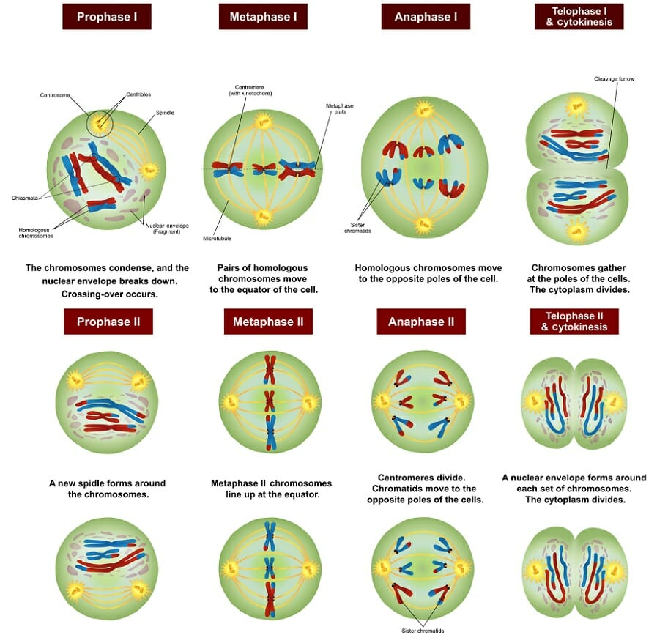

Slide 11
Importance of Meiosis
Meiosis results in formation of four daughter cells from a single parent cell and each of the daughter cell will have half of the genetic materials as of that in the parent cell. There are various importance of Meiosis, it is responsible for formation of gametes.
Chromosomes from parent cells are distributed equally in the cells during meiosis. it also helps in maintaining the chromosomal number in somatic cells.
Meiosis is responsible for diversity among the species since it results in unique arrangement of chromosomes in the gametes and hence resulting in unique offspring. This is also called as variation.

