Slide 1
RESEARCH METHODS IN Education Course Code: Maj/B.Eds-312
Instructor: Dr. Ghazala Noureen Associate Professor
Department of Education(Planning & Development)
Lahore College for Women University, Lahore.
B.Ed(Hons) Secondary
Semester VI Session(2017-21)
Spring 2020

Slide 2
Learning outcomes
After this chapter students will be able to:
Understand analyze, organize, and report a review of the literature.
Recognize the steps in conducing a literature review

Slide 3
Unit.3 Review of Related Literature: definition
The review of related literature involves the systematic identification, location, and analysis of documents containing information related to the research problem. The term is also used to describe the written component of a research plan or report that discusses the reviewed documents. These documents can include articles, abstracts, reviews, monographs, dissertations, books, other research reports, and electronic media effort.

Slide 4
Purpose of literature
reviewing the literature is to determine what has already been done that relates to your topic. This knowledge not only prevents you from unintentionally duplicating another person’s research, but it also gives you the understanding and insight you need to place your topic within a logical framework. Previous studies can provide the rationale for your research hypothesis, and indications of what needs to be done can help you justify the significance of your study. Put simply, the review tells you what has been done and what needs to be done.

Slide 5
cont
Another important purpose of reviewing the literature is to discover research strategies and specific data collection approaches that have or have not been productive in investigations of topics similar to yours. This information will help you avoid other researchers’ mistakes and profit from their experiences. It may suggest a For example, suppose your topic involved the comparative effects of a brand-new experimental method versus the traditional method on the achievement of eighth-grade science students. The review of literature may reveal 10 related studies that found no differences in achievement. Several of the studies, however, may suggest that the brand-new method is more effective for certain kinds of students than for others. Thus, you may reformulate your topic to involve the comparative effectiveness of the brand new method versus the traditional method on the achievement of a subgroup of eighth-grade science students: those with low aptitude.

Slide 6
cont
Being familiar with previous research also facilitates interpretation of your study results. The results can be discussed in terms of whether and how they agree with previous findings. If the results contradict previous findings, you can describe differences between your study and the others, providing a rationale for the discrepancy. If your results are consistent with other findings, your report should include suggestions for the next step; if they are not consistent, your report should include suggestions for studies that may resolve the conflict.

Slide 7
cont
Beginning researchers often have difficulty determining how broad and comprehensive their literature reviews should be. At times, all the literature will seem directly related to the topic, so it may be difficult to determine when to stop. Determining if an article is truly relevant to the topic is complicated and requires time. Unfortunately, there is no simple formula to solve the problem. You must decide using your own judgment and the advice of your teachers or advisors.
identifying possible gaps

Slide 8
The following are general guidelines to select literature
Avoid the temptation to include everything you find in your literature review. Bigger does not mean better. A smaller, well-organized review is definitely preferred to a review containing many studies that are only tangentially related to the problem.
When investigating a heavily researched area, review only those works that are directly related to your specific problem. You will find plenty of references and should not have to rely on less relevant studies. For example, the role of feedback for verbal and nonverbal learning has been extensively studied in both nonhuman animals and human beings for a variety of different learning tasks. Focus on those using similar subjects or similar variables— for example, if you were concerned with the relation between frequency of feedback and chemistry achievement, you would probably not have to review feedback studies related to non-human animal learning.

Slide 9
cont
When investigating a new or little-researched problem area, review any study related in some meaningful way to your problem. Gather enough information to develop a logical framework for the study and a sound rationale for the research hypothesis. For example, suppose you wanted to study the effects of an exam for non-English speaking studentson GPA. The students must pass the exam to graduate. Your literature review would probably include any studies that involved English as a second language (ESL) classes and the effects of culture-specific grading practices as well as studies that identified strategies to improve the learning of ESL students.

Slide 10
Sources of literature
Primary sources are publications in which researchers report the results of their studies directly to the reader. Most primary sources in education are journals, such as the Journal of Educational Research or the Journal of Research in Science Teaching . These journals are usually published monthly or quarterly, and the articles in them typically report on a particular research study. Most college libraries pay for subscriptions to online collections that provide registered students free access to a wide array of online databases, including electronic journals that allow users to download full text articles on demand.

Slide 11
cont
Secondary sources refer to publications in which authors describe the work of others. The most common secondary sources in education are textbooks. A textbook in educational psychology, for example, may describe several studies as a way to illustrate various ideas and concepts in psychology. Other commonly used secondary sources include educational encyclopedias, research reviews (usually peer reviewed journals that publish literature reviews on specific topics), and yearbooks.

Slide 12
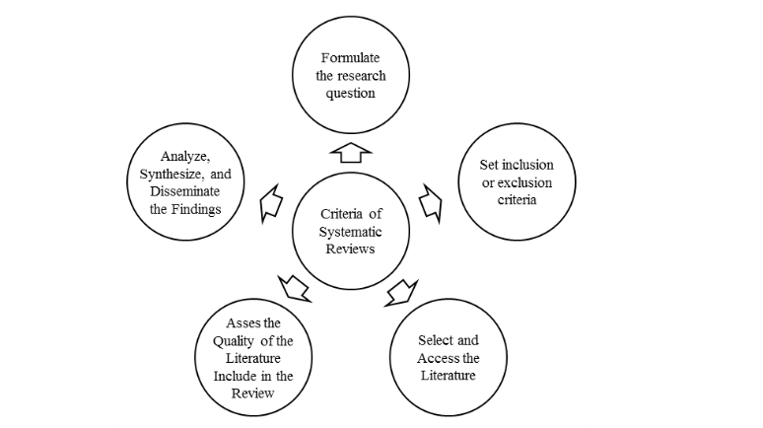
Literature Review Process

Slide 13
Steps
Define the research problem as precisely as possible.
Look at relevant secondary sources (these can include research reviews).
Select and peruse one or two appropriate general reference works.
Formulate search terms (key words or phrases) pertinent to the problem or question of interest.
Search for relevant primary sources using appropriate general reference tools.
Obtain and read relevant primary sources, and note and summarize key points in the sources.

Slide 14
Evaluating Your Sources
When you have retrieved a list of sources, you will need to evaluate them to determine not only if these sources are relevant, but whether they are reliable and legitimate. Good researchers must be able to distinguish between the quality and limitations of a source, so good research requires excellent judgment.
Relevancy
What was the purpose or problem statement of the study?
Obviously, the first thing to do is to determine if the source really applies to your research topic and qualifies to be included in a review of related literature. Does the title of the source reflect research related to your work? Is there a well-refined question or statement of purpose? The problem statement is often found in the abstract and will allow you to determine the relevance of the research to your own research.

Slide 15
cont
Author
Who was the author?
What are the qualifications, reputation, and status of the author? In most databases, the name of the author links to any other published works in the database. Is the subject matter a primary interest in the published works of the author? Is the author affiliated with any institution or organization? Most importantly, can you contact the author? Does the author have a personal website with vitae?
Where was the source published?
Does the information come from a scholarly or peer reviewed journal, an education related magazine, or a popular magazine? Is the information personal opinion or the result of a research study? Clearly, sources of different types merit different weight in your review. For instance, did you find your source in a refereed or a nonrefereed journal? In a refereed journal , articles are reviewed by a panel of experts in the field and are more scholarly and trustworthy than articles from nonrefereed or popular journals.

Slide 16
cont
Methodology
How was the study conducted?
It is important to verify that the information presented in a particular source is objective and impartial. What was the methodology used to investigate the problem or test the hypothesis? Was an appropriate method used? Can the research be replicated by others? Was the sample size suitable for the research? Does the source add to the information you have already gathered about your topic? Is the information presented in the source accurate? It is important to verify that the information presented ina particular source is objective and impartial.

Slide 17
Guidelines for technical writing
Document facts and substantiate opinions.
Cite references to support your facts and opinions. Note that facts are usually based on empirical data, whereas opinions are not. In the hierarchy of persuasiveness, facts are more persuasive than opinions. Differentiate between facts and opinions in the review.
Define terms clearly, and be consistent in your use of terms.
Organize content logically.
Direct your writing to a particular audience.
Usually the literature review is aimed at a relatively naïve reader, one who has some basic understanding of the topic but requires additional education to understand the topic or issue. Do not assume your audience knows as much as you do about the topic and literature! They don’t, so you have to write to educate them.

Slide 18
cont
Follow an accepted manual of style. The manual indicates the style in which chapter headings are set up, how tables must be constructed, how footnotes and bibliographies must be prepared, and the like. Commonly used manuals and their current editions are Publication Manual of the American Psychological Association , Sixth Edition, and The Chicago Manual of Style , Sixteenth Edition.
Evade affected verbiage and eschew obscuration of the obvious. In other words, limit big words and avoid jargon.
Start each major section with a brief overview of the section. The overview may begin like this: “In this section, three main issues are examined. The first is. . . .”
End each major section with a summary of the main ideas.

