Slide 1
How to Design a Research in Social Sciences
Dr.Ghazala Noureen
Incharge/Chairperson Department of Education
Lahore College for Women University, Lahore.

Slide 2
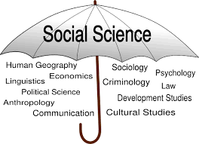

Slide 4
Thinking Like a Researcher
This requires visualizing the abstract from actual observations, mentally “connecting the dots” to identify hidden concepts and patterns, and synthesizing those patterns into generalizable laws and theories that apply to other contexts beyond the domain of the initial observations. Research involves constantly moving back and forth. This is a skill that takes many years to develop, is not something that is taught in graduate or doctoral programs.

Slide 5
Continue……….
Some of the mental abstractions needed to think like a researcher include
unit of analysis,
constructs,
Operational definition
hypotheses,
theories,
models,
induction, deduction,

Slide 6
Unit of analysis
One of the first decisions in any social science research is the unit of analysis of a scientific study. The unit of analysis refers to the person, collective, or object that is the target of the investigation. Typical unit of analysis include individuals, groups, organizations, countries, technologies, objects,

Slide 7
Construct
A construct is an abstract concept that is specifically chosen (or “created”) to explain a given phenomenon. A construct may be a simple concept, such as a person’s weight, or a combination of a set of related concepts such as a person’s communication skill, which may consist of several underlying concepts such as the person’s vocabulary, syntax, and spelling. The former instance (weight) is a unidimensional construct, while the latter (communication skill) is a multi-dimensional construct (i.e., it consists of multiple underlying concepts). The distinction between constructs and concepts are clearer in multi-dimensional constructs, where the higher order abstraction is called a construct and the lower order abstractions are called concepts.

Slide 8
Operational Definition
Define constructs in terms of how they will be empirically measured.
Learning
Personality
intelligence
A variable is a measurable representation of an abstract construct.
Constructs are conceptualized at the theoretical (abstract) plane, while variables are operationalized and measured at the empirical (observational) plane.

Slide 9
Continue….
Variables may be classified as independent, dependent, moderating, mediating, or control variables.
Variables that explain other variables are called independent variables, those that are explained by other variables are dependent variables, those that are explained by independent variables while also explaining dependent variables are mediating variables (or intermediate variables), and those that influence the relationship between independent and dependent variables are called moderating variables. As an example, if we state that higher intelligence causes improved learning among students, then intelligence is an independent variable and learning is a dependent variable. There may be other extraneous variables that are not pertinent to explaining a given dependent variable, but may have some impact on the dependent variable. These variables must be controlled for in a scientific study, and are therefore called control variable

Slide 10
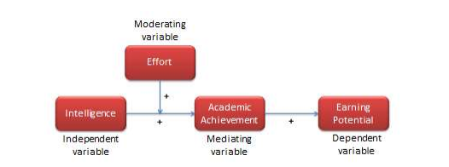

Slide 11
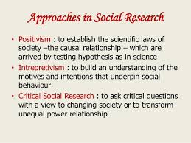

Slide 12
A population is divided into four strata. The population sizes of the four strata are 830,660,480 and 1030 for stratum 1 through stratum 4, respectively. A sample of size 450 is to be selected, using stratified random sampling with proportional allocation. What is the sampling fraction? Distribute the sample among the four strata using proportional allocation.
Solution: The sampling fraction is 450/3000, which equals 3/20 or .15. Sample sizes for strata 1 through 4, respectively, are 124.5,99,72, and 154.5.Since partial units probably cannot be included, the researcher must arbitrarily decide whether to select 125 from stratum 1 or 155 from stratum 4.

