Slide 1
Condition of Equilibrium for a particle

Slide 2
Equilibrium:
Where there is no change in state of rest or uniform motion of a body on which the forces acts, then the body is said to be in equilibrium

Slide 3
Types of equilibrium
Static equilibrium
Dynami equilibrium

Slide 4
Static Equilibrium:
If a body is at rest it is said to be in static equilibrium

Slide 6
Dynamic Equilibrium:
If a body is moving with uniform velocity,it is said to be in dynamic equilibrium

Slide 8
Equilibrium for a particle
A particle is in equilibrium if the vector sum of the external forces acting on it is zero

Slide 9
If the particle is at rest and remains at rest then it is said to be in static equilibrium
If the particle is moving with uniform velocity then it is said to be in dynamic equilibrium

Slide 10
Condition of equilibrium for a particle:
Thera are two conditions of equilibrium for a particle

Slide 11
1st Condition:
If there are two forces acting on a particle that is in equilibrium,then the two forces must be equal(in magnitude) and opposite in direction to each other

Slide 12
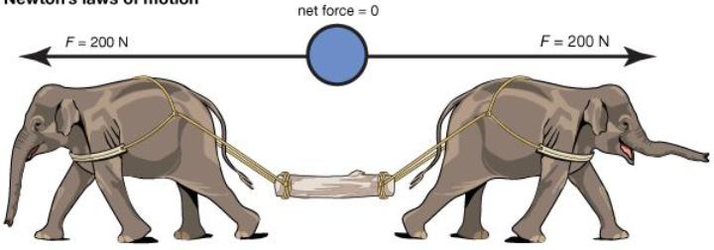

Slide 13
F1 and F2
F1+F2=0
F1=-F2
Equal in magnitude but opposite in direction

Slide 14
2nd Condition:
If there are three forces acting on a particle,then when three forces are placed end to end,they must form a triangle

Slide 15
