Slide 1
Enzyme Kinetics

Slide 2
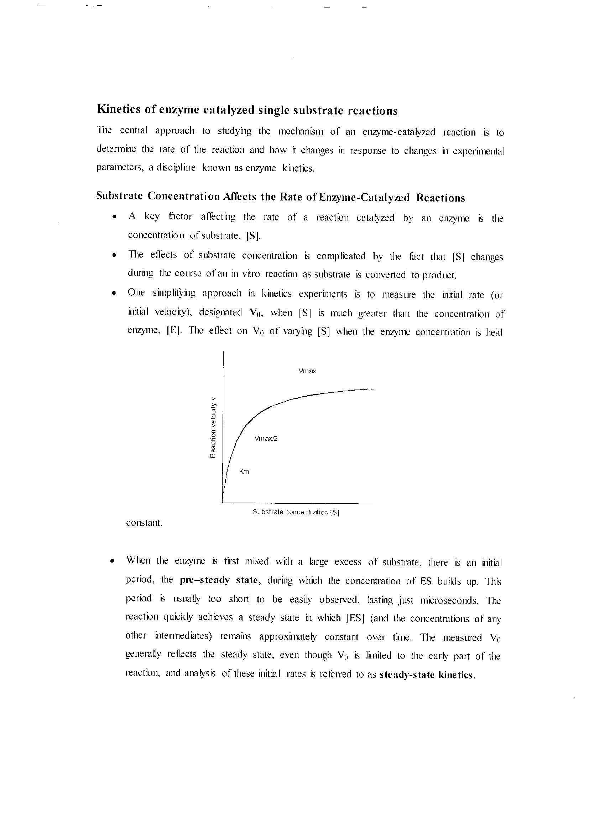

Slide 3
